Slide 1
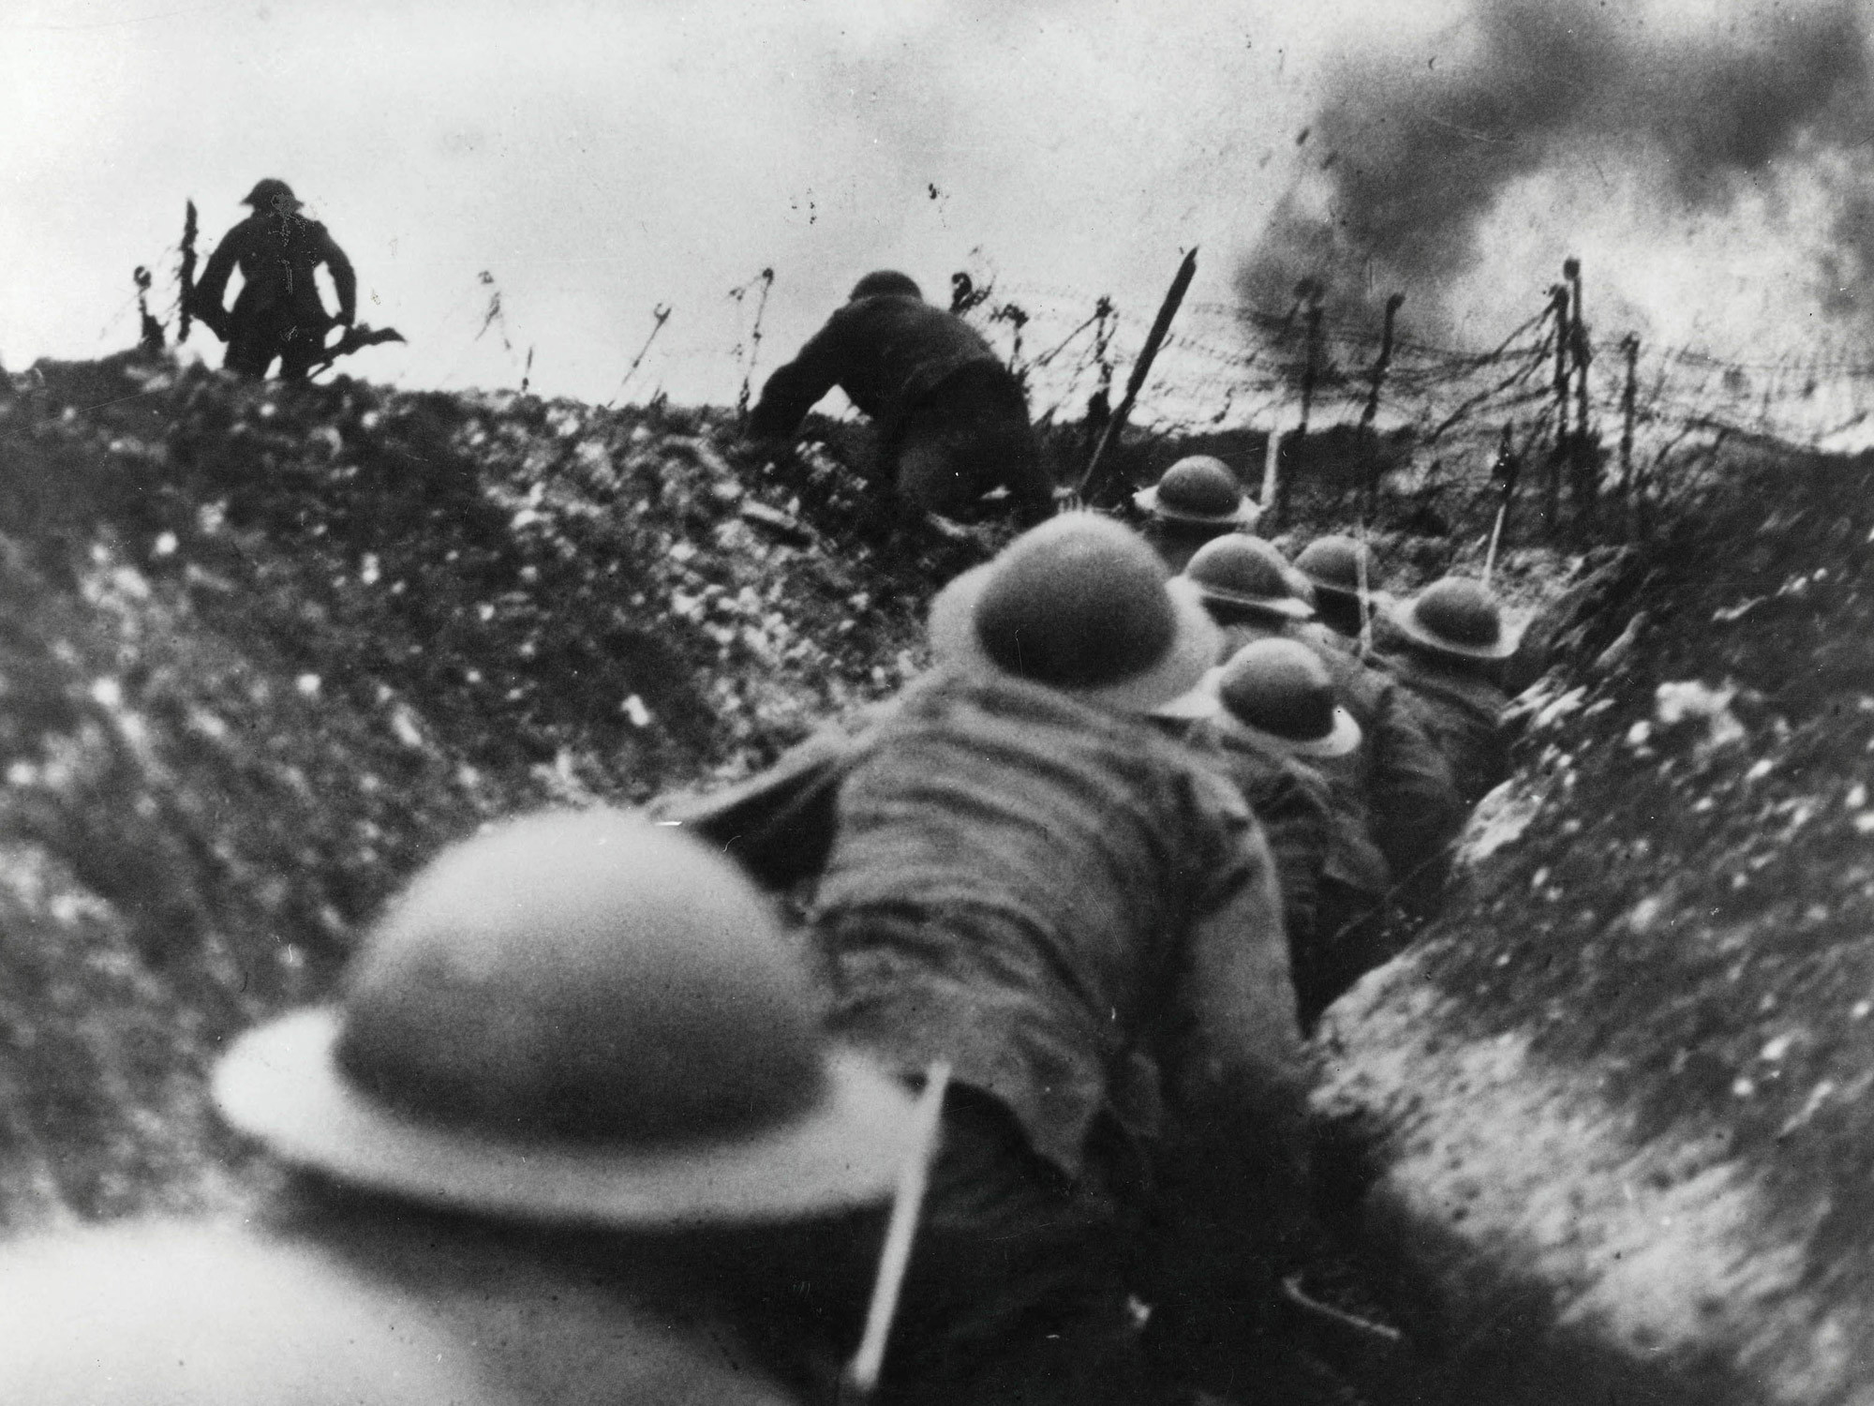
World War 1
The Great War
1914 - 1918

Slide 2
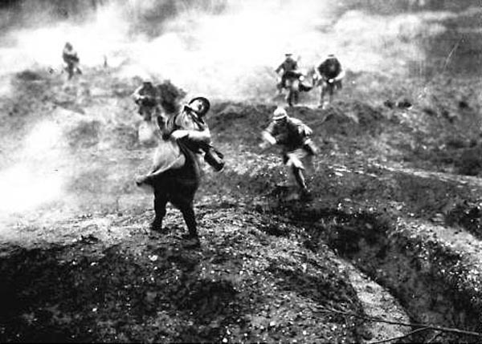

Slide 3
The Great War
World War 1 began in 1914 and ended in 1918.
Most of the nations of Europe took sides, and eventually the US, too.
Much of the war was fought in trenches, with new weapons of war: the tank, machine gun, hand grenades, poison gas, and bi planes
At war’s end over 10 million soldiers died and 7 million civilians perished through disease and starvation.

Slide 4
Military and Economic Competition
Underlying the conflict was competition between the European powers.
European nations competed for colonies in Asia and Africa.
Each sought military and economic supremacy.
For example, Germany and Britain competed, each trying to create the world’s most powerful navy.

Slide 5
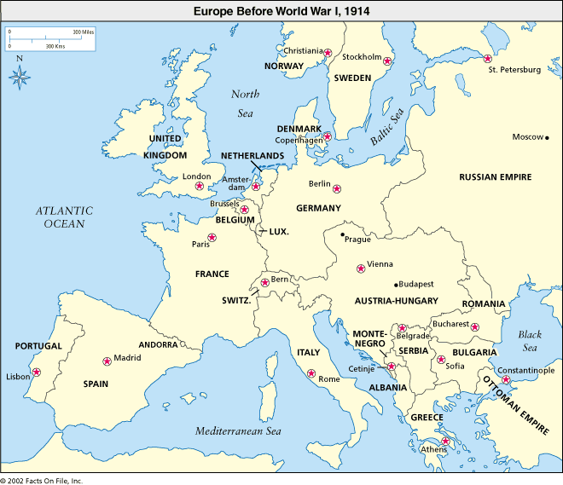

Slide 6
European Alliances
Europe was divided by alliances.
Countries pledged support if attacked by an adversary
Germany and Austro Hungary were allied against Russia and France
France, Britain, and Russia were united in their opposition to Germany.
Russia was determined to help the Serbs against the Austro Hungarian Empire.

Slide 7
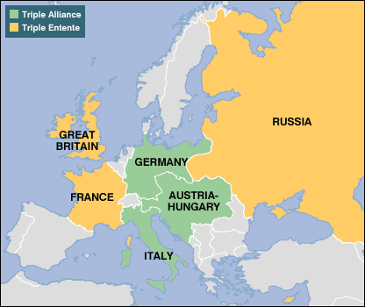

Slide 8
Assassination in Sarajevo
The spark that lit the fire of World War 1 was the assassination of Austro Hungarian Archduke Franz Ferdinand.
He was killed by Gavrilo Princip, a member of a Serbian Nationalist group called the Black Hand.

Slide 9
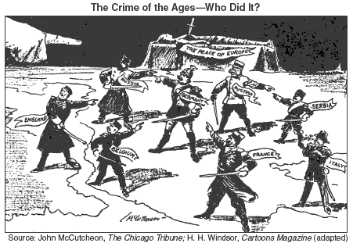

Slide 10
1914 –World War 1 Begins
Austro Hungary declares war on Serbia
Russia enters war to aid Serbians
Germany backs Austrians
France aids Russia
Germany declares war on France
Britain enters war to aid France and Russia

Slide 11
Central Powers vs. Allied Powers
Germany, Austria, and the Ottoman Empire form the Central Powers
Russia, France and Great Britain form the Allied Powers
Spain, Norway, and the US remain neutral, not taking sides in the conflict.

Slide 12
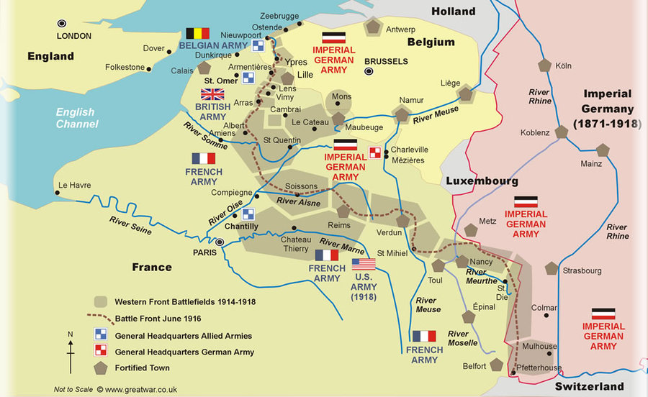
Trench Warfare on the Western Front

Slide 13
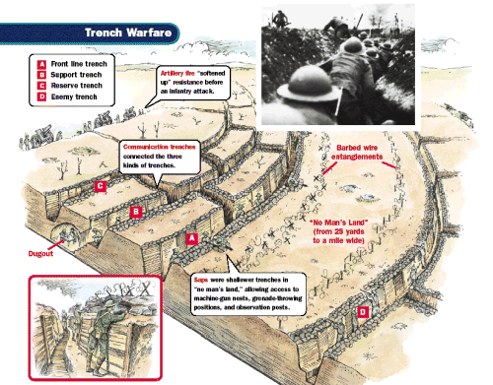

Slide 14
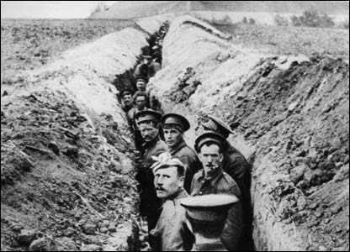

Slide 15
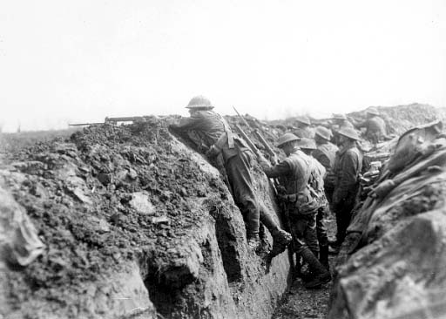

Slide 16
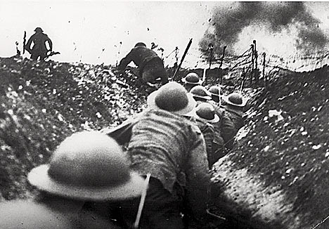

Slide 17
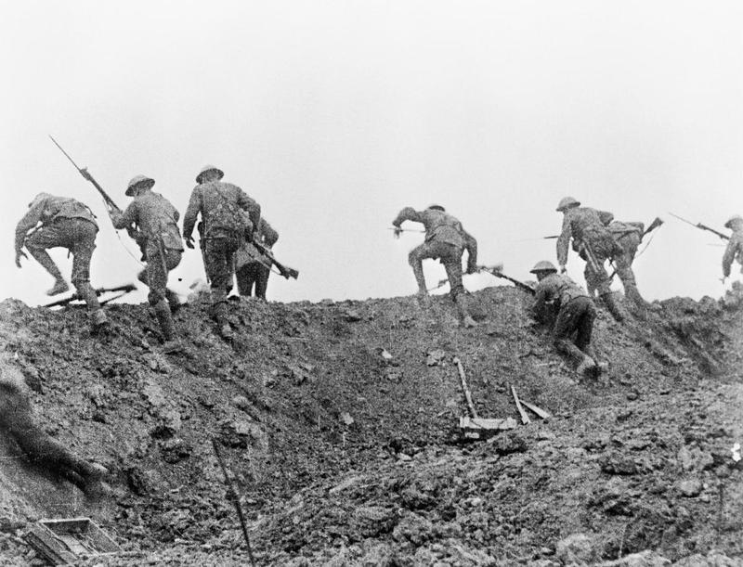

Slide 18
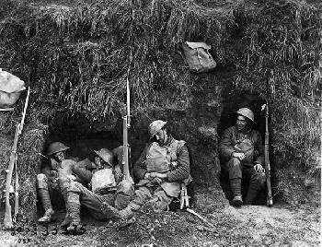

Slide 19
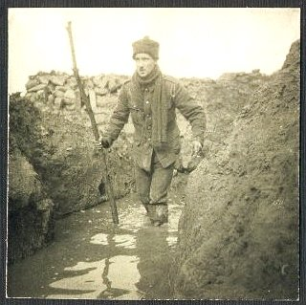

Slide 20
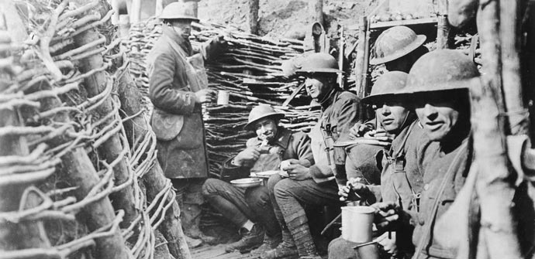

Slide 21
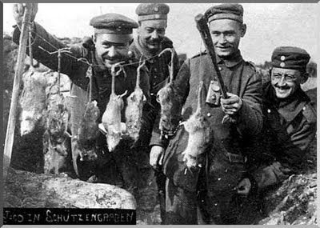

Slide 22
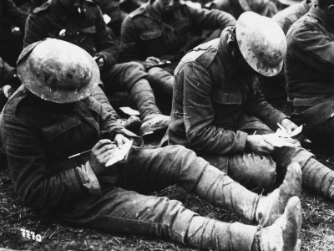

Slide 23
1914 – Stalemate
Germany attacked Belgium and France in the hopes of a quick victory on the western front
However, Russia mobilized quickly and entered the war on the eastern front.
The war became a stalemate, with both sides dug into trenches where they remained for 4 years.

Slide 24
1915 – Total War
Modern warfare demanded that most of society’s resources were devoted to war production at home.
Women entered the factories, as men were drafted into war.
People bought war bonds to support the war effort.

Slide 25
1916 – War Fatigue
The European powers were being exhausted by war
Nations were on the verge of bankruptcy.
The Germans tried to defeat the French at the Battle of Verdun.
The Allied offensive was at the Somme River
Thousands were killed in a single day and a million soldiers in five months on the western front.

Slide 26
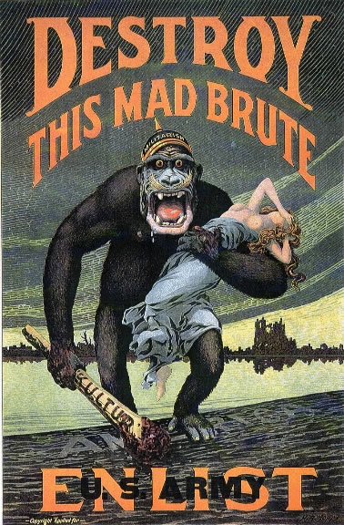

Slide 27
World War 1 Propaganda
Propaganda is the art of persuasion.
We see it daily in advertising by business
The countries of Europe on all sides used various types of propaganda to persuade their people that the war was worth fighting and supporting
Look at the following posters and explain what appeal is being used.

Slide 28
The Enemy As Beast
In this US propaganda poster, the German army is portrayed as a horrible ape.
The enemy is a beast that must be stopped.
He is raping and pillaging.
The poster asks young men to enlist, or join the army to stop the monster.

Slide 29
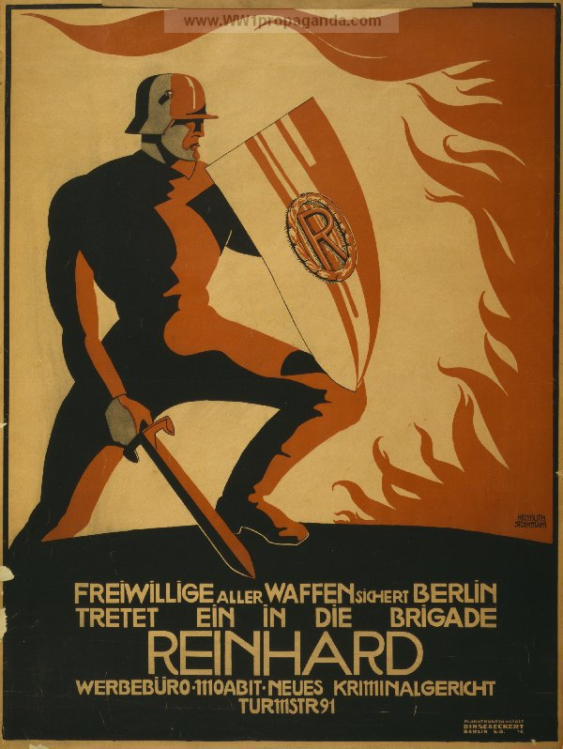

Slide 30
Heroic Military Men
This German posters shows the soldier as heroic.
He is holding a sword, which symbolizes the knights from the middle ages.

Slide 31
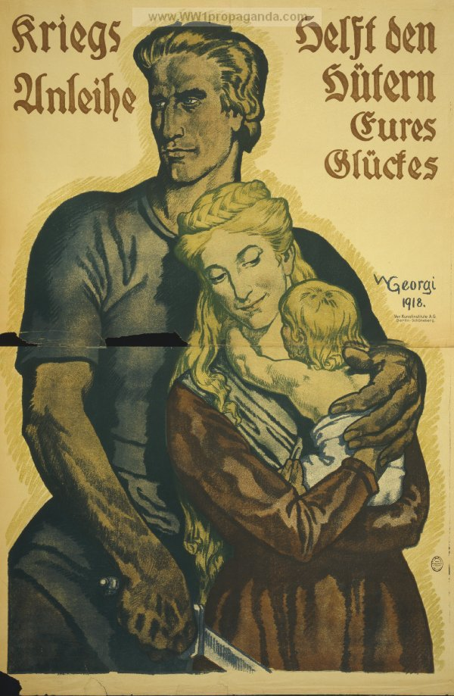

Slide 32
Soldiers defend women and children
German propaganda poster shows man with arm around his wife and baby.
The text says, “War loans help the guardians of you happiness.”
Government used propaganda to help raise money for the war effort by having citizens buy war bonds.

Slide 33
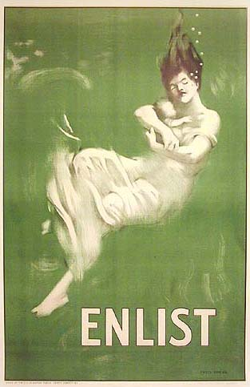

Slide 34
Playing on emotion
In this poster a women is shown holding her baby.
Both are underwater.
This was designed to remind Americans of the German U-Boat which sunk the civilian steamship, the Lusitania in 1915.
Defenseless women and children perished.

Slide 35
Your turn to find and analyze a propaganda poster
Go to the website on world war 1 propaganda poster
Find a poster
Write a paragraph analysis of your poster
Look at my model, as you write your own.

Slide 36
1917 - Russia Out
In March of 1917 the the war weary Russian people overthrew the Tsar, the Russian king.
By October the Russian Communists, called the Bolsheviks and led by Lenin, took over.
Early in 1918 the Russian communists withdrew Russia from World War 1.

Slide 37
1917 – The US In
In April of 1917 President Wilson asked the Congress to declare war on Germany.
The US was angered by the sinking of the Lusitania in 1915.
In 1917 the Germans sent a secret telegram to Mexico, promising them land if they came in the war against the US
The Zimmerman Telegram was the final straw

Slide 38
1918 – The War’s Final Year
By 1918 about two million fresh US troops joined the Allies fighting on the Western Front.
The US also provided much needed money and aid.
The Germans tried a final offensive, but were repulsed by the Allies
Hungry Germans rioted and Austria was near collapse.
The defeated Germans sought an armistice, or cease fire, with the Allies in November of 1918.

Slide 39
The Costs of World War 1
9 million soldiers were killed
Millions of soldiers were wounded and “shell shocked.”
10 million civilians died
Over 250 billion dollars were spent on the war
Much of Europe lay in shambles.

Slide 40
Wilson’s 14 Points
US President Wilson wanted there to be a “peace without victory”
He hoped each nation would go home and rebuild, without blaming or punishing their adversary
His ideas were embodied in the 14 Points.
He wanted a League of Nations to prevent future wars.

Slide 41
The Treaty of Versailles
The nations met in Versailles, France.
The British and the French blamed Germany for World War 1.
They demanded the Central Powers pay war reparations for the damage they caused.
They stripped Germany of its colonies and broke up the Austrian and Ottoman empires.
The Treaty of Versailles punished the Central Powers.

Slide 42
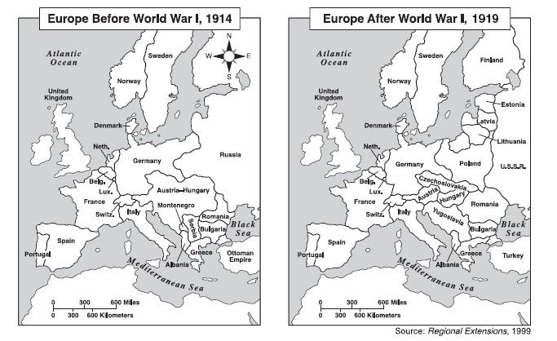

Slide 43
A Changed Map of Europe
The Germans lost land, the Alsace Lorraine, to France.
The Austrian Empire was dismantled, creating the nations of Austria, Hungary, and Czechoslovakia
Poland and the Baltic Republics were carved out of land once controlled by the old Russian Empire.
In the Balkans, the new nation of Yugoslavia was created.

