Slide 1
The Holocaust
1933 -1945

Slide 2
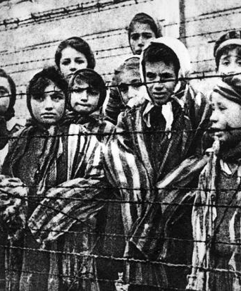
The Holocaust
Holocaust in Greek means destruction by fire.
The Holocaust is the historical name given to the destruction of 6 million European Jews at the hands of the Nazis during World War II.
The attempt to annihilate an entire race, religion, or ethnic group is called genocide.

Slide 3
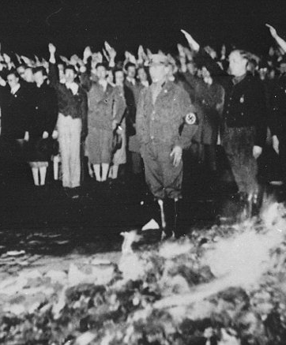
1933
First Concentration Camps
When Adolf Hitler took power in Germany, he suspended civil liberties of German citizens.
The Nazis burned books.
The Nazis set up their first concentration camp at Dachau; the first inmates are 200 communists.

Slide 4
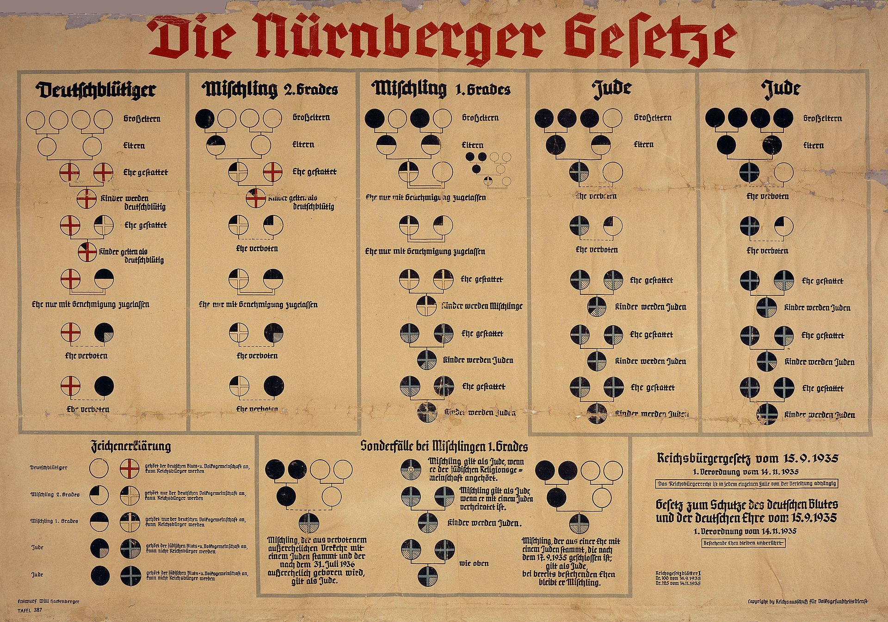
1935
The Nuremburg Laws
The Nazis enact Nuremburg laws, stripping German Jews of their citizenship.
The Nazis define Jews as an inferior race, who are not allowed to mix or marry “ superior Aryans.”
The Nazis believed in eugenics, the racist idea you can improve genetic features of people through breeding and sterilization.

Slide 5
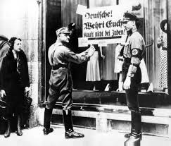
1938
Kristallnacht
On Kristallnacht, or the Night of Broken Glass, Nazi gangs physically attacked Jews throughout Germany and Austria.
Jewish business and synagogues were destroyed.

Slide 6
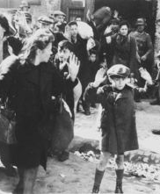
1939
Jews Forced into Ghettos
With the start of World War II, Hitler ordered Polish Jews to wear Star of David.
Jews are relocated from their homes to ghettos, poor communities surrounded by barbed wire and Nazi guards.
Hitler orders systematic murder of mentally and physically disabled in Germany and Austria.

Slide 7
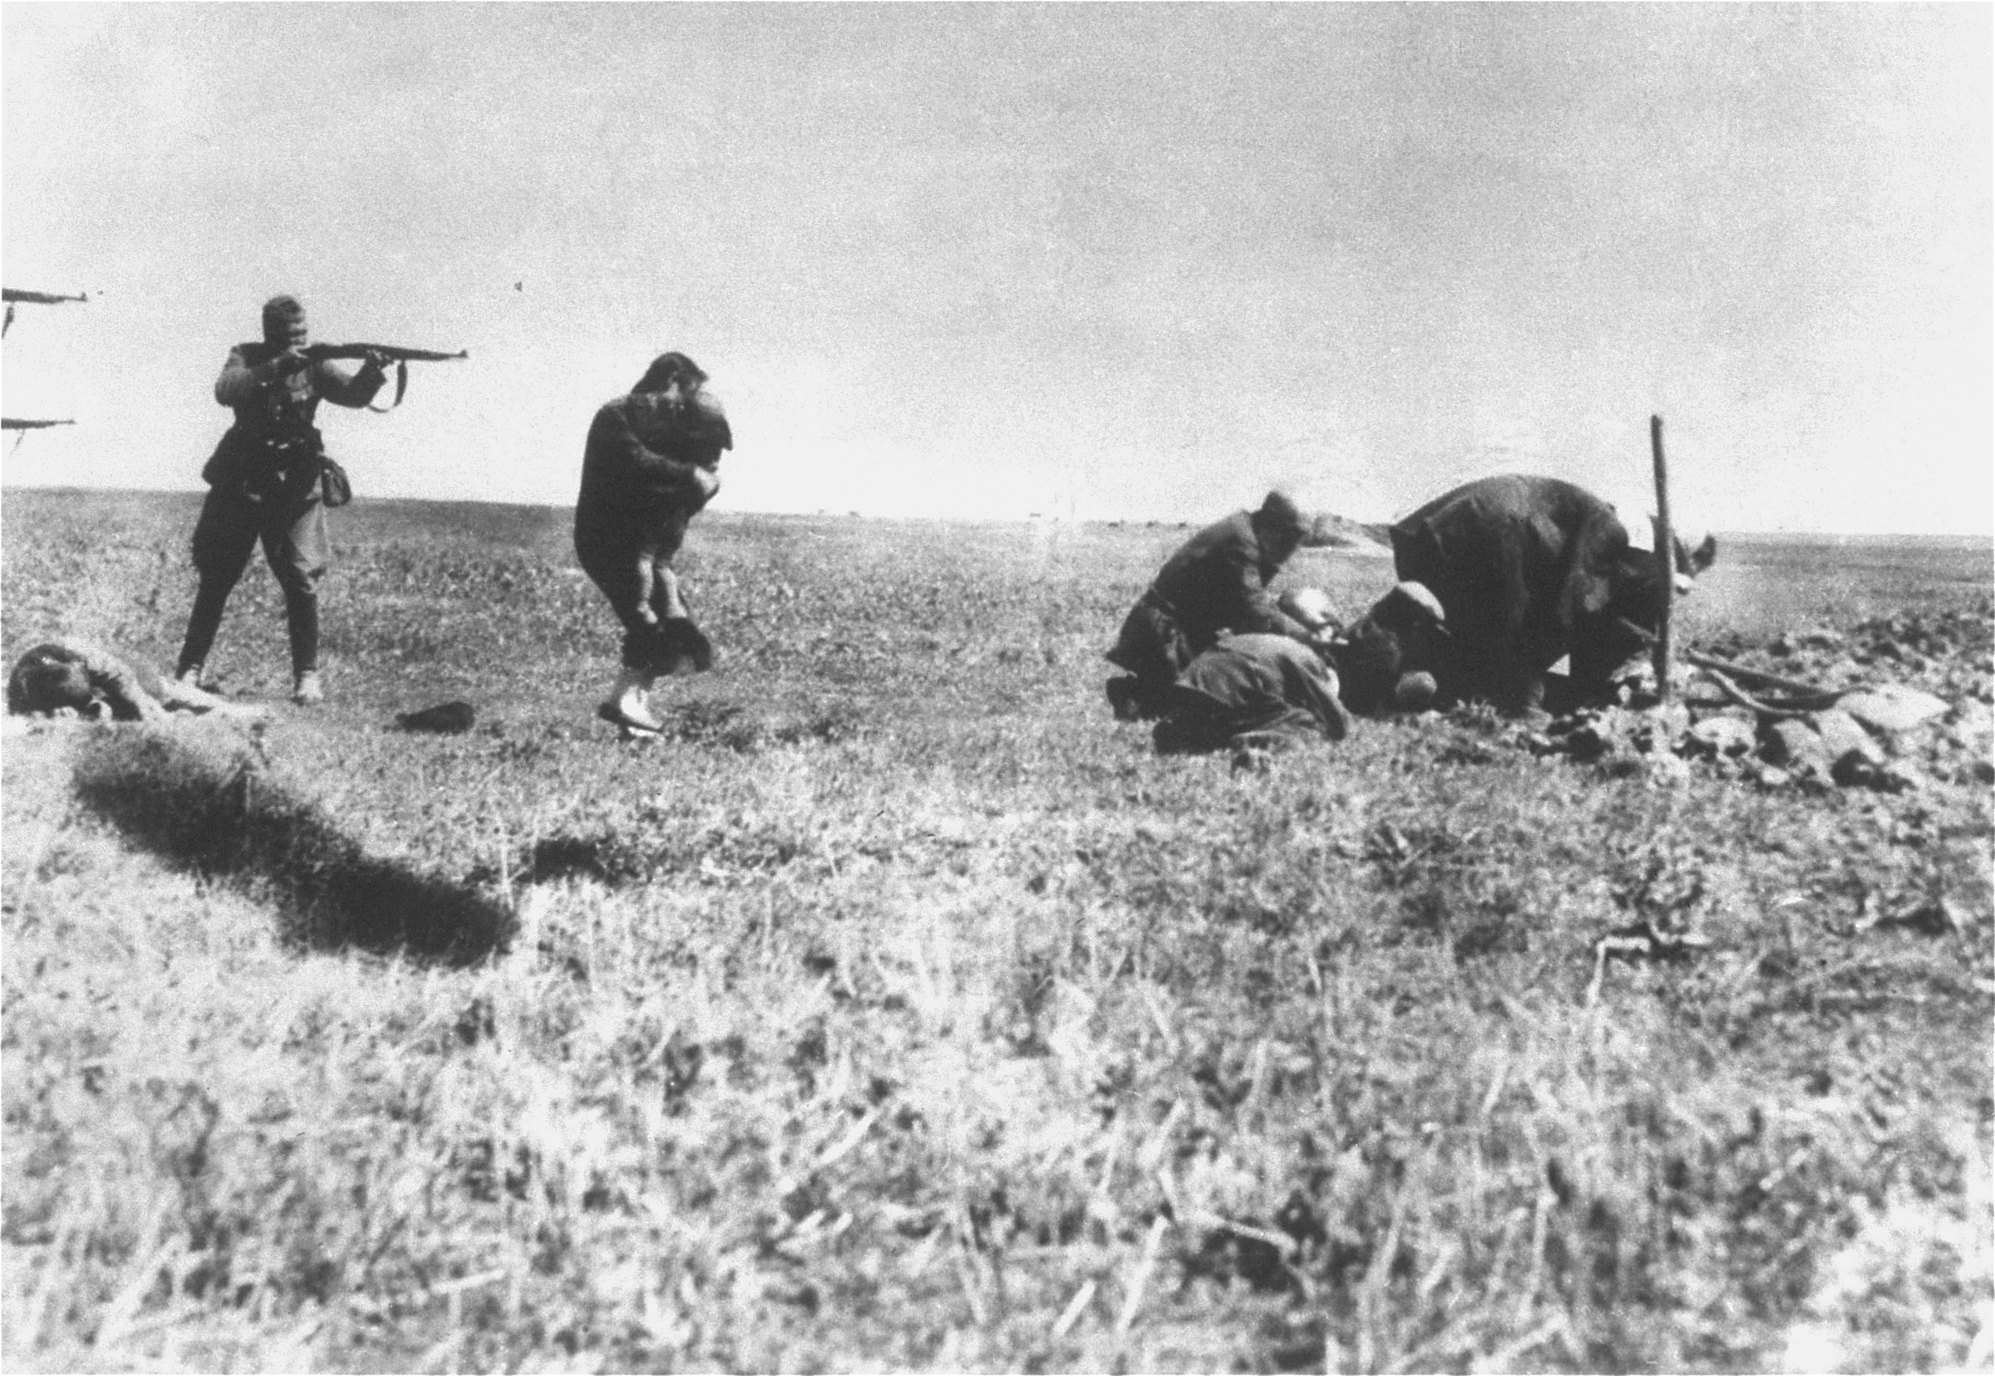
1941
The “Final Solution”
The Nazis developed a plan to kill all Jews in Europe.
This was a policy of genocide, the total annihilation of a group.
The Nazis create mobile killing units to slaughter all Jews in occupied areas.
The Nazis establish the first death camp at Chelmno in Poland.

Slide 8
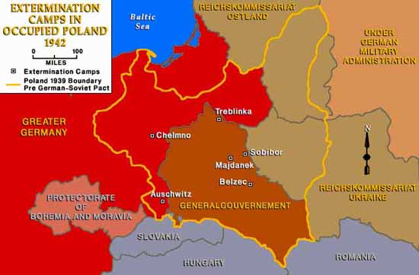
1942
Death Camps
The Nazi established six death camps in Poland.
They emptied the ghettos and sent Jews to these concentration camps.
Jews either worked as slave laborers or were killed immediately.
Jews were taken to gas chambers and their bodies were burned in crematoria.

