Slide 1
The French Revolution
The End of the French Monarchy
The Rise and Fall of the French Republic
And
Napoleon Bonaparte
1789-1813

Slide 2
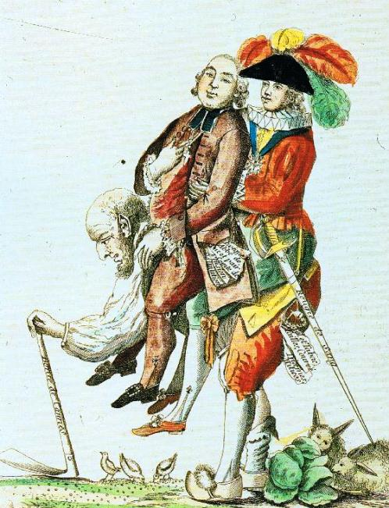
The Old Regime
In 1789 France was divided into three social classes, called Estates.
The First Estate was made of up of the clergy from the Roman Catholic church. They owned 10 % of the land and paid no taxes.
The Second Estate were the nobility. These large land held the top government jobs and also paid no taxes.

Slide 3
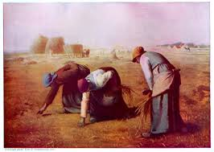
The third Estate
97% of France’s population belonged to the Third Estate.
The majority were peasants who paid rent to land owners, a tithe to the church, and taxes to the King.
Poor urban workers faced unemployment and rising food prices.
The middle class members of the Third Estate were lawyers, merchants, and professionals called the Bourgeoisie.

Slide 4
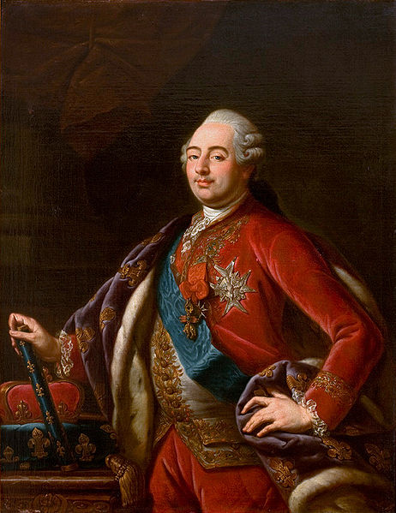
King Louis XVI
France was a monarchy ruled by King Louis XVI and his Austrian Queen, Maria Antoinette.
Louis XVI inherited a France deeply in debt from spending on wars and a lavish royal court.
France borrowed, but by 1789 the King needed to raise taxes to pay its mounting debt.

Slide 5
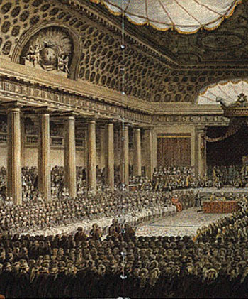
The Estates General
In order to solve the financial crisis King Louis XVI called for a meeting of the three.
This was a legislative, or law making body, which had not met in over 175 years.
To prepare for the meeting King Louis had each estate prepare its grievances.
Each estate only received one vote, so the tiny clergy and nobility could out vote the much larger Third Estate at the meeting.

Slide 6
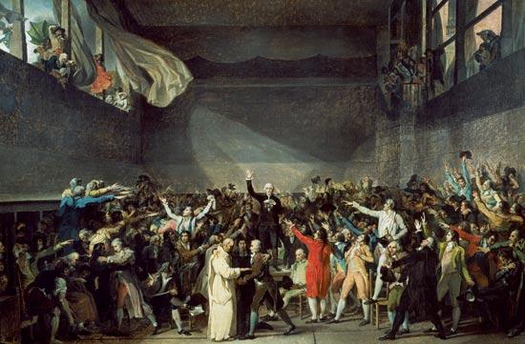
National Assembly
The Estates General met in May of 1789.
The Third Estate demanded that delegates be counted by head, and not by Estate.
The King refused and locked them out of the Estates General.
The Third Estate moved its meeting to an indoor tennis court, declaring itself a National Assembly representing the French people.

Slide 7
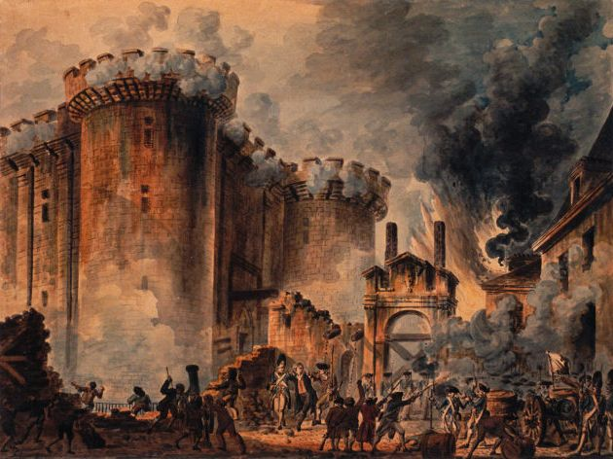
Storming of Bastille
Rumors spread that the King planned to dissolve the National Assembly.
On July 14, 1789 an armed crowd in Paris took over the royal prison called the Bastille.
They killed the guards and freed several prisoners.
The Bastille was a symbol of royal authority.

Slide 8
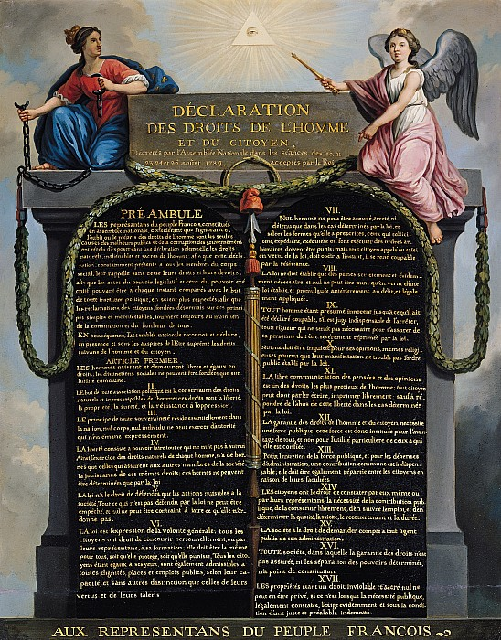
Declaration of Rights
Between 1789 and 1791 the National Assembly limited the monarchy of Louis XVI.
They passed a Declaration of Rights of Man and Citizen which called for liberty and equality, and included many ideas from the American Declaration of Independence.
The National Assembly called for the nobles to give up their special privileges and for taxes to be levied more fairly among French citizens.
It put Catholic Church officials under government control.

Slide 9
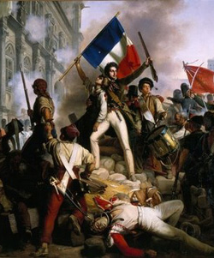
Radicals Take Over
In 1791 the Royal family tried to escape France. They were captured and imprisoned as traitors.
European allies of the King, Prussia and Austria, attacked France.
Radicals in the National Assembly, called Jacobins, took over.
They declared a French Republic, a government without the King.

Slide 10
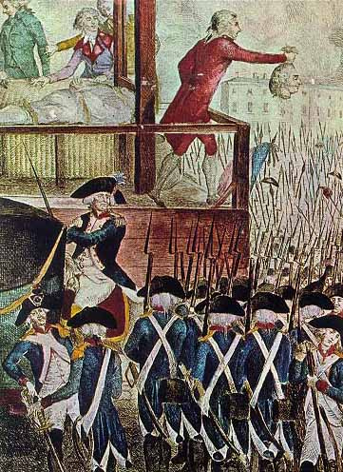
The Reign of Terror
The Jacobins took over the French government. There new government was called the Convention.
They placed the King and Queen on trial as traitors, and executed them by guillotine.
The leader of the Jacobins Robespierre ordered the execution of anyone accused of being an enemy of the revolution.
The Reign of Terror killed over 17,000 victims, many of whom were innocent.

Slide 11
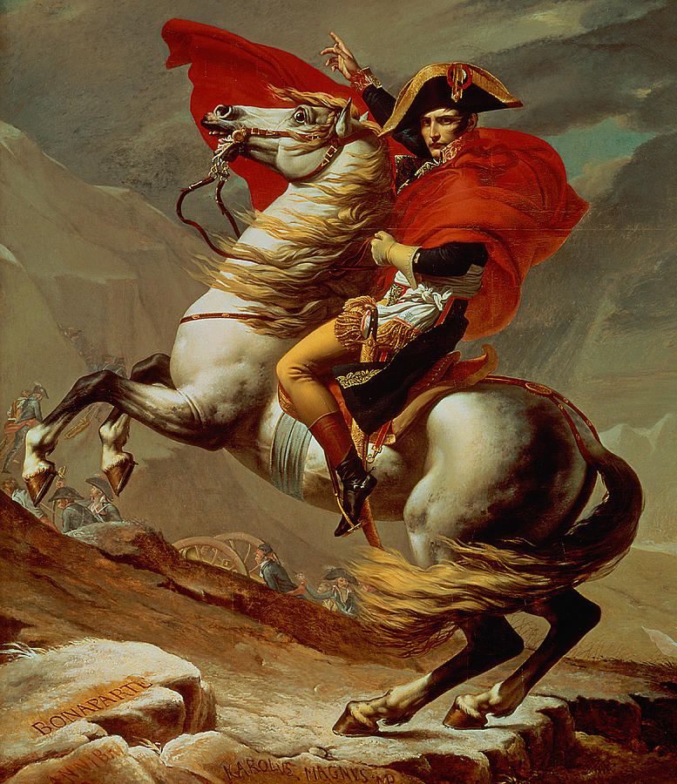
Rise of Napoleon
The Convention ended in 1795 with the establishment of the Directory government.
It was made up of middle class leaders, elected by male citizens with property.
This weak government was overthrown in a military coup, taken over in 1799 by military hero Napoleon Bonaparte.

Slide 12
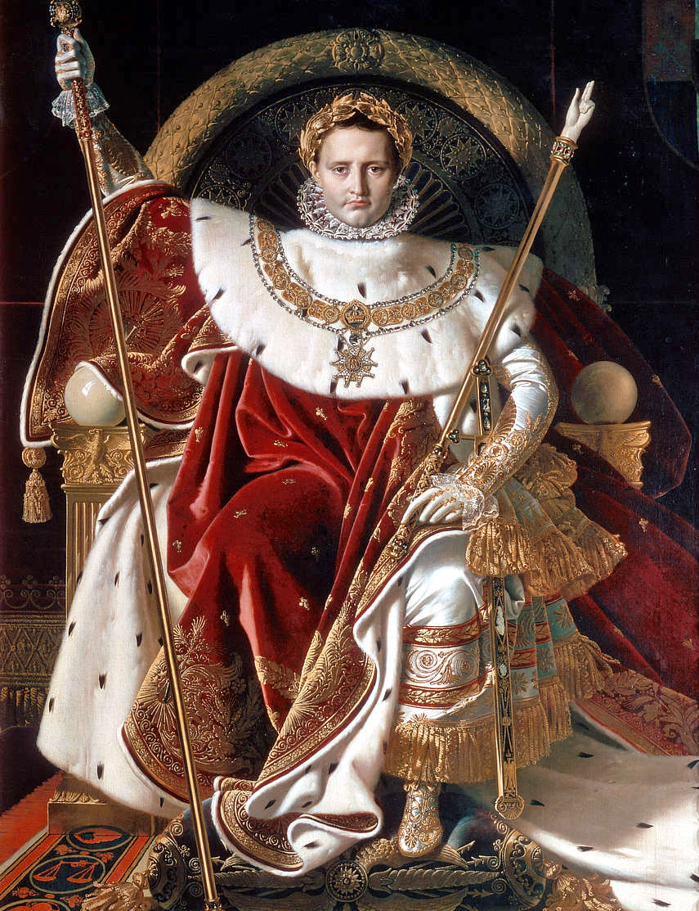
Emperor Napoleon
Napoleon crowned himself emperor, an all powerful leader, of the French empire.
He held a plebiscite, a popular vote, in which he was elected by a large margin.
Some have called Napoleon the first modern dictator, because he took power through military means and had absolute control of French society.

Slide 13
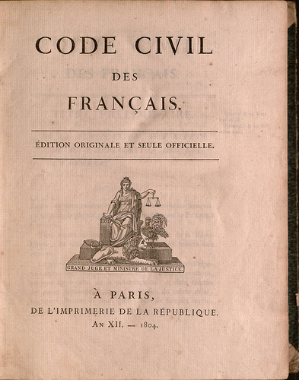
Napoleonic Code
Napoleon gained support for many of his policies which included:
Restoring Order
Controlling rising prices
Building roads and canals
Making peace with the Catholic Church
Instituting the Napoleonic Code which called for equality of all citizens and religious freedom.

Slide 14
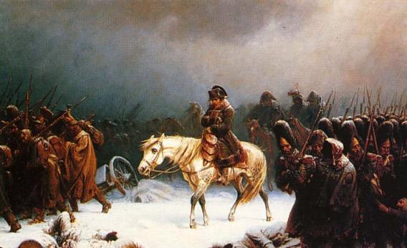
Napoleonic Wars
Napoleon used war to create a vast European empire which included control of Belgium, and parts of Italy and Germany.
He created the Federation of the Rhine under his control.
He put his own brother on the throne of Spain.
By 1812 Napoleon controlled most of Europe, with the exception of Britain.

Slide 15
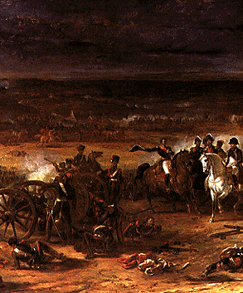
Napoleon’s Defeat
France tried to isolate Britain by keeping it from trading with its neighbors.
The French empire fueled nationalism, loyalty to a person’s country.
Revolt against France broke out throughout Europe.
The French Army was stopped in Russia due to the cold winter.
The British defeated Napoleon’s army at Waterloo.

Slide 16
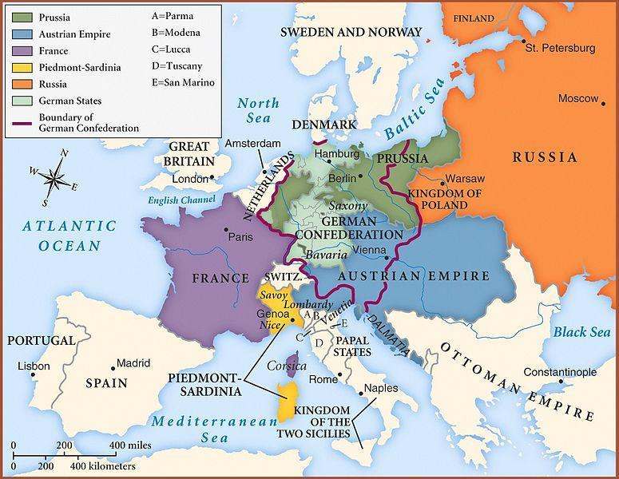
Congress of Vienna
After Napoleon’s defeat, representatives from throughout Europe met in Vienna.
They tried to restore peace, but also monarchies to Europe.
They limited France powers by creating strong countries on its borders.
They put King Louis XVIII on the French throne.
The Congress also created the Concert of Europe, an attempt to have European countries meet to discuss peace.

