Slide 1
Second Semester
Units, Grading, and Rule Reminders
Class Reading and Writing Growth

Slide 2
Semester 2 Units
The Rise of Dictators: Stalin and Hitler
World War II
The Cold War
The Emergence of New Nations After World War II

Slide 3
Grading Categories
35% Tests and Quizzes
15% Final Exam
10% Research Paper
30% Classwork and Homework
10% Participation

Slide 4
Rule Reminders
Arrive on time, and be in your seat when the bell rings.
Bring your notebook, Chromebook, pen or pencil each day.
Participate in class discussions by raising your hand. Please don’t interrupt teacher during instruction or fellow students during discussion.
Turn your cell phones and personal electronic devices off and put them away.
Be nice and work hard.

Slide 5
Make Up Work and Absences
If you have an excused absence, you have as many days to make up missed work as days you missed class. You will not be allowed to make up class work when your absences are unexcused.

Slide 6
Class Reading Growth
 | Average Score | Advanced 90-100 A | Proficient 80-89 B | Basic 70-79 C | Below Basic 60-69 D | Far Below Basic <60=F
1st Reading Assess. | 71% | 3 – 9% | 5 -15% | 7 – 21% | 13 – 40% | 5 – 15%
Common Final Questions | 78% | 8 – 22% | 12 -34% | 5 – 14% | 7- 20% | 3 -9 %

Slide 7
Class Writing Growth
 | Average Score | Advanced 90-100 A | Proficient 80-89 B | Basic 70-79 C | Below Basic 60-69 D | Far Below Basic <60 = F
1st Writing Assess. | 64% | 1 – 3% | 7 -20% | 8 – 23% | 8 – 23% | 11 – 31%
Industrial Revolution Essay | 78% | 4 – 11% | 12 -33% | 15 – 42% | 5- 14% | 0 -0 %

Slide 8
Student Scorecard and Second Semester Goals
Move to your new seat. Talk to your seat partner about how you did last semester.
Mark the Student Scorecard. How did you do last semester in the various areas of the class: classwork, homework, test and quizzes, writing and research, attendance.
What goals do you have for improvement second semester in World Studies. Write me a paragraph.

Slide 9
Tsarist Russia
The Rise of Dictators After World War 1

Slide 10
Tsarist Russia
Russia has the largest population of any European nation
Russia is geographically the largest country in the world, spanning both Europe and Asia
For centuries Russia was ruled by a Tsar, an all powerful monarch
The Tsars controlled a vast empire of different nationalities beyond Russia

Slide 11
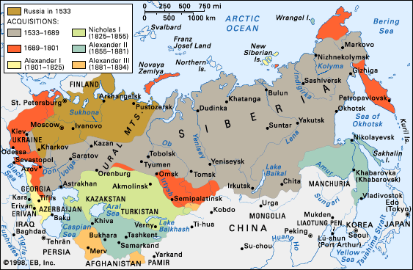

Slide 12
Russian Social Structure
Below the Tsar were the wealthy land owners called nobles.
They controlled the serfs, who were poor peasants.
The serfs could not leave the land of the nobles
In 1861 the serfs were emancipated

Slide 13
Opponents to the Tsar
The Russian middle class wanted reforms to Tsarist rule.
Liberals wanted a constitution and an elected legislature.
The Russian Radicals were communists, who believed in the ideas of Karl Marx
They were revolutionaries, who wanted to overthrow the Tsar and make Russia a socialist country

Slide 14
The Revolution of 1905
In 1905 peaceful protestors were killed by the Tsar’s soldiers. This was called “Bloody Sunday.”
Strikes spread throughout Russia.
Finally Tsar Nicholas announced changes, including a constitution and a law making group called the Duma.

Slide 15
The Russian Revolution
1917 - 1920

Slide 16
Tsar Abdicates
In 1917 the Russians were war weary, facing shortages on the front and starvation in the cities.
The Tsar unsuccessfully tried to take over leading the Russian Army.
Unrest grew, and the Tsar abdicated, stepping down in March of 1917.

Slide 17
The Provisional Government
Middle class liberals, led by Kerensky, set up a provisional or temporary government.
The Russian legislature, the Duma met to make a Constitution.
However, radical socialists set up Soviets, or workers councils, opposing the policies of the new government.

Slide 18
Bolsheviks Take Over
The radical socialists were called Bolsheviks, meaning the majority.
They were led by V. I. Lenin.
They demanded “peace, bread, and land.”
The provisional government fell in November, and the Bolsheviks took over.

Slide 19
Civil War
Lenin and the Communists consolidated power.
In 1918 they took Russia out of WW 1.
Russia fell into civil war, between the “reds” the communists, and the “whites”, their opponents.
The western nations supported the “whites.”

Slide 20
From Russia to the Soviet Union
The communists were victorious in the Civil War in 1920
The Russian empire became the Soviet Union or the USSR, with Lenin as its leader.

Slide 21
Lenin’s Communism
Lenin ruled until his death in 1924.
He instituted the New Economic Policy, which included giving land to the peasants.
Industry was run by the government and was called war communism.

Slide 22
Power Struggle: Stalin vs Trotsky
The death of Lenin led to a power struggle between Stalin and Trotsky.
Trotsky believed that communism had to spread to other countries before it could be successful in the Soviet Union.
Stalin wanted to push ahead, with socialism and government control of the Soviet Union

Slide 23
Communist Dictator Stalin Takes Charge
Stalin was successful in gaining control of the Communist Party.
In 1927 Stalin forced Trotsky into exile, eventually sending agents to kill him in Mexico.
Stalin consolidated a communist dictatorship, by eliminating opponents.

Slide 24
A Totalitarian Dictatorship
Stalin’s rule was a Totalitarian dictatorship.
This means that he exerted total control over the Communist Party and the Soviet Union.
No one could oppose Stalin, without fear of death.

Slide 25
The 5 Year Plan and Forced Collectivization
Stalin set a Five Year Plan for government run industries.
He also ended Lenin’s NEP, and demanded that the peasants be brought into government collectives.
He sent Soviet troops into the countryside to crush the rebellion of the Kulaks, the rich peasants.

Slide 26
Stalin’s Terror
Stalin used the secret police to silence his opponents.
In the mid 30’s Stalin purged any opponents in the Communist Party.
Old Bolsheviks were put on trial as traitors and killed or sent to Siberia in exile.

Slide 27
Propaganda and Cult of Personality
Stalin used posters, the press, movies and schools to persuade Soviet citizens that he was the savior of the country.
The communists were atheists and repressed the Russian Orthodox Church and Jewish minorities.

