Slide 1
The Origins of Democracy
The Greek, Roman, and Religious Sources of the
Western Democratic Tradition

Slide 2
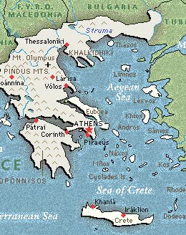
The Greek City State
2700 years ago, 700 BC, the Greeks developed city-states
The first Greek city-state was a monarchy, a government ruled by kings and queens
Over time the Greek city- states developed a democracy, a government ruled by the people

Slide 3
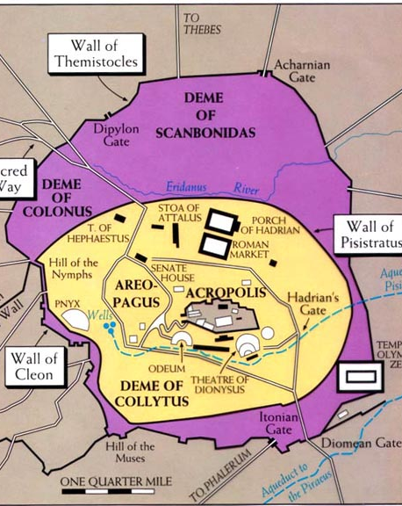
Athenian Democracy
The most powerful Greek city-state was Athens
At first Athens was controlled by a wealthy aristocracy, land owners.
Eventually more citizens participated in a direct democracy, voting on important laws.
Athens had a legislature, or law making group
Citizens also served on juries, deciding on the guilt or innocence of others

Slide 4
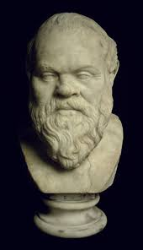
The Greek Philosophers
A philosopher is a thinker, or a “lover of wisdom”
The most famous Greek philosopher was Socrates
He supported Greek democracy and opposed tyrants, people who took power by force
His student Plato believed in the importance of reason and logic.
Aristotle focused on the importance of law.

Slide 5
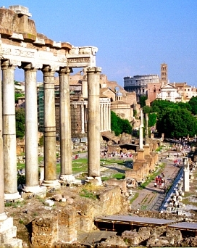
The Roman Republic
The Greeks greatly influenced the Romans
In 2500 years ago, in 500 BC, the Romans established a republic, a representative democracy.
The governing body was the senate, a law making group made up of the land holding upper classes called patricians.

Slide 6
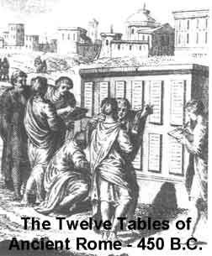
Roman Law
Common Romans, called plebeians, sought a voice in the Republic.
They elected tribunes, who could stop or veto laws made by the Senate.
All Roman citizens could vote in the assemblies, which could pass or reject laws passed by the Senate.
The Romans Republic developed written law, which applied to all its citizens.

Slide 7
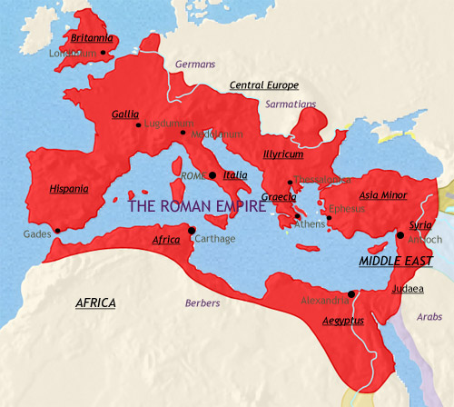
The Roman Empire
The Roman Republic took over much of Europe, establishing an empire.
During times of war the Senate sometimes chose a dictator, a ruler with complete control over government.
The Roman empire became ruled by a series of emperors, all powerful rulers

Slide 8
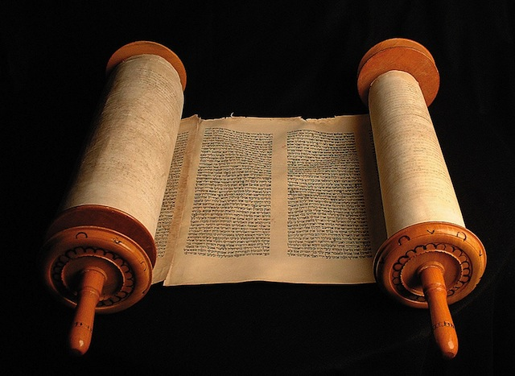
The Principles of Judaism
The Jews were the first monotheistic religion, believing in a single powerful God.
The Jewish, The Old Testament, contains the 10 Commandments
These commandments forbade followers to murder or steal.
The Jewish Torah also contains rules for followers and calls for people to establish courts to enforce these laws.

Slide 9
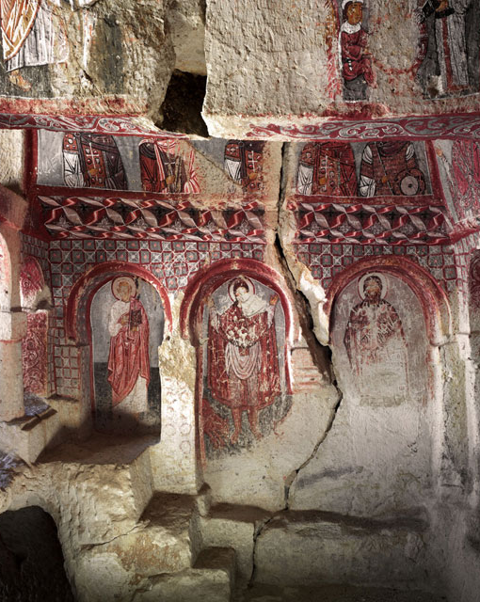
Christianity
During the period of the Roman Empire, Christianity arose.
Jesus was a Jew who preached a single all powerful God and the 10 Commandments.
His followers separated from the Jewish religion, believing that Jesus was the son of God.
Christ’s teachings became the basis for the Christian Bible, The New Testament.
Christianity emphasized loving your neighbor and the importance of forgiveness.

Slide 10

Judeo-Christian Tradition
The ideas in the Old Testament are accepted by Jews, Christians, and Muslims, alike.
Western civilization is based on the moral and ethical principles found in these religious traditions.
Each person is considered a child of God, and therefore deserving equal and fair treatment.

