Slide 1
How is making a delicious sandwich
like writing a strong body paragraph?

Slide 2
Describe your favorite sandwich
Tell your seat partner about your favorite sandwich:
What type of bread do you like?
What are the main ingredients in your favorite sandwich?
What other things do you put in your sandwich?
What condiments do you like on this sandwich?

Slide 3
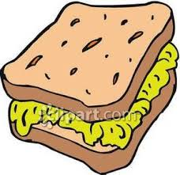
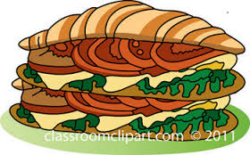
Which sandwich looks better?
Why?

Slide 4
How is making a delicious sandwich like writing a strong body paragraph?

Slide 5
A delicious sandwich starts with tasty bread.
A strong body paragraph starts with a topic sentence directly related to one of the reasons in the claim.
In addition, it has a strong concluding sentence as well.

Slide 6
A delicious sandwich is filled with lots of great ingredients.
A good body paragraph is filled with lots of strong evidence. This evidence should come from reliable sources.
In addition, each piece of evidence should have an in-text citation, directly related to one of the sources in the Works Cited page.

Slide 7
The condiments on a delicious sandwich enhance the main ingredients.
A good paragraph stays focused on the topic sentence and does not contain unrelated evidence or information that can distract the reader.
A strong body paragraph is well written, containing good transitions, and correct grammar, spelling, and punctuation.

Slide 8
Make me a delicious sandwich for each body paragraph, and please, no lettuce sandwiches.

