Slide 1
Life in the Manzanar Internment Camp
Photos by Dorothea Lange

Slide 3
Do you remember where the Manzanar Internment camp was located?
Describe camp terrain, and the weather in both summer and winter?

Slide 6
Barbed Wire and Guard Towers
How would it feel to be kept in an internment camp with barbed wire and guard towers?

Slide 9
The Barracks
How is the barracks different from your house back home?
How would you feel sharing a room with your entire family?

Slide 12
The Mess Hall
What would be the sights, smells, and sounds of the mess hall?
How would it be different than eating at home?

Slide 13
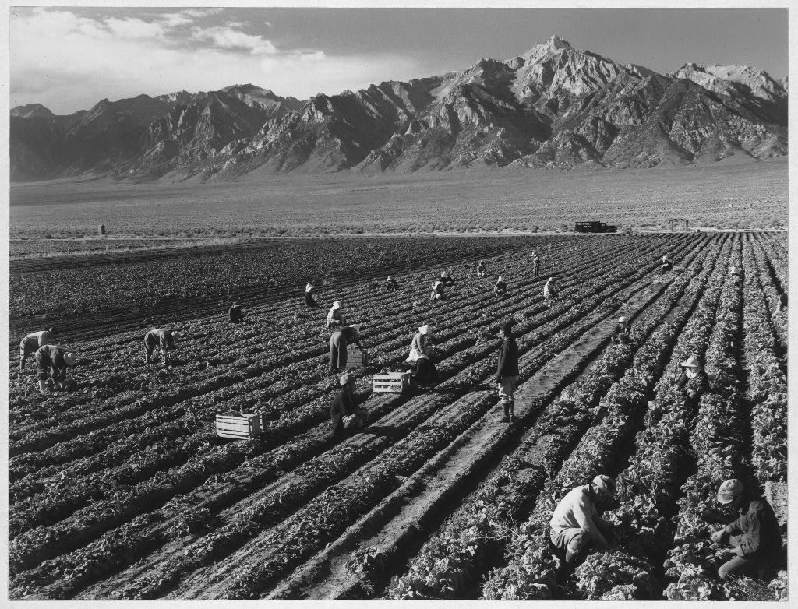

Slide 15
What type of work did people do in the internment camps?

Slide 22
School
What would it be like to go to school in an internment camp?
What would it be like to graduate high school in a camp?

Slide 25
Recreation
What would you do for fun?
How would you make the time pass more quickly?

Slide 27
Missing Home
What would you miss most about your home and your friends?

