Slide 1
Life of Washington Mural Controversy
Analyze a Depression Era mural at Washington High School by Victor Arnautoff.
Decide if it should be painted over, covered or remain on the high school’s walls.

Slide 2
The Mural at Washington High School
During the 1930’s many artists were employed by New Deal programs to create public art.
Muralist Victor Arnautoff was commissioned to paint a mural at Washington High School in San Francisco. He named his mural, Life of Washington.
Recently the San Francisco School Board voted to cover the mural, against the opposition of others who wanted to have the artwork remain.
View the mural and tell us what you think.

Slide 3
Analyze the Mural Panel 1
Who are the main figures in this mural?
What activities do you see in the mural?
Which aspects of Washington’s life is shown in this panel?
Why do you think the artist, Arnautoff, chose to paint this scene?
What do you think he was trying to say about Washington and the founding of our nation?
How does this image make you feel? Explain.

Slide 4
Look in more detail
Who are the main figures in this mural?
What activities do you see in the mural?
Which aspect of Washington’s life is shown in this panel?
Why do you think the artist, Arnautoff chose to paint this scene?
What do you think he was trying to say about Washington?
How does this image make you feel? Explain.

Slide 5
Look in more detail
Who are the main figures in this mural?
What activities do you see in the mural?
Which aspect of Washington’s life is shown in this panel?
Why do you think the artist, Arnautoff chose to paint this scene?
What do you think he was trying to say about Washington?
How does this image make you feel? Explain.

Slide 6
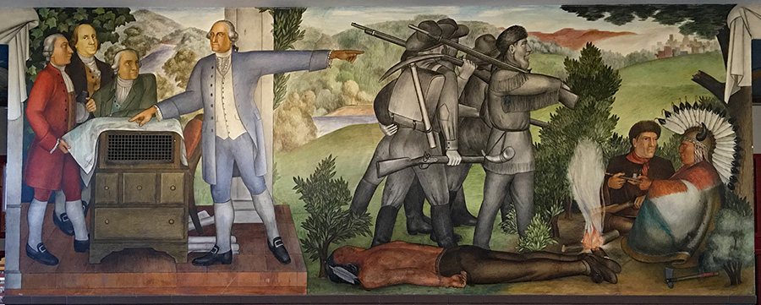
Analyze the Mural Panel 2
Who are the main figures in this mural?
What activities do you see in the mural?
Which aspect of Washington’s life is shown in this panel?
Why do you think the artist, Arnautoff chose to paint this scene?
What do you think he was trying to say about Washington?
How does this image make you feel? Explain.

Slide 7
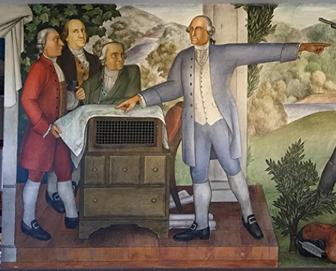
Look in More Detail
Who are the main figures in this mural?
What activities do you see in the mural?
Which aspect of Washington’s life is shown in this panel?
Why do you think the artist, Arnautoff chose to paint this scene?
What do you think he was trying to say about Washington?
How does this image make you feel? Explain.

Slide 8
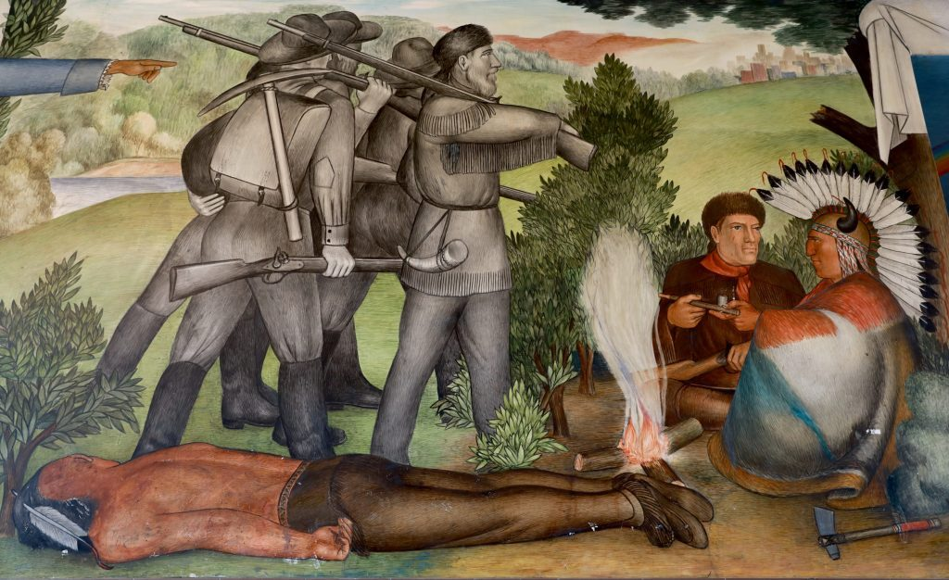
Look in More Detail
Who are the main figures in this mural?
What activities do you see in the mural?
Which aspect of Washington’s life is shown in this panel?
Why do you think the artist, Arnautoff chose to paint this scene?
What do you think he was trying to say about Washington?
How does this image make you feel? Explain.

Slide 9
Read More about the Mural Controversy
Read Jill Tucker’s article from the San Francisco Chronicle, SF school board reverses course, decides to save the controversy.
Before you read define important vocabulary from the article.
As you read, use the T chart to identify the critics who want the mural covered or painted over, and the preservationists, who want to have the mural remain on the walls to be viewed.

Slide 10
Article Vocabulary with Definitions
Mural or frescoes – a painting or work of art put directly on a wall.
Controversial - Something that gives rise to public disagreement
Obscure – to keep from being seen or concealed
Critic – a person who has an unfavorable view of something
Preservationists – a supporter to keep something, such as artwork or a building, the way it is
Look at the list of vocabulary words on your Reading Guide.
Write your own definition for the words you know.
You can look up or copy down the Google Dictionary definitions shown here.

Slide 11
Article Vocabulary with Definitions
Censorship – to prohibit an article, artwork, or film
Indigenous – a person who was originally here, like Native Americans
Trauma – a deeply distressing or disturbing experience
Relic – something that is old from another time and also outdated
Look at the list of vocabulary words on your Reading Guide.
Write your own definition for the words you know.
You can look up or copy down the Google Dictionary definitions shown here.

Slide 12
Discuss the Mural Controversy
Why do you think artist Victor Arnautoff painted Life of Washington Mural, including the images of slavery and the conquest of Native Americans?
Do you agree or disagree with the preservationists, who argue the images of slavery and the conquest of Native American tribes depicts a truth about our nation that should be shown to high school students?
Do you agree or disagree with the critics who say that the images in this mural are too painful and traumatize students who have to view them everyday at school?
After you read Jill Tucker’s article, answer the following questions and then discuss your answers with your partner and the class.

Slide 13
Discuss the Mural Controversy
Do you agree or disagree with Danny Glover and other preservationists who argue that “art should make people feel uncomfortable” and taking down the mural would be censorship?
Do you agree or disagree with critics of the mural who feel that the Life of Washington Mural only portrays African Americans and Native Americans as victims, and ignores their resistance to oppression and their contributions to US society?
If you were a student at Washington High School, would you want the mural covered, painted over, or preserved?
After you read Jill Tucker’s article, answer the following questions and then discuss your answers with your partner and the class.

Slide 14
Write a short speech for the School Board
Imagine you were a Washington High School student. You’ve been invited to speak at the next school board meeting. Write a short speech, advising the San Francisco School Board concerning the Life of Washington mural.
Should it be painted over, covered, or should it remain as it is to be viewed by students?
Use The Life of Washington Mural Writing prompt.

Slide 15
Credits
“A Veteran Teacher’s Lessons: Teaching History with Murals” by Dave Forrest
Life of Washington Mural Controversy Lessons by Dave Forrest including:
Slideshow
Viewing Guide,
Reading Guide,
Discussion Guide,
Writing Prompt
Tucker, Jill, “SF school board reverses course, decides to save controversial mural”, SF Chronicle, 13, August, 2019.
The Life of Washington Mural Controversy Lessons by Dave Forrest
2019

