Slide 1
Improving Your
Slideshow Design
Keep it simple.

Slide 2
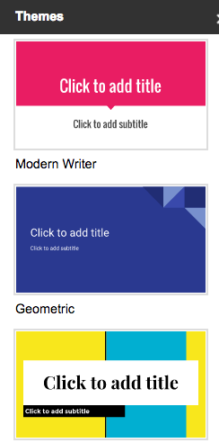
Explore Templates
Choose a theme for your google slideshow with colors, fonts, photos, and graphic elements that match your topic.

Slide 3
What color?
What font or background color might be best for a proposition dealing with the legalization of marijuana?

Slide 4
What colors might be best for a slideshow about a proposition supporting the death penalty?

Slide 5
Fonts
Pick easy to read fonts.
Use contrast.
Dark font on a light background.
Light font on a dark background.

Slide 6
Photos
Use high quality photos.
Don’t place images on the card edge. Frame them in your layout.
One photo on a card can be more powerful than several.

Slide 7
What’s this slideshow about?
How did you know?

Slide 8
Happy Friday!
Looking forward to seeing your slideshows on Monday.

