Slide 1
Clouds Over Sidra
A Virtual Field Trip
And
Discussion

Slide 2
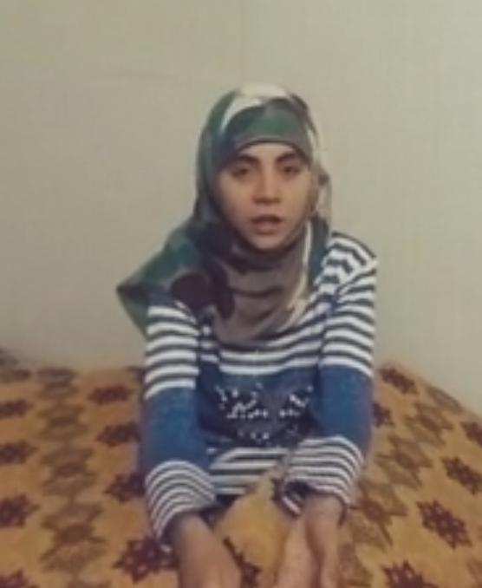
Syrian Refugee Sidra
Sidra is a 12 year old Syrian refugee, living in the Zaatari Refugee camp. The camp in Jordan has 130,000 Syrians, who have fled violence and war.

Slide 3
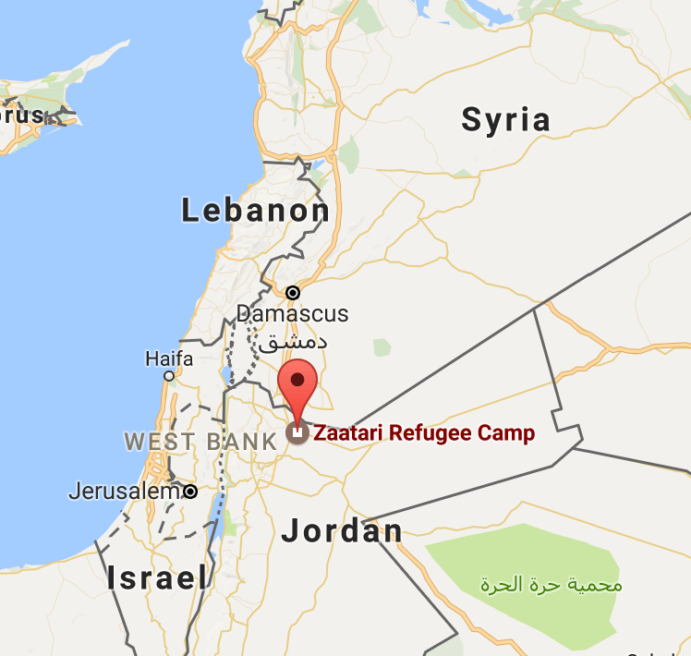
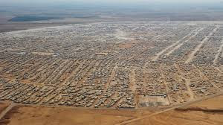
The Zaatari Refugee Camp in Jordan

Slide 4
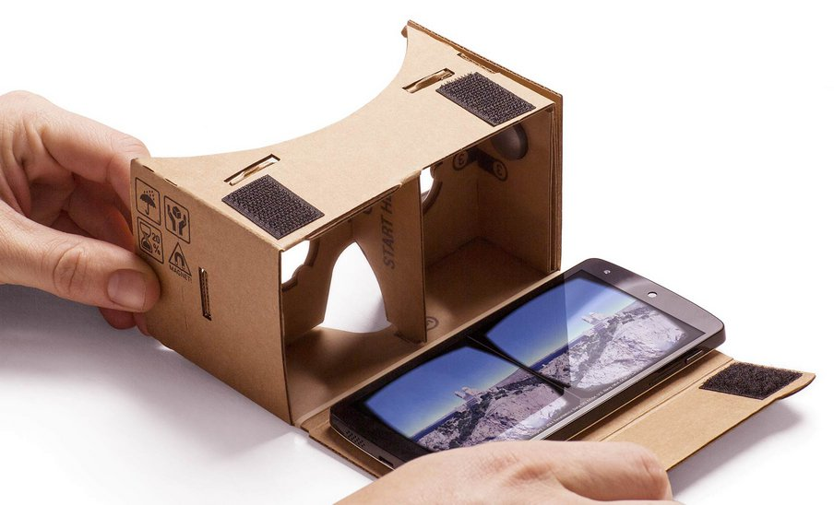
Clouds Over Sidra
Watch the Virtual Reality film.
App --> Within --> Clouds Over Sidra

Slide 5
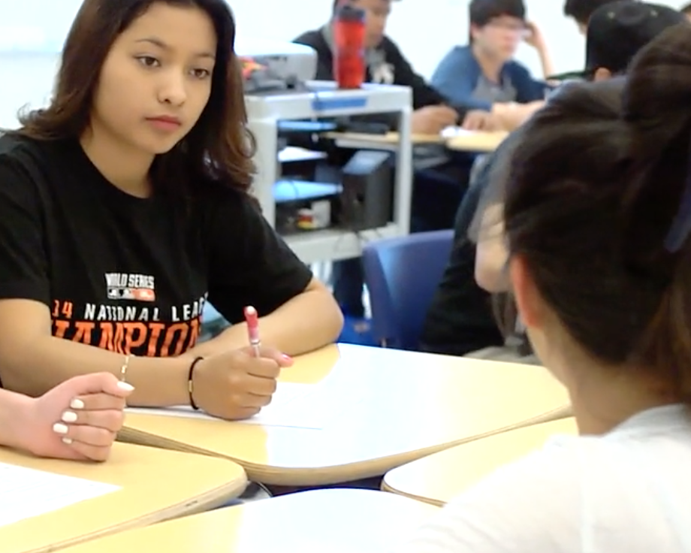
Discussion
After you have taken the virtual field trip, discuss the following questions with your partner and classmates.

Slide 6
How did Sidra get to the Zaatari Refugee Camp?
What is a refugee?

Slide 7
Describe Sidra’s home and living conditions in the refugee camp.

Slide 8
Why does Sidra like cloudy days? What are clouds a metaphor for in Sidra’s eyes?

Slide 9
How is Sidra’s schools different from yours?
What evidence do you have that Sidra is a good student?

Slide 10
What evidence can you provide that boys and girls are treated differently in the refugee camp?

Slide 11
Food and meals are mentioned several times in the video. Why do you think food is so important to Sidra?

Slide 12
Speculate on why there may be as many kids as adults in the refugee camps.

Slide 13
Why do you think the film is named Clouds Over Sidra? Do you think this is a good name?

Slide 14
The film says, “The world is facing the most devastating refugee crisis since WW II...”

Slide 15
What can Americans do to help Syrian refugees like Sidra?

Slide 16
Lesson by Dave Forrest
May 2017
https://with.in/watch/clouds-over-sidra

