Slide 1
Making a Title Card
Pick a title that tells the viewer about the person or movement of your project. Be sure to use the person’s or movement’s name in the title.
Choose colors that communicate your topic.
Pick a photo that shows your person or movement in action.
Add your own name to the title card.

Slide 2
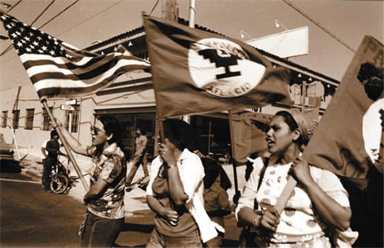
The United Farmworkers
By Dave Forrest

Slide 3
Design Six Information Cards
After the Title Card, write six information cards to tell the story of your person or movement.
Be sure each title tells the card topic or theme.
Choose Layout and choose the two column and title layout for your information cards.
Use both text and photos.
Use 18 to 24 point font for information.
Keep a unified color scheme.
Put your six cards in chronological order.

Slide 4
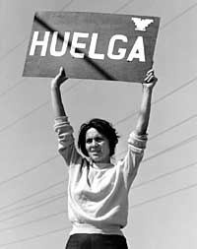
The UFW Grape Strike
In 1965 the United Farm Workers called for a national boycott of table grapes.
The “huelga” (strike) was designed to put pressure on California grape growers to provide better pay and working conditions for farm workers.
The Grape Strike lasted five years.
The UFW won the first victory for migrant workers in the US.

Slide 5
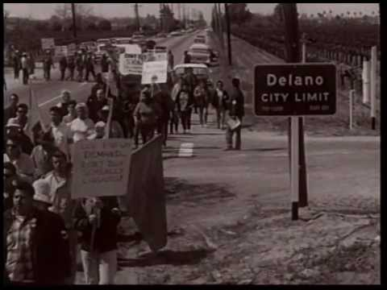
The UFW March to Sacramento
The UFW marched to Sacramento

Slide 6
Design and Google Slide Show Tips
Keep text and photos off the edges of your cards.
Use the Edit/Duplicate feature to duplicate cards and copy layout and color
Use the Tools/Research feature to search for photos and pull in pictures for your project
Use the Insert/Video feature to pull in a video to your project
Use the Tools/Spelling feature to spell check and edit your work.

Slide 7
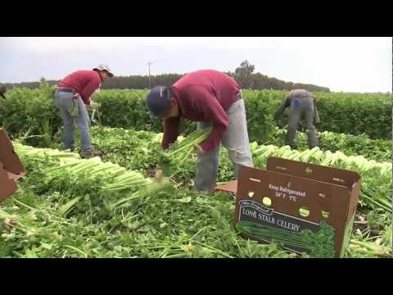
Farmworkers Video
United Farm Workers Celebrate 50th Anniversary
Video footage from Univision1News, 2012.

Slide 8
Making a Works Cited final card
Put your Gale Group source and your book on the final card.
Put them in the correct Works Cited Format
If you used a third or fourth source, put them, too.
Put them in alphabetical order.
Use the Logan Research Guide for help.

Slide 9
Works Cited
Ferriss, Susan and Sandoval, Ricardo. The Fight in the Fields, New York:
Harcourt Brace and Company.,1997.
United Farm Workers Celebrates 50th anniversary. UnivisionNews1. May 12,
2012.
“United Farm Workers.” Gale Encyclopedia of U.S. Economic History. Ed.
Thomas Carson and Mary Bonk. Detroit: Gale, 1999. Student Resources in
Context. Web. 18 Mar. 2014.

