Slide 1
Writing a Claim
Dogs are better pets than cats because ...
Dave Forrest - 2015

Slide 2
Are you a dog person or a cat person?

Slide 3
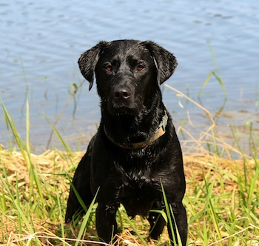
Making a claim
You learned last year that a claim is an arguable position. For example,someone might argue that dogs make better pets than cats.
A claim contains both the arguable position along with the main reasons. Typically the main reasons follows the word because.

Slide 4
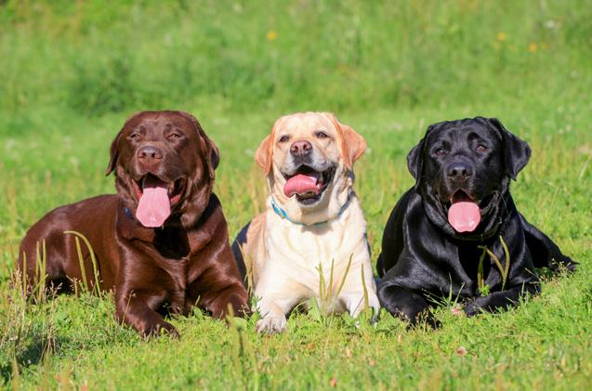
Example of a claim
Dogs make better pets because they are more loyal than cats, they provide protection, and they encourage their owners to exercise.

Slide 5
your Claim Guides Your Paper
In an argumentative essay or research paper your claim will guide your paper.
In our example, the first body paragraph would support the reason that dogs are more loyal than cats.
The second paragraph would be centered around the idea that dogs provide protection in ways that cats can’t.
The third body paragraph would be focused on the idea that walking a dog helps an owner exercise.

Slide 6
Improving A Claim
Step 1:
Pick a Claim, Fix a Claim
Pick the best claim from the six. Explain what made it strong.
Rewrite the weakest claim, making it a strong claim.
Work with a partner.

Slide 7
Practice writing a Claim
Step 2:
Practice Writing Reasons for a Claim on Immigration.
Choose whichever side of the immigration debate you agree with.
Work with a partner.

Slide 8
Write A Clear Claim For Your Paper
Step 3:
Write a strong claim for the research paper topic you have chosen.
Be sure to spell out the three reasons you will be developing in your research paper.
Work alone.

Slide 9
Finding Sources to Support Your Claim
Step 4:
Find sources that will provide strong evidence for your claim.
Search SIRS data base.
Collect sources on a google.docs page.
Copy and paste the correct MLA citation, to start your Works Cited page.
Work alone.

