Slide 1
The Fight for Women’s Rights
The 19th Amendment
Title VII and IX
ERA and Roe v Wade

Slide 2
19th amendment
Women won the right to vote in 1920 due to efforts of suffragists.

Slide 3
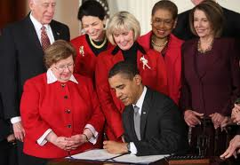
Title VII and workplace equality for women
Title VII of the 1964 Civil Rights Act prohibits discrimination in the workplace based on race or sex.
The Fair Pay Act, also called the Lillie Ledbetter Act, signed by President Obama in 2009.

Slide 4
Title IX
Title IX. passed in 1972, said no person shall be, on the basis of sex, excluded from an educational program or activity receiving federal funds.
This law ensured that girls had equal access to school sports.

Slide 5
Equal Rights Amendment
The Equal Rights Amendment was first proposed by Alice Paul in the 1920’s
The ERA was passed by both houses of Congress in 1972.
However, it failed to receive enough support in state legislatures to be ratified.

Slide 6
Roe v Wade
1973 Supreme Court decision made abortion legal, citing the right of privacy and the 14th amendment.
Pro choice advocates emphasize the right of women to control their bodies, while pro life advocates focus on the life of the unborn child.

Slide 7
Women in Politics
Do you know the first woman to serve as Secretary of State, or to serve on the Supreme Court, or to be elected Speaker of the House, or to run for President?

