Slide 1
Political Parties – Chapter 5

Slide 2
Political Parties
Political parties are not mentioned in the Constitution and our founders feared that political parties would lead to factionalism and political division.
Nevertheless, the US has had two main competing parties, dating all the way back to the Federalists and the Anti-Federalists at the founding of the nation.

Slide 3
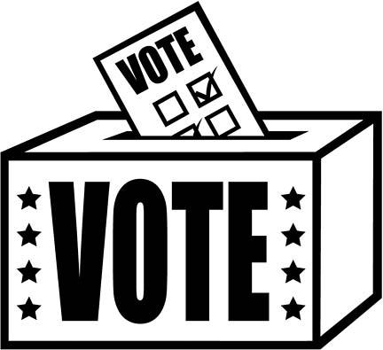
Winning Elections
Political parties nominate candidates, inform voters, and seek to win elections.
Once in power, a political party influences government policy and its candidate governs the nation.
The political party out of power acts as a watchdog against the party in power.

Slide 4
Our Two Party System
The US political system is described as a two party system.
Today the main two parties are Democrats and Republicans.
We have important third parties, too, like the Libertarian and Green Parties.

Slide 5
“Winner Take All” System
In our system, the political party that wins the most votes, a plurality, wins the election. This does not have to be a majority of the voters.
The person who comes in second does not hold political office.
The President is elected by winning the majority of the Electoral College, or 270 electors.

Slide 6
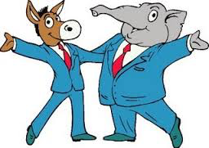
Partisan vs. Bipartisan
At times our two parties are able to reach bipartisan agreement, making compromises.
At other periods, we have extreme partisanship, making it very difficult to compromise or pass laws.

Slide 7
Multi Party Democracies
Many democracies have multiparty systems, where a wide range of parties have candidates for political office.
For example, most European countries are multi party democracies.
They don’t have a winner take all system so that these democracies are often run with multiparty coalitions.

Slide 8
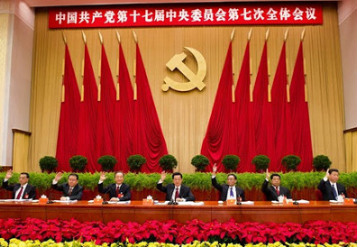
One Party Systems
One party systems are not democratic.
For example, China and Cuba only allow candidates from a single party to run, therefore voters do not have a choice in elections.
The former Soviet Union was a one party system controlled by the Communist Party.

Slide 9
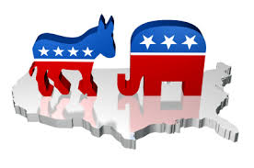
The Two Party System in American History

Slide 10
Era 1: Democratic Domination
The election of Thomas Jefferson marked a 60 year period of Democratic Party domination.
During Andrew Jackson’s Presidency in the 1830’s the Democratic Party was named and the donkey became its symbol

Slide 11
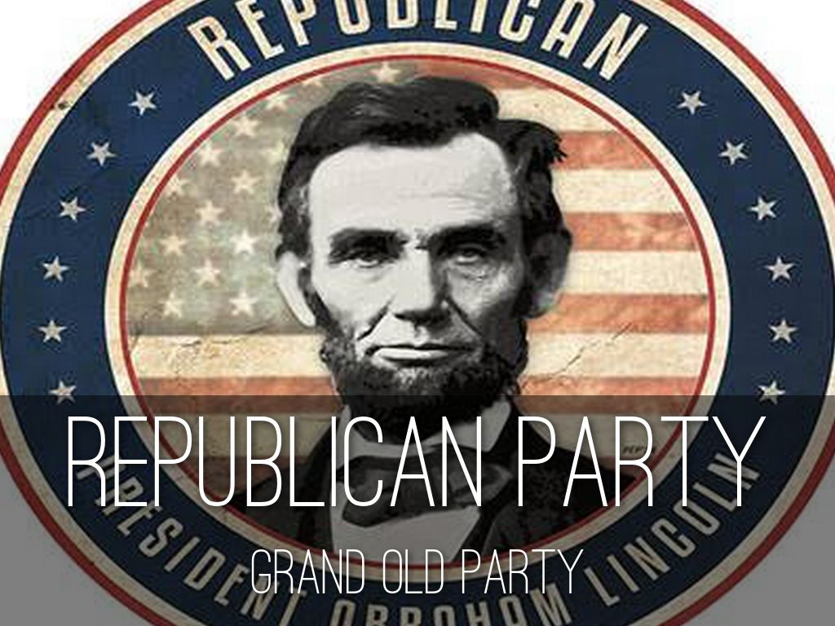
Era 2: Republican Domination
The election of Abraham Lincoln marks the 72 year reign of the Republicans
After the Civil War the Republicans were mainly a party of the North, while the Democrats were the majority in the South.

Slide 12
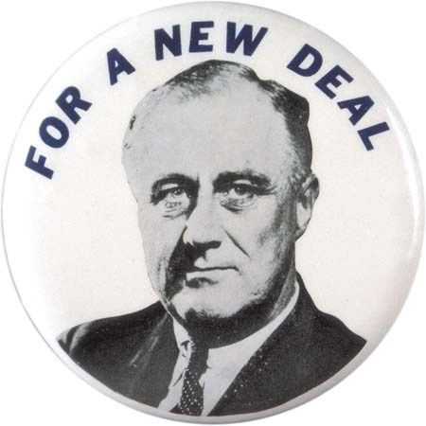
Era 3: Democratic Domination
The Election of Franklin Roosevelt during the Great Depression marked the period of Democratic domination.
FDR changed the conception of national government with his New Deal programs.
FDR also expanded the Democratic coalition bringing many African Americans into the party.

Slide 13
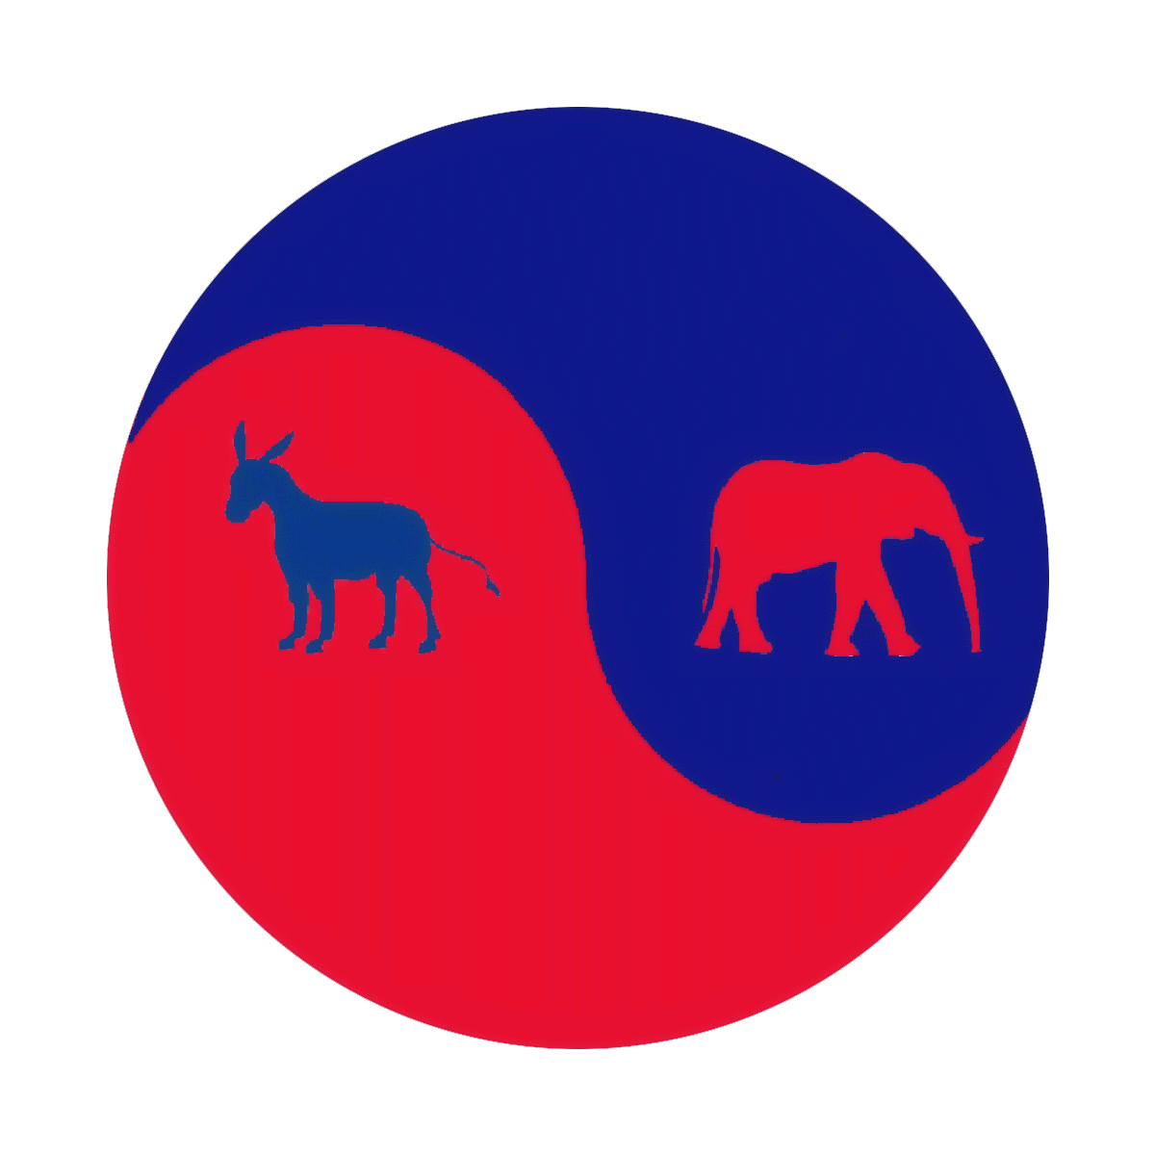
Era 4: Divided Goverment
The election of Republican Richard Nixon in 1968 marks the beginning of the current era of divided government.
It is called divided government because Republican and Democrats have both won the presidencies during the last 50 years.
Divided government often has opposing parties controlling the Presidency and Congress, as is the case today.

Slide 14
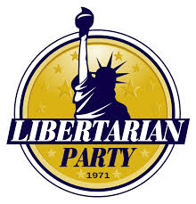
Minor Parties
Throughout our history we have had minor parties organized around specific issues or ideology.
For example, the Green Party focuses on issues of the environment.
Libertarian candidate for President, Gary Johnson, is polling about 10% of the voters.

Slide 15
Minor Parties
While our two party system has dominated our history, minor parties have been important, too.
Minor Parties raise important issues, sometimes adopted by the major parties.
They also can split the vote, leading to the victory of one major party over the other.

Slide 16
The Basis for Minor Parties
Minor Parties may be based on a single issue, or they may be organized as an economic protest.
Minor Parties are sometimes organized around a single ideology, or are the result of a splinter group from a major party.

Slide 17
The Structure of the Political Parties
Both Democrats and Republicans have national, state, and local party organizations.

Slide 18
The National Party Organization
The National Conventions of both Democrats and Republicans meet every 4 year to pick a nominee and to adopt a party platform.
The day to day operations are led by the National Committees (The RNC and DNC)
Each committee is led by a chair.

Slide 19
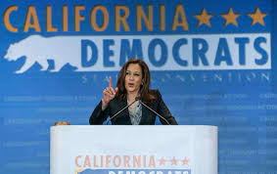
State and Local Party Organizations
Each political party has state and local party organizations.
These are loosely affiliated with the national party structures.
State party organizations are organized around Districts, Wards, and Precincts.

Slide 20
Weakening Parties
Political Science say that party affiliation has weakened, beginning in the 1960’s.
They point to a number of factors including: the rise of independent voters, split ticket voters, and the rise of the mass media, making candidates less dependent on political parties.

Slide 21
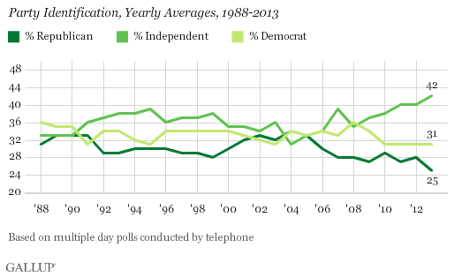
Party Identification Averages

