Slide 1
Civil Rights
The struggle for equality in the US

Slide 2
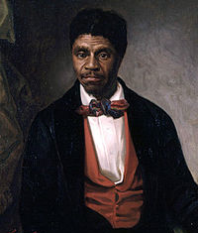
Dred Scott v Sanford
Slave Dred Scott was brought to free states in the North. He sought his emancipation, arguing he was in a state where slavery was illegal.
In 1857 the Supreme Court ruled that the federal government had no power to regulate slavery, and that slaves did not have protection of the Constitution or the rights of citizens.

Slide 3
First Freedoms
In 1863, during the Civil War, Lincoln declared slaves free with the Emancipation Proclamation
The US Congress abolished slavery with the 13th amendment.
14th amendment
provided citizenship to former slaves, and equal protection for all US citizens
15th amendment guaranteed the right to vote for African American men

Slide 4
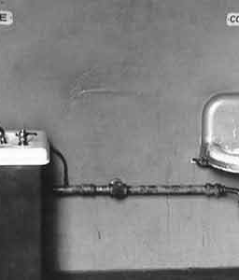
Freedoms Overturned
During Reconstruction African Americans exercised the right to vote for the first time.
However, at the end of this period of new rights, southern states controlled by whites limited black voting and political power through:
Literacy tests
White primaries
Poll Taxes
Grandfather clause

Slide 5
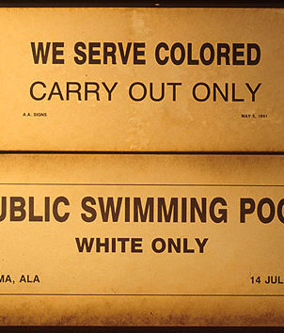
“Jim Crow” laws
The South implemented Jim Crow Laws, making African Americans second-class citizens,
blacks were separated from whites by law in transportation, public accommodations, recreational facilities, and schools

Slide 6
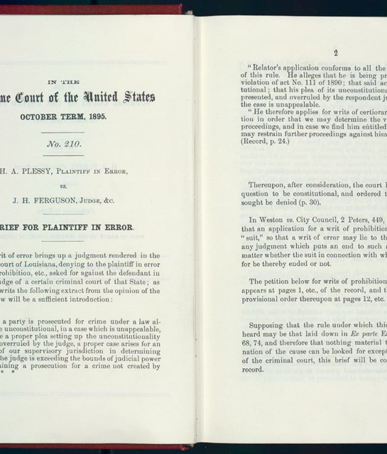
Plessy v. Ferguson
In 1896 the Supreme Court sanctioned legal separation of the races by its ruling in H.A. Plessy v. J.H. Ferguson, which held that separate but equal facilities did not violate the U.S. Constitution's Fourteenth Amendment.

Slide 7
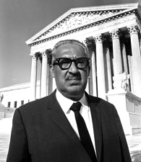
Brown v. Board of Education
In 1954 Linda Brown argued that she should be allowed to attend the all white school in her neighborhood
NAACP Lawyer Thurgood Marshall showed that segregation instilled feelings of inferiority in black children
The Court supported Linda Brown, striking down segregation in the southern schools

Slide 8
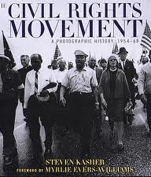
Civil Rights Movement
The Brown decision also struck down the separate but equal precedent of the Plessey decision
In 1955 Rosa Parks sparked the Montgomery Bus Boycott
In 1957 nine black students integrated the Little Rock High School
Civil Rights activists demonstrated, staged sit-ins , etc.

Slide 9
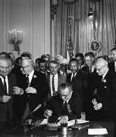
Civil Rights Act of 1964
In 1964 The Congress passed, and Lyndon Johnson signed the Civil rights Act
This sweeping Civil Rights legislation struck down the Jim Crow laws of the south

Slide 10
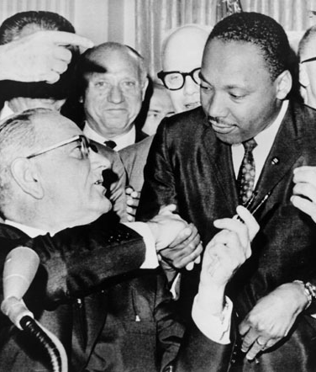
Voting Rights Act of 1965
The Voting Rights Act struck down the various southern practices that excluded the registration and voting of African Americans in the South
The results were a rapid rise in voter registration among Blacks, and the rise of African American political power

Slide 11
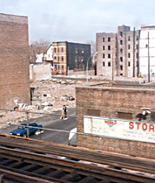
Racism
Dejure discrimination was segregation codified into southern law
Defacto discrimination existed in the north
Poor minority communities “red lined”
Ill equipped schools
Unequal pay

Slide 12
Discuss with your partner
Should race be a factor in college admissions? Why or why not?
Should society take affirmative steps to insure that minority groups are equally represented in college?
Is using race in college admissions reverse discrimination?
Should other factors be considered in college admissions other than test scores and grades? (eg income)

Slide 13
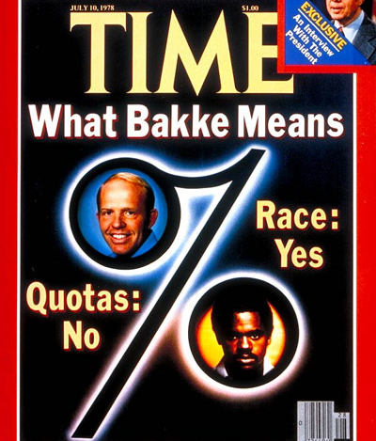
Bakke Decision
Alan Bakke was a white applicant to the UC Davis medical school.
He sued the University for reverse discrimination, arguing that the school had admitted non-whites with lower test scores
The court ruled that the UC could not use a racial quota system, but could make diversity a factor in admissions decisions.

Slide 14
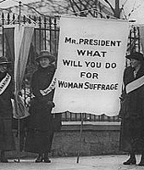
Landmarks in Women’s Rights
19th amendment guarantees the right to vote
Equal Pay act of 1963
Title VII of Civil Rights Act –prohibits discrimination against women in employment
Title IX – equal money for sports for girls

Slide 15
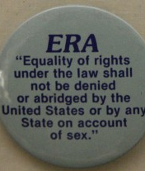
Landmark Events
Supreme Court Case – Rowe v. Wades makes abortions in first trimester legal
Americans divided over “pro choice” vs. “pro life”
Equal Rights Amendments (ERA) proposed in 1972, but did not pass

Slide 16
Is it reasonable or discriminatory?
Women were not allowed in combat positions, until recently.
Women were not required to sign up for the draft during the Vietnam War, but 18 year old men were?
If there is a draft should women be required to sign up?

Slide 17
Is it reasonable or discriminatory?
Women make 76 cents on average for each dollar earned by men?
Women are often paid less because they do different jobs than men?
Women are eligible for affirmative action in hiring, in jobs where they are underrepresented?
Women who are having a baby should be eligible for maternity leave from their jobs without penalty?
Men should have the same rights for paternity leave when a child is born?

Slide 18
Should it be legal?
Should abortion be legal?
Should women have the right to choose abortion without consent from the father?
Should women under 18 required parental consent and have to wait 24 hours?

Slide 19
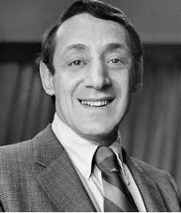
Gay and Lesbian Rights
First protests at Stonewall bar in NYC 1969
First openly Gay politician Harvey Milk elected to SF Board of Supervisors -1977
Romer v.Evans - 1996 – Supreme Court struck down anti-gay Colorado referendum

Slide 20
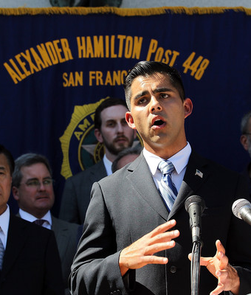
Gay and Lesbian Rights
President Obama repeals “don’t ask don’t tell”, allowing gays and lesbians to serve openly in the military
Same sex marriage recognized in seven states, most recently Washington State
Federal Appellate Court strikes down Prop 8, as discriminatory - 2012

Slide 21
The Way Forward
The US is currently debating the issue of same sex marriage or marriage equality. Discuss with your partner your own position about this issue.
Whichever position you hold, discuss what you think are the best political strategy and tactics to win.
For example, should this be a state by state battle or one that the federal government takes up.
Do you favor direct action: marches, boycotts, and protests as the Civil Rights Movement used?
Should this be taken up by the Supreme Court or do we need to pass a national law or Constitutional Amendment.
Discuss the most important ways to have your point of view prevail.

