Slide 1
The ABC's of Political Parties
Democrats and Republicans

Slide 2
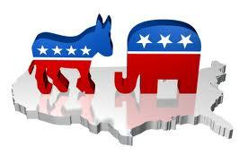
Two Political Parties
The US has a two party system
The two big political parties are Democrats and Republicans
We have smaller third parties, too, like the Libertarians and the Green Party

Slide 3
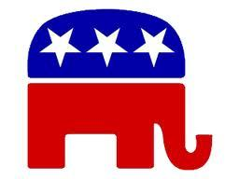
Republican
The Republican Party believes in conservative principles of small government, low taxes and individual responsibility
The Republican mascot is an elephant

Slide 4
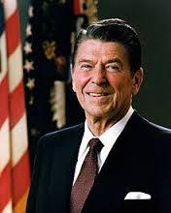
Famous Republicans
Famous Republican Presidents include:
Abraham Lincoln
Teddy Roosevelt
Ronald Reagan.
When the majority of people in a state vote Republican it is called a "Red State."

Slide 5
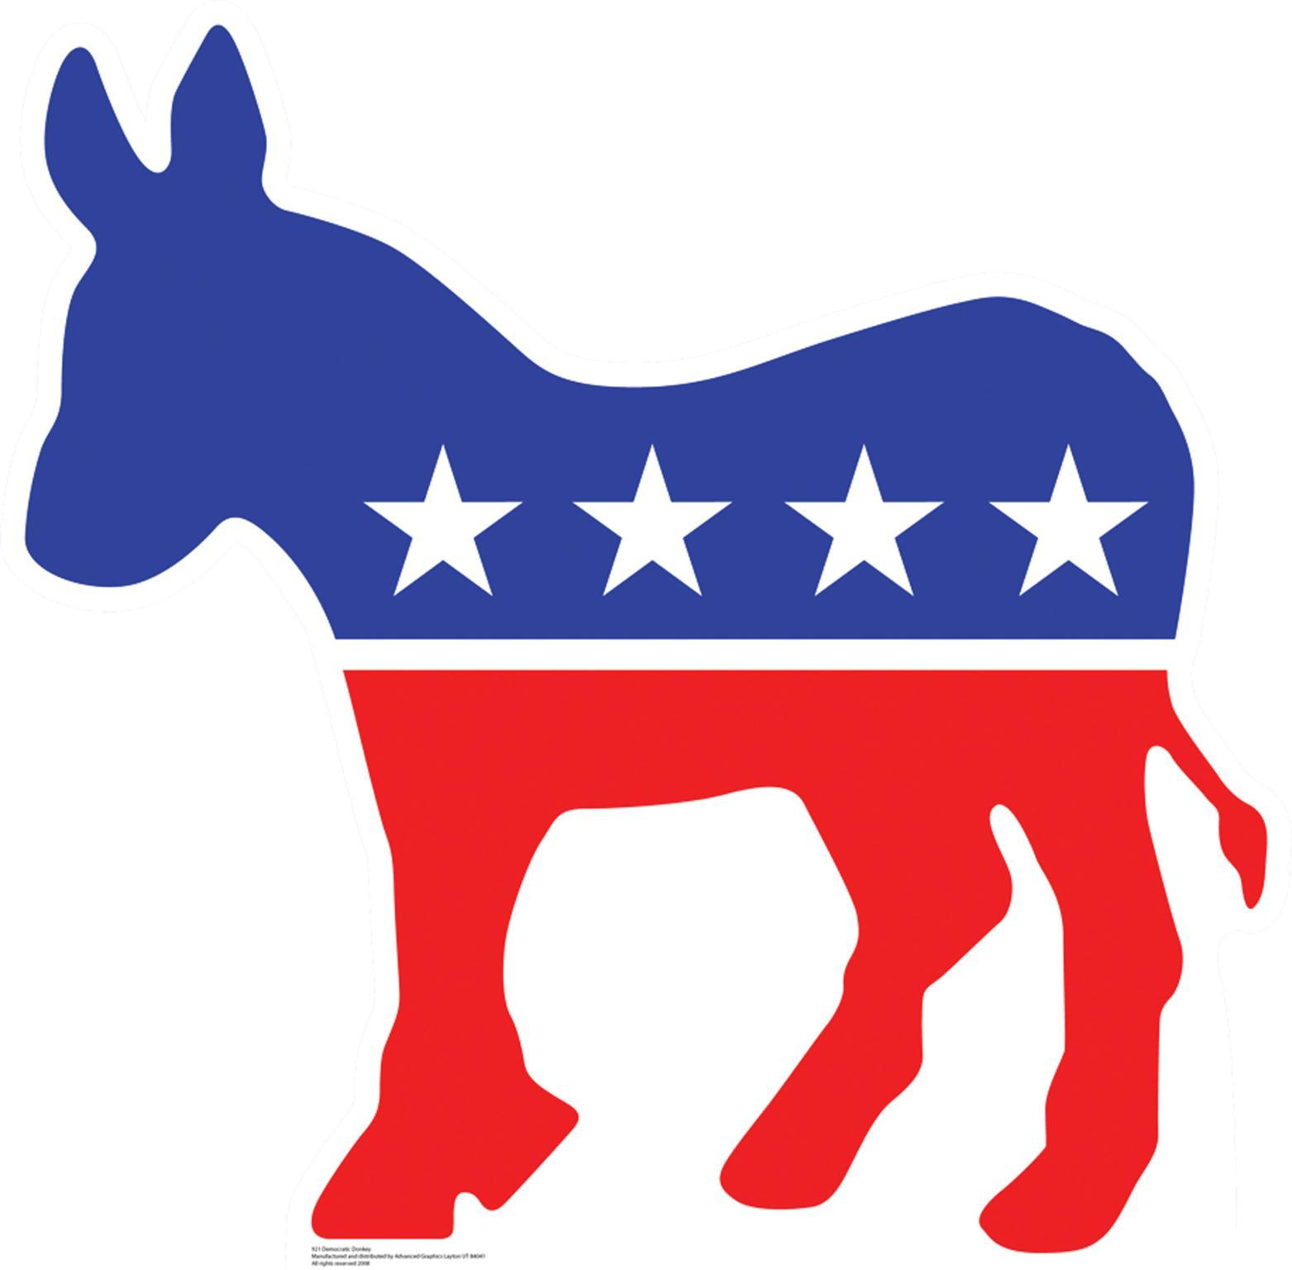
The Democrats
The Democrats believe in liberal principles that government can help people by providing programs for the poor and regulating business
The Democrats mascot is a donkey

Slide 6
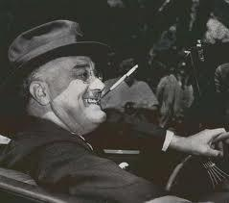
Famous Democrats
Famous Democratic Presidents include:
Franklin Roosevelt
John F. Kennedy
Barack Obama
When the majority of people in a state vote Democratic it is called a "Blue State."

Slide 7
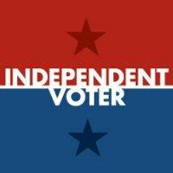
Independents and Moderates
Not all Americans belong to a political party. They are called independents.
Many Republicans and Democrats like ideas from both parties and they are called moderates.

Slide 8
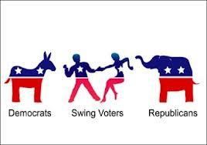
Swing Voters and Purple States
In close elections, independents and moderates are very important. They are often called swing voters.
States that are closely divided between Democrats and Republicans are called purple states.

