Slide 1
Saving and Investing for the Long Term
Double Your Money with the Rule of 72

Slide 2
Double your money with the Rule of 72
72 / interest rate = years to double investment
For Example:
72/ 10% interest rate = 7.2 years to double investment
The rule of 72 shows how quickly money that is saved is doubled. Even if you save a small amount, it can grow quickly.

Slide 3
Your turn to try the rule of 72
John saves $1,000 in a money market with an interest rate of 4%.
How long will it take for John’s money to double to $2,000?

Slide 4
Your turn to try the rule of 72
John saves $1,000 in a money market with an interest rate of 4%.
How long will it take for John’s money to double to $2,000?
72/4% = 18 years
How long will it take if the interest rate is 10%?

Slide 5
Rule of 72
Finding Interest Rates
You can also put in the number of years to double your investment and find the interest rate.
72/years to double investment = interest rate
Example:
72/ 8 years = 9% interest rate

Slide 6
Your turn
Amy saves $5,000 and she wants to double her money in 12 years. What interest rate does she need to do this?

Slide 7
Answer
Amy saves $5,000 and she wants to double her money in 12 years. What interest rate does she need to do this?
72/12 years =6 % interest rate
What if she wanted to double her money in 8 years? What interest rate would she need?

Slide 8

Banks
A Safe Place for Money
The Federal Deposit Insurance Corporation insures depositors money up to $250,000.
This includes insurance for checking accounts and CD’s, but not stocks.
This government system began in the 1930’s after many people lost their savings due to bank failures.

Slide 9

The Interest Rate:
The Price of Money
The price of money is the interest rate.
Depositors are paid interest for their savings accounts or CD’s.
Borrowers pay the bank interest when they take out a loan.
Banks make money by the difference between the two rates.

Slide 10
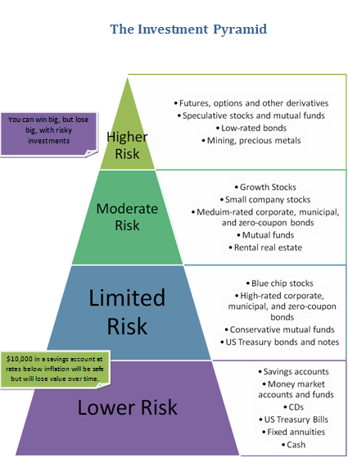
Investments and interest rates
Investments with higher risk often have higher interest rates.
Investments with lower risks often have lower interest rates.

Slide 11

Tax Sheltered Retirement Investments
Social Security provides some income for Americans 65 or older.
This usually isn’t enough to live, so people try to set up additional savings and investments for retirement.

Slide 12

Tax Sheltering Money
401 K and annuities
401 K is a retirement savings plan sponsored by employer.
Annuities provide retirement savings plan for public workers.
Both let workers take money out of paycheck their before taxes.
Taxes aren’t paid unit money is withdrawn from the account.

Slide 13
Saving for Retirement
You can use the rule of 72 to figure out how much to save for retirement.
Figure out the interest rate and the amount you want to put away each month.
How many years will it take to double.
How many years will you be saving?

