Slide 1
The ABC’s of Money and Banking
Chapter 11 and 12

Slide 2
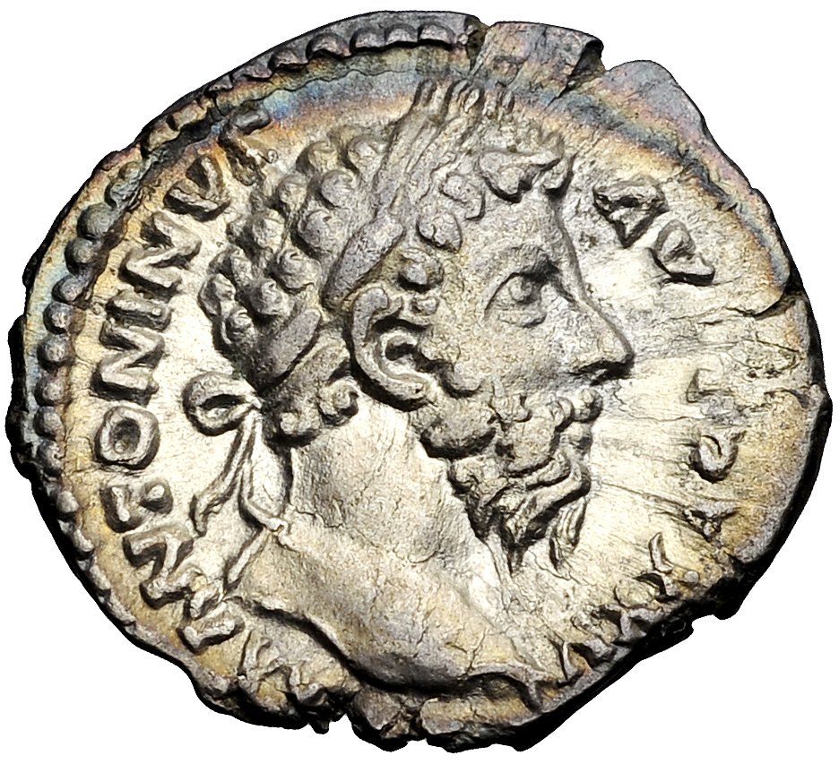
Money
In early societies people traded or bartered products.
Money made these transactions much easier.
In early societies money could be coins, but also shells or salt.
Money is a medium of exchange, and is used to measure and store value.

Slide 3
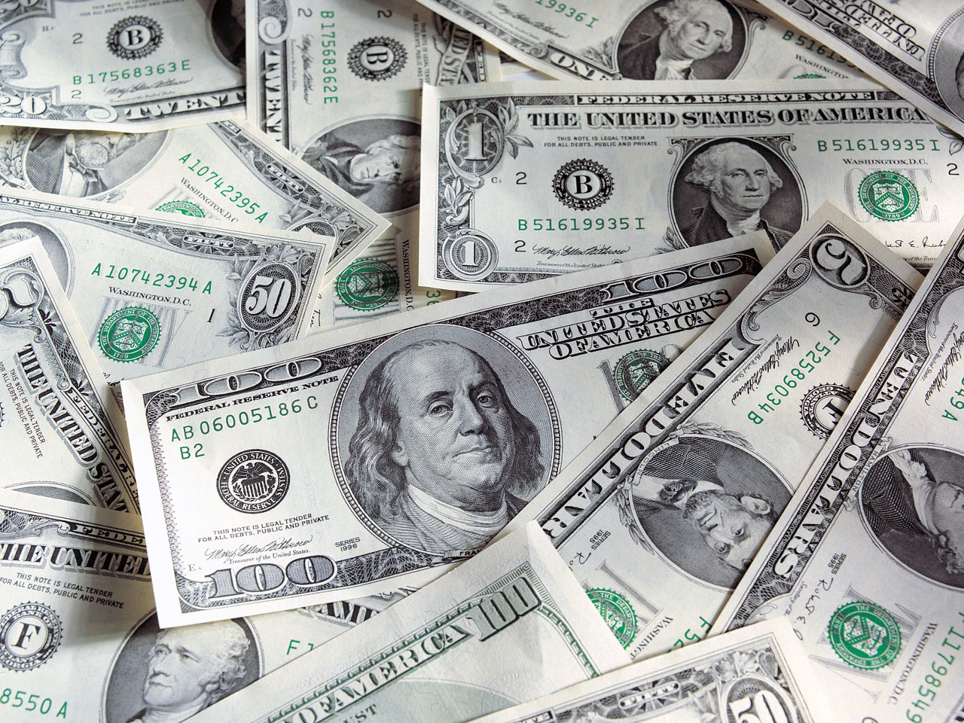
Currency
Currency is paper money, like our dollar.
At times in our history our currency has been backed by gold or silver.
However, now our money is fiat money, called a Federal Reserve Note.

Slide 4
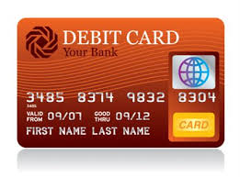
New Types of Money
Currently, we also use electronic forms of money, like a debit card used to access a checking account.
Credit cards are not considered money, but a loan from a short term loan from a credit card company. They have a monthly payment with interest.

Slide 5
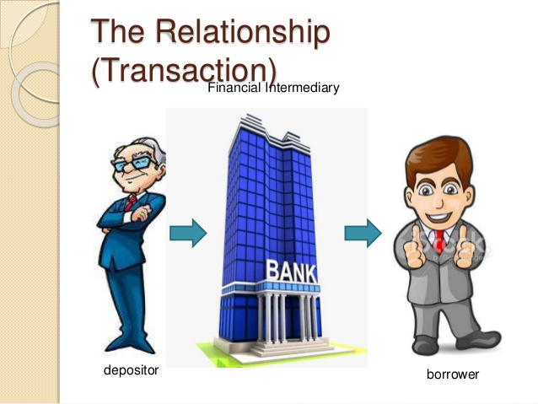
Banks
Banks are called financial intermediaries because they take money from their depositors and make loans to borrowers.
Credit Unions and Savings and Loans play a similar role to banks.

Slide 6

Banks
A Safe Place for Money
The Federal Deposit Insurance Corporation insures depositors money up to $250,000.
This includes insurance for checking accounts and CD’s, but not stocks.
This government system began in the 1930’s after many people lost their savings due to bank failures.

Slide 7
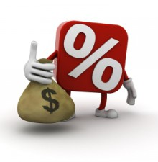
The Interest Rate:
The Price of Money
The price of money is the interest rate.
Depositors are paid interest for their savings accounts or CD’s.
Borrowers pay the bank interest when they take out a loan.
Banks make money by the difference between the two rates.

Slide 8
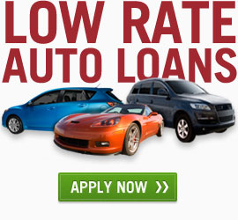
Your Auto Loan
If you borrow money to buy a car you will pay back the bank or loan agency each month.
You will pay a portion of the principle (the total amount of the loan divided by the months of the loan)
In addition, you will pay interest to the bank for the loan. The amount of interest you will pay depends on your rate.

Slide 9

Creating An Affordable Monthly Car Payment
You can make your monthly car payment affordable by:
Purchasing a less expensive car.
Putting a larger down payment on the car
Spreading payments over a longer period.
Getting a low interest rate

