Slide 1
International Trade
Chapter 17
Is Trade Beneficial?
The Great Debate:
Free Trade versus Protectionism

Slide 2
What do countries trade?

Slide 3
Why do countries trade?
Not all countries have the same natural resources, products or technology.
Trade allows countries to import raw materials or to buy goods which may be produced cheaply in other countries.
Trade also allows countries to sell products to other nations, increasing their GDP.

Slide 4
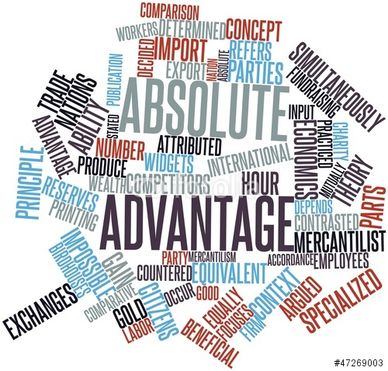
Absolute Advantage
Each country has an absolute advantage in certain products, meaning they can produce them more efficiently.
For example, Saudi Arabia has a absolute advantage in oil, China in making toys, and the US in the production of wheat.
These efficiencies may be due to technology, natural resources, climate, or labor costs.

Slide 5
Comparative Advantage
19th century economist David Ricardo argued that trade was beneficial, even for a country has absolute advantage in several areas.
He argued a country should specialize in what it does best, and trade with other nations for other goods.

Slide 6
Global Trade

Slide 7
Trade Terms
Export – good or service sold to another country
Import – good or service purchased from another country
Import tariff – a tax on an imported good
Import quota – a limit on the quantity of a product that can be important
Trade deficit – when the value of a country’s imports is higher than exports
Trade surplus – when the value of a country’s exports is higher than imports

Slide 8
Free Trade versus Protectionism
Free Trade
Protectionism
The idea that countries benefit from trading with other nations.
The policy of trading with other nations without restrictions, tariffs, or quotas.
The concept that a nation has an “open economy.”
Protectionism is the idea that protecting the home market is necessary because other countries take advantage of a country while trading.
The policy of using tariffs or quotas to restrict trade.
The concept of protecting domestic workers and industries in the face of foreign competition.

Slide 9
The Debate Over Trade
Benefits of Trade
Problems with Trade
Countries trade for products they don’t have
US producers profit from exports
US Consumers benefit from lower prices of foreign products
Countries specialize at what they are most efficient at producing
Low labor costs in other countries, undercuts wages and employment in home country.
Cheap imported goods, drives domestic industries bankrupt.
Countries become dependent on other nations.

Slide 10
Free Trade Movement
World Trade Organzation
1947 countries signed GATT agreement to lower tariffs and do away with import quotas.
The World Trade Organization (WTO) replaced GATT

Slide 11
WTO countries in Green

Slide 12
Free Trade Movement
North American Free Trade Agreement
NAFTA is an agreement signed in 1993 to lower tariffs and quotas between Canada, the US, and Mexico
The purpose is to increase trade among the three North American nations.

Slide 13
Free Trade Movement
The TransPacific Partnership (TPP)
The Trans Pacific Partnership is a new trade agreement signed by 12 Pacific nations and Asian nations.
The TPP is supported by the President, but has not been approved by Congress.
All three remaining Presidential candidates oppose the TPP.

Slide 14
TPP Countries

Slide 15
Exchange Rates and International Trade
When countries trade or travel they have to exchange currencies.
If the US buys a Japanese car, they have to exchange dollars for Yen.
The price of another currency is called the exchange rate.
Most exchange rates fluctuate over time.

Slide 16
Strong and Weak Currencies
The strength of a currency has to do with the demand for a nation’s products.
The price of a currency increases when other nations demand their products. This is called a strong currency, or an appreciating currency.
Those nations which do not produce goods desired by other nations, have a weak or depreciating currency.

Slide 17
Take A World Tour
Summer is almost here and I am sending you on a trip.
You’ll tour 10 spots around the world. I’ll give you hints where you are going.
I’ll tell you how much you are spending in each country’s currency.
You’ll have to exchange your dollars for the local currency and calculate your total budget in dollars.

Slide 19
Major Exporters and Importers

Slide 20
US Trading Partners - Exports

Slide 21
US Trading Partners - Imports

Slide 22
Trade Deficit

