Slide 1
Business Organizations
Chapter 3

Slide 2

Sole Proprietorships
The most common form of business organization in the US is the sole proprietorship.
This is a business owned and run by one person.
It is the easiest form of business to start because it has very few requirements.

Slide 3

Partnerships
A partnership is a business owned by two or more people.
Partnerships are relatively easy businesses to start.
Partners usually decide at the beginning if profits will be divided equally.
In limited partnerships, one person may not be involved in running the business, although they may have given funds to finance the business.

Slide 4
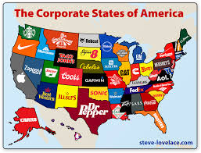
Corporations
A corporation is a company owned by many people.
If a business decides it wants to incorporate, it issues stocks to its shareholders.
This new business is recognized by law as having the same rights as an individual.

Slide 5
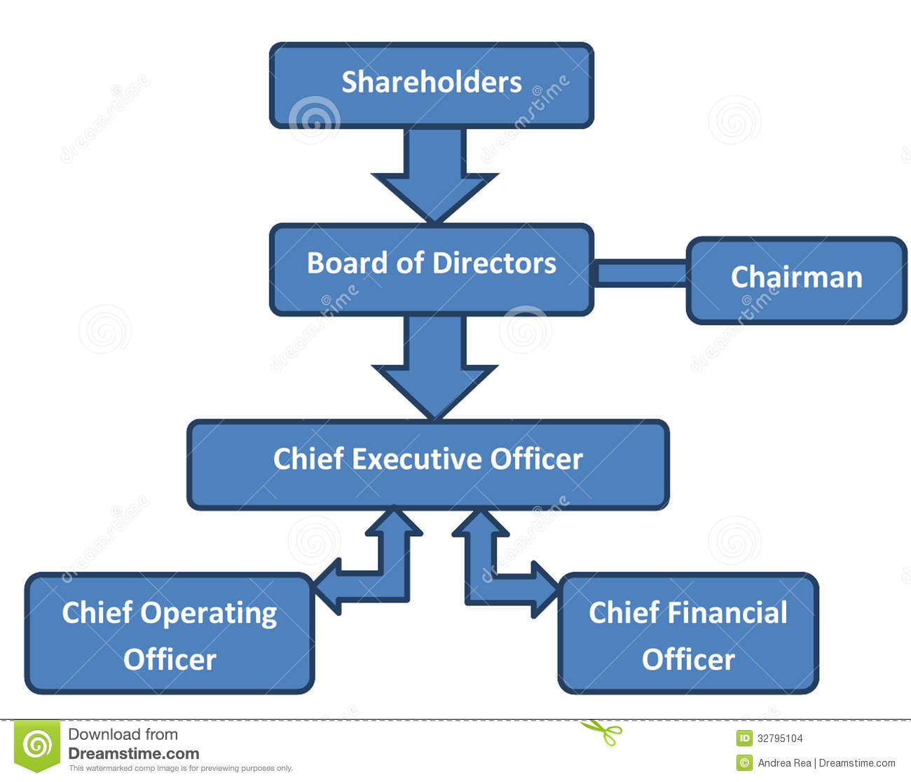
Corporate Structure
Shareholders own the company with stock. People who own common stock get to vote on company policy.
The Board of Directors selects the President of the Company
The President hires the management of a corporation

Slide 6
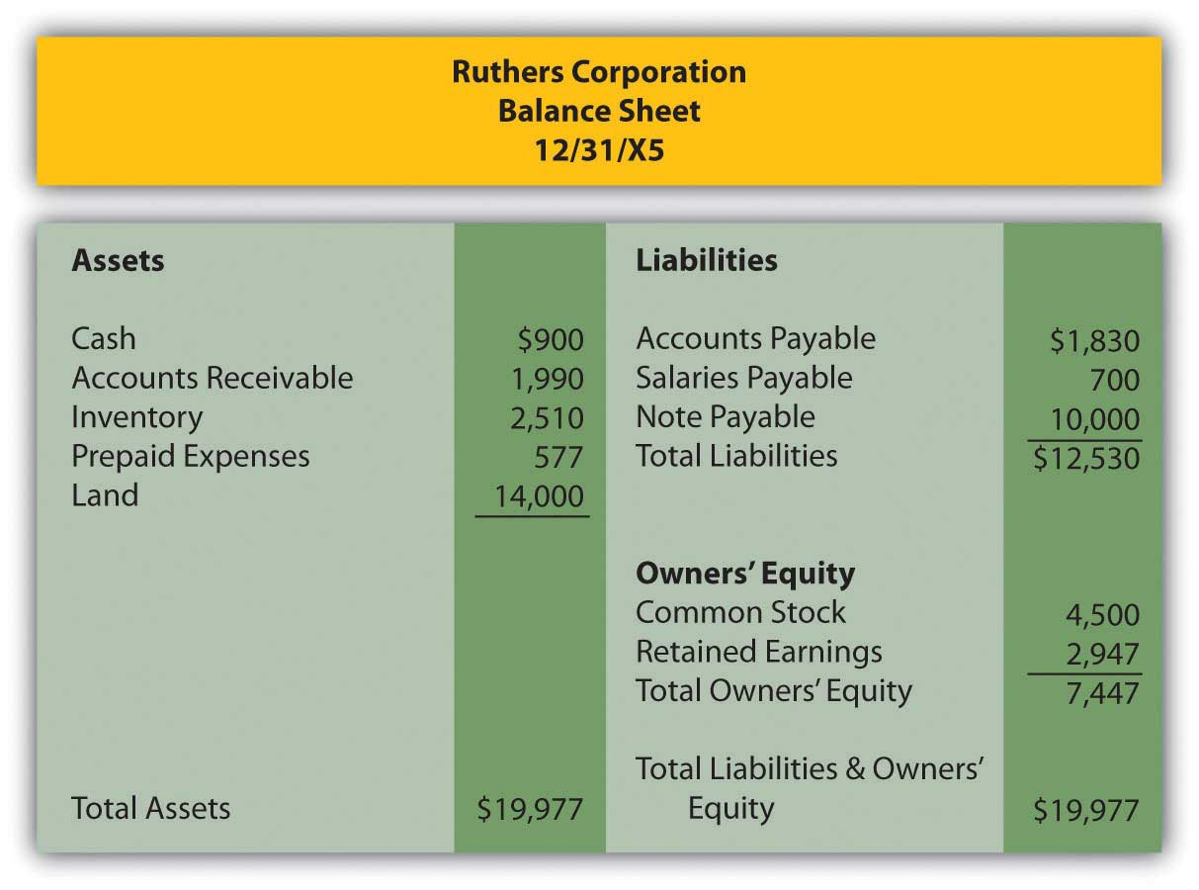
Business Growth
Businesses have expenses, such as paying for raw materials, buildings, labor costs, tools, advertising etc.
Businesses earn income from selling their products or services.
After all their expenses are paid, a business earn a net income or profits. (income – expenses = net income)
Profits may be reinvested in the company or dispersed to stock holders as dividends.

Slide 7
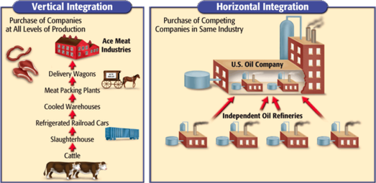
Mergers
Businesses sometimes grow by merging with other companies.
A horizontal merger is when two firms, creating the same product, join together.
A vertical merger is when a company buys businesses, which have raw materials or goods used in their product.
A conglomerate is when a businesses buys companies that sell completely different products.

Slide 8
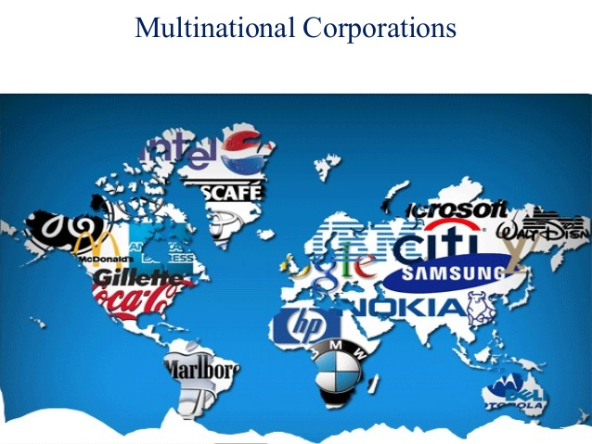
Multinational Corporations
A multinational corporation is one that makes products in different countries.
Multinational companies have grown in recent decades as companies seek to manufacture in low wage and low tax countries.
In addition, multinationals want to expand their markets, by selling their products or services in many different countries.

Slide 9
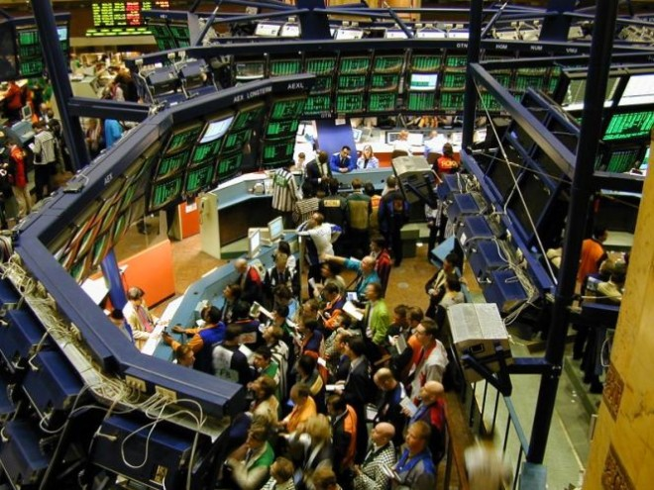
The Stock Market
The Stock Market is a place where shares of companies are bought and sold.
There are stock markets in many major cities, like the New York Stock Exchange.
Stock prices go up and down each day, depending upon how well a company is doing.
The Dow Jones Industrial Average, or Dow, is the average stock value of 30 major US stocks.

Slide 10
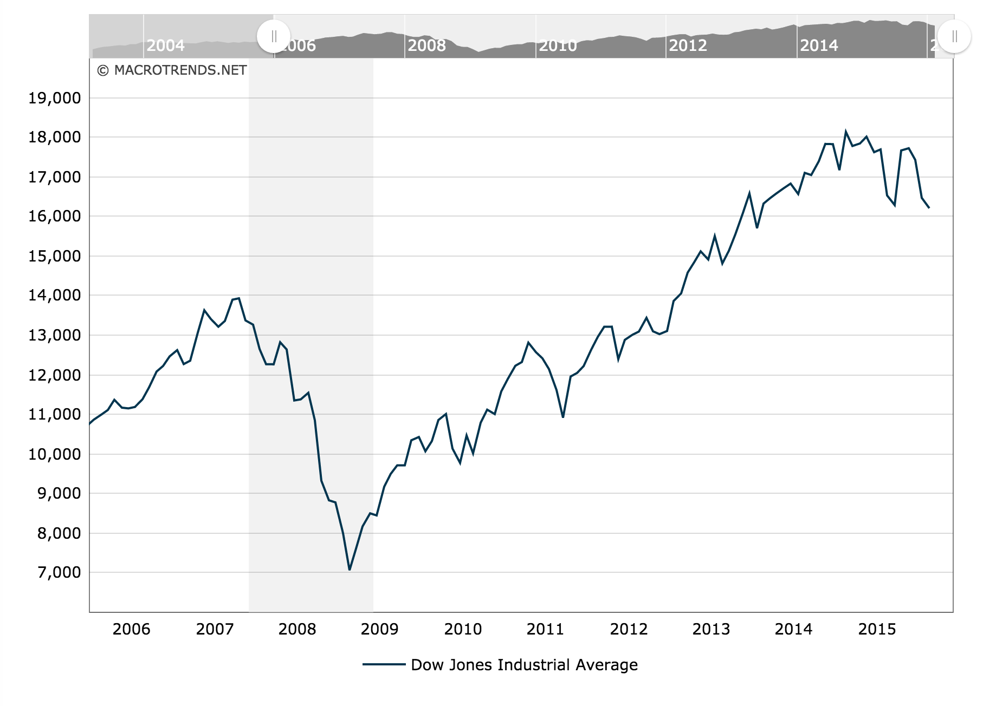
Changes in the Dow

Slide 11
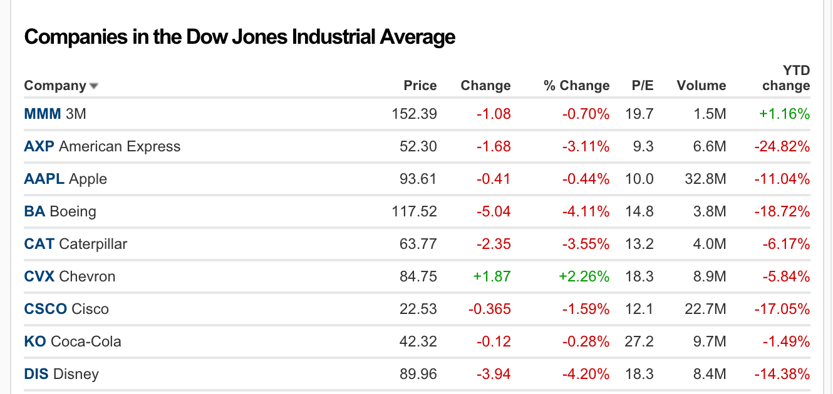
How To Read the Stock Market
Each Stock has a symbol
For example, AAPL is Apple
The Price of a stock is how much that sold for on that day.
The change is whether the price has gone up or down that day.
The exchanges post the YTD or year to date changes.
The volume is the number of shares traded.
The PE ration is the amount the price of tte stock in relationship to its earnings.

Slide 12
Reading a Stock Page

Slide 13
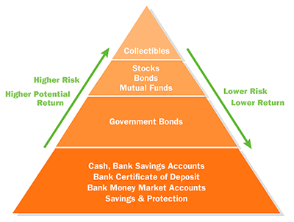
Should you invest in stocks?
Before you decide to invest in the stock market, let’s ask a few questions.
Do you have enough income to cover you food, shelter, clothing, and education?
If you have enough money to cover the basic necessities, then you might think about investing additional money.
Stocks can be high reward, but they are also high risk. Spend a little time on the Mint website, looking at investment alternatives.

Slide 14

Non profit organizations
While the majority of economic business function for profit, there is also a wide array of nonprofit organizations
These organizations function for their members.
For example, many community agencies, such as the Red Cross, are non profit.
Food coops provide low cost food to their members as well.

Slide 15
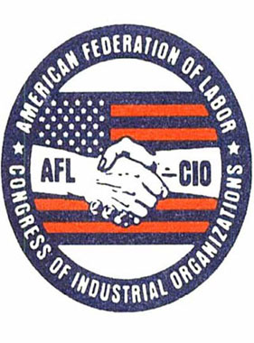
Labor Unions
Labor Unions are organizations designed to protect the rights of workers and improve their living conditions.
A union engages in collective bargaining with employers, to insure fair wages, working conditions and benefits.
About 11% of all US workers is unionized, but more in the public sector have unions than in the private sector.

Slide 16
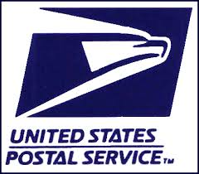
The Role of Government
As we have learned, our economy is not entirely a free market economy.
The US Government plays a direct role in providing goods and services, such as the US Post Office and the Department of Defense.
The US Government also plays an indirect role, providing payments to citizens such as social security and veterans benefits, and student loans.

