Slide 1
Basic Economic Concepts
Chapter 1:
Sections 1, 2, and 3

Slide 2
Economic Products
These are goods which are useful, scarce, and transferable to others.
Consumer goods, such as food and clothing, are designed for final use by consumers.
A capital good, or producer good, is a tool used in the process of production. For example, a hammer or robot.

Slide 3
Markets
A market is a place where goods and services are bought and sold. It may be a physical market like a store, or a virtual market like Amazon.com or the stock market.
We are most familiar with product markets, like the grocery store where food is sold.
A factor market is where productive resources, like land, labor, and capital are bought and sold.

Slide 4
Economic Growth
The goal of an economy is to grow by producing more goods and services.
Economic growth occurs due to the increase in productivity of labor.
There are several factors that can increase productivity: an efficient division of labor, use of machinery, and increases in the skills of workers.

Slide 5
The Market System and Adam Smith
Smith described the power of the market system in his book, The Wealth of Nations, published in 1776.
He argued that nations become wealthy through specialization.
He favored free trade among nations and limiting government interference in the market, called laissez-faire.

Slide 6
Trade-offs
Scarcity means there are limited resources
Individuals face trade-offs, deciding how to spend time or money between competing items.
Companies face trade-offs, deciding which products to produce
Countries face trade-offs, deciding how much to spend on defense and how much on social programs

Slide 7
Scare Resource: Time
Imagine after dinner, you have 3 hours to spend on homework in your two toughest courses.
Math Homework | Economics Homework
3 hours | 0 hours
2 hours | 1 hour
1 hour | 2 hours
0 hours | 3 hours

Slide 8
Opportunity Costs
Economists describe opportunity costs as the value of the next best alternative. For example, for each hour you devote to math, you give up one hour to study econ.
A business may decide to make refrigerators and cars. The more production resources are used for refrigerators, the fewer resources are available for cars.

Slide 9
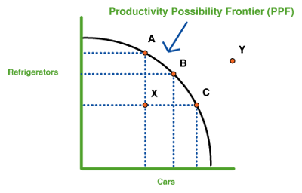
Production Possibilities Graph
A production possibilities graph is designed to show the different trade-offs.

Slide 10
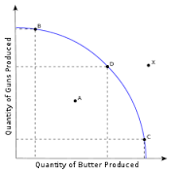
Societal Trade-Offs: Guns versus Butter
Societies also decide how to spend tax revenue. They may emphasize social services or military spending. Each dollar spent on one, is not available to the other.

Slide 11
Economic Growth
Economic growth occurs when the production possibilities moves out.
This can be due to increased population, more job training, or cheaper resources.

Slide 12
Cost Benefit Analysis
Economists use a tool, comparing the cost of a decision with the benefits received.
For example, some of you will go to college. There will be specific costs to attend, but your hope is that your future income and satisfaction will increase in the long run.
Others of you will go into vocational training or a job immediately after graduation. This will provide income immediately, an important benefit.
The answer will be different for each student, but a cost-benefit analysis is a good place to start.

Slide 13
Activity: The Costs and Benefits of College

