Slide 1
The Vietnam War
Famous Photos That Changed
American Public Opinion

Slide 2
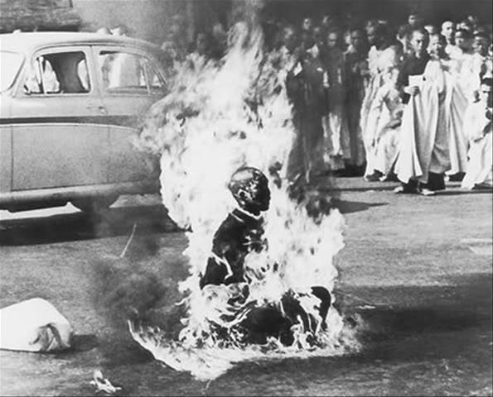
1963 - Buddhist Monk Burns Himself

Slide 3
1963 - Buddhist Monk Burns Himself
Monk kills himself, protesting the corrupt South Vietnamese leader Diem
Diem was killed by military officers

Slide 4
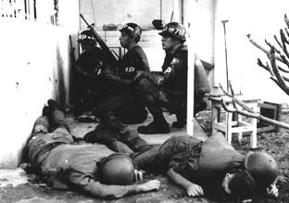
1968 - US Embassy Attacked

Slide 5
1968 - US Embassy Attacked
The US embassy was attacked during the Tet Offensive
This shook the US public’s confidence about a quick victory

Slide 6
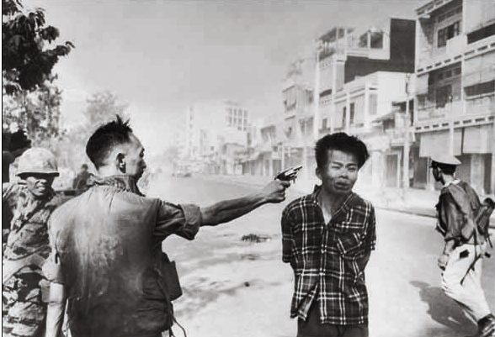
1968 - Execution of Prisoner

Slide 7
1968 - Execution of Prisoner
Saigon police chief executed this Viet Cong prisoner
Showed the brutality of our allies in South Veitnam

Slide 8
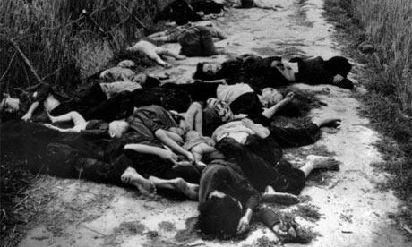
1968 - My Lai Massacre

Slide 9
1968 - My Lai Massacre
American soldiers killed 500 unarmed civilians
Lt. Calley was convicted but then paroled by Nixon

Slide 10
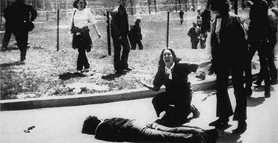
1970 - Protestors Shot at Kent State

Slide 11
1970 - Protestors Shot at Kent State
Kent State anti war protestors burned the ROTC building
The Ohio National Guard opened fire, killing 4 students and wounding 11

Slide 12
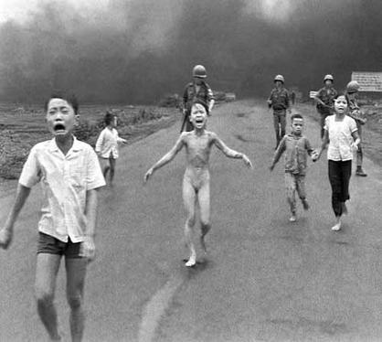
1972 - Napalm dropped on girl

Slide 13
1972 - Napalm dropped on girl
Nine year old girl photographed fleeing from napalm attack
Showed the innocent victims of war

Slide 14
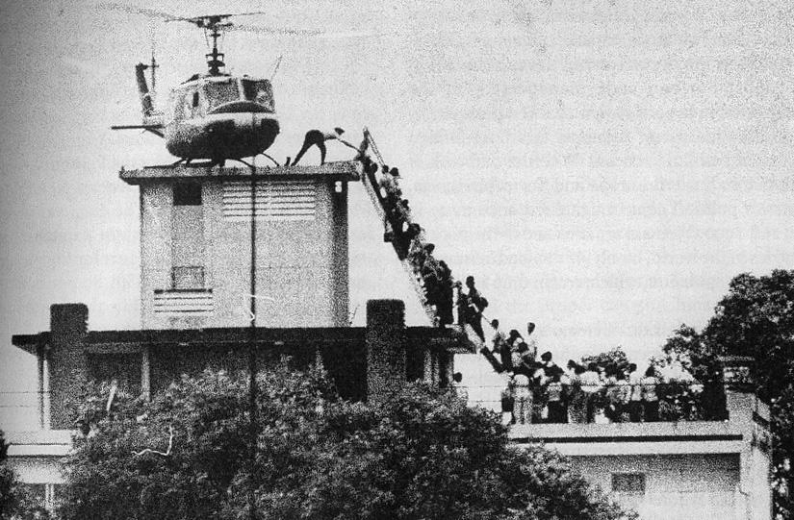
1975 - Saigon Falls to Communists

Slide 15
1975 - Saigon Falls to Communists
South Vietnamese evacuated by helicopter after the fall of Saigon to communists
Many South Vietnamese couldn’t escape.

