Slide 1
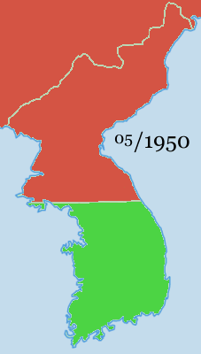
The Korean War
1950-1953

Slide 2
The division Of Korea
After WW II Korea became free from Japan.
Soviet troops stayed in the North and US troops stayed in the South.
In 1948 South Korea voted to be a democratic country.
The same year the Soviets put in a communist government in the North/
The United Nations divided Korea at the 38th parallel.

Slide 3
Korean Geography
On Your Map Label:
North Korea and South Korea
The capitols of North and South Korea
The Sea of Japan
The the 38th parallel?

Slide 4
The Korean War 1950 - 1953
Which side attacked the other first in 1950, the North or the South?
Label the two South Korean cities where US troops landed?
What do you notice about the fighting from 1951-1953?

Slide 5
The Korean War 1951-1953
What do you notice about the fighting from 1951 to 1953?
Label the Yalu River on your map.
On which parallel did the Korean War end?
Why do you think people call the Korean War a stalemate?

Slide 6
The Korean War Ends
In 1953 the North and South signed an armistice, ceasefire agreement.
Why do you think historians call the Korean War a stalemate?
Label the DMZ, demilitarized zone, at the 38th parallel.

