Slide 1
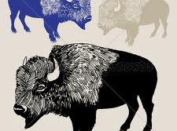
The Return of the
North American Buffalo
A Then and Now Project by Dave Forrest

Slide 2
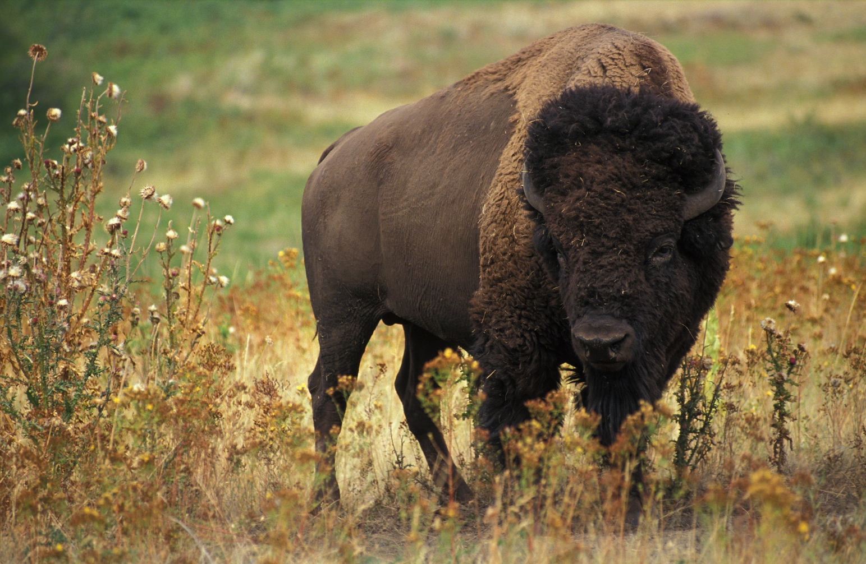
What happened to the buffalo?
In 1800 more than
60,000,000
(60 million) buffalo roamed the plains and prairies of the American West.
In 1894, the number was believed to be only
25.

Slide 3
History Mystery
What happened to the Buffalo?
Work in a team of 4 to find out.
Be sure to use the 4 L’s
Look at your team mate’s eyes
Lean toward your partner
Lower your voice
Listen Attentively
Use the pictures and writing in your folder to find 5 reasons the buffalo disappeared.
Be sure to discuss and agree on the 5 reasons.
Your team should write each reason with a full sentence.
We will have your team report to the class.

Slide 4
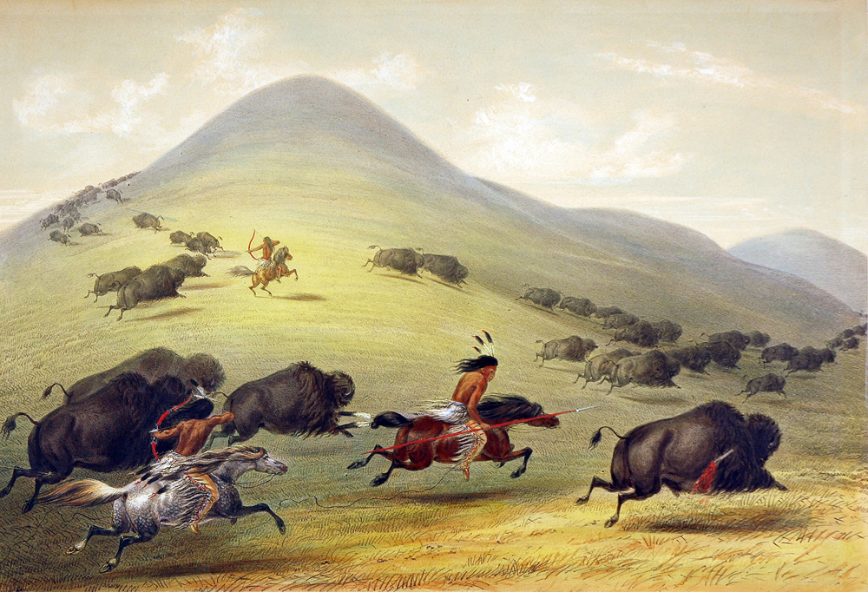
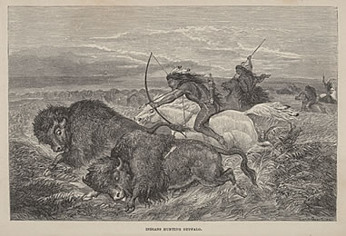
Native Americans and the Buffalo
.
Early in the 19th century an estimated fifty to seventy
million buffalo, also called bison, roamed America’s Great Plains.
Native Americans hunted bison for centuries, eating buffalo meat and using hides for clothing and tepees.
The Indians wasted nothing. The buffalo’s blood was used for paint, the bones for tools, and the droppings were burned as fuel.

Slide 5
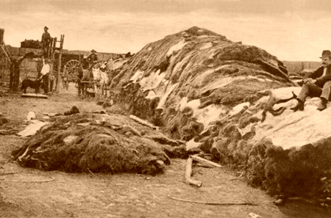
Traders and the US Military
Millions of buffalo were slaughtered by traders,
who sold buffalo hides for one to three dollars a piece.
The US military killed millions more in an effort to force
Native Americans off their hunting grounds and onto reservations.

Slide 6
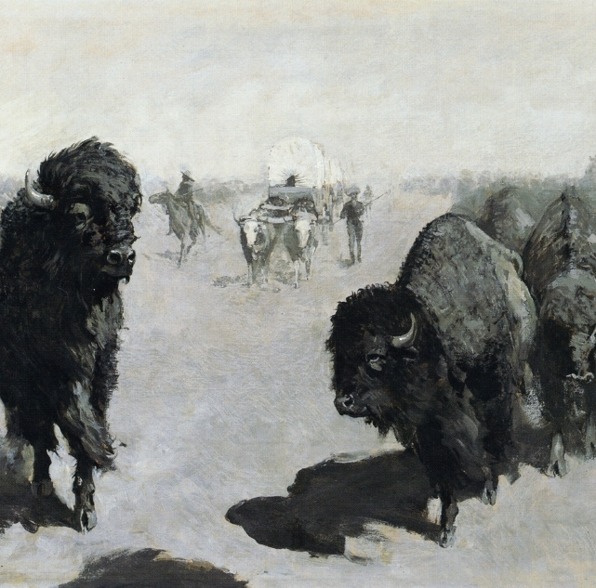
Farmers and Ranchers
After the Civil War white farmers and ranchers wanted tribal lands to grow crops and graze cattle.
They killed buffalo, as did railroad companies who used the meat to feed workers.

Slide 7
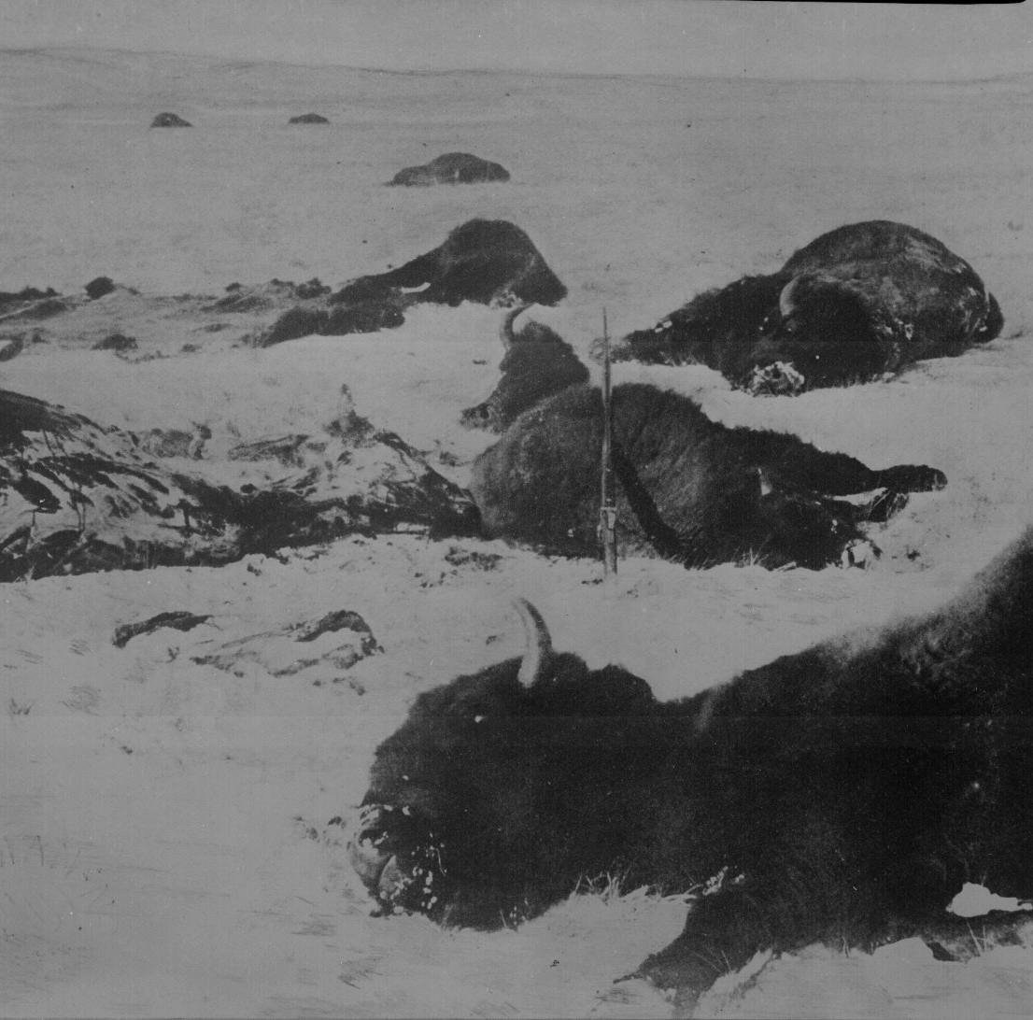
The Brink of Extinction
13 million buffalo were killed after the Civil War
In 1872 only seven million buffalo remained
By 1890 the North American buffalo was almost extinct
In 1903 there were less than 100 bison in the US

Slide 8
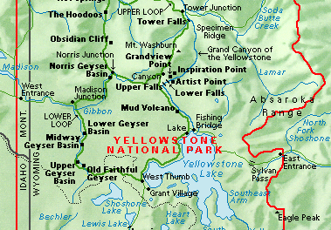
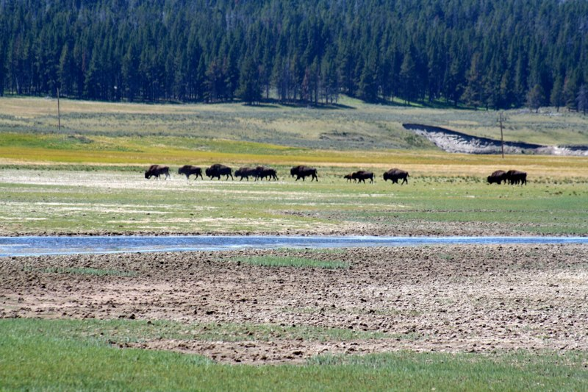
Buffalo Safe in Yellowstone
In 1902 a small herd of 23 bison found refuge in Yellowstone National Park.
In the park they were safe from hunters. This protected herd grew during the 20th century.
Today rangers estimate that the buffalo herds fluctuate between 2300-4500 bison.

Slide 9
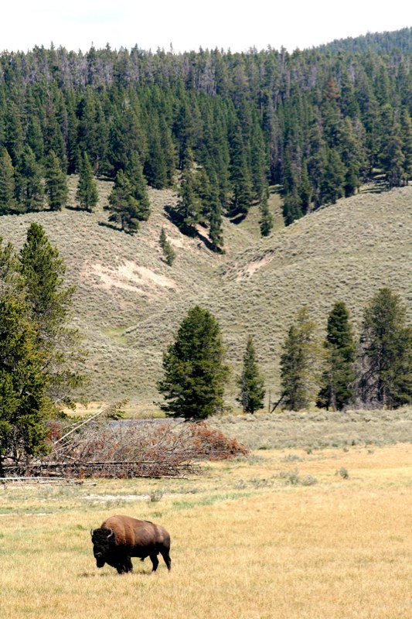
The buffalo are no longer an endangered species.
Over 400,000 buffalo are raised each year on private ranches.
In addition, the first Yellowstone buffalo have been allowed to leave the park to roam on nearby grasslands.
The Sioux Indians welcomed the animals back to the wild, as did conservationists.

Slide 10
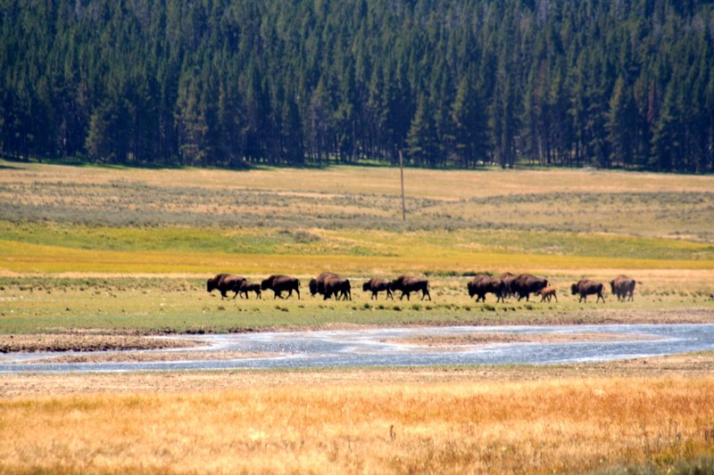
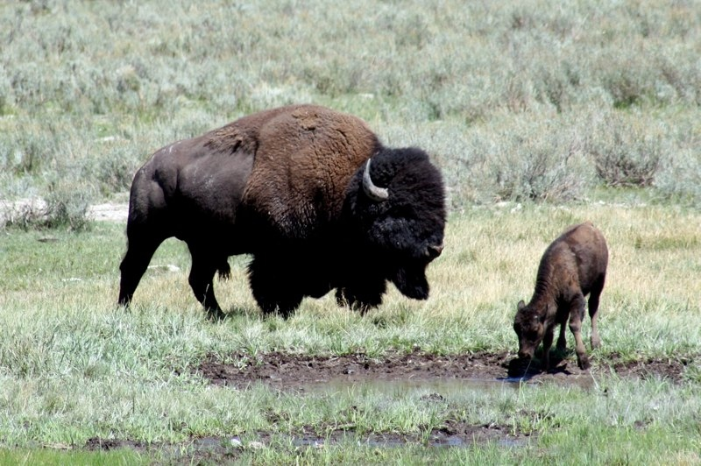
The Buffalo Are Back
However, farmers and ranchers in the region fear the bison will damage their fences, eat their crops, and compete with cattle for grassland, as they did a century ago.
It is not clear who will win the argument about if bison should roam freely, but one thing is for certain, the buffalo are here to stay!

Slide 11
Works Cited
“Buffalo Extermination,” Gale Encyclopedia of US Economic History. Ed. Thomas Carson and Mary Bonk. Detroit: Gale, 199. Gale Student Resources in Context, Web. 14 May 2012.
Downey, Matthew, American History 2, Chicago: McGraw Hill, 2006. Print
“FAQ About Bison,” Yellowstone National Park, National Park Service. Web. 15 May 2012. http://www.nps.gov/yell/naturalscience/bisonqu.htm.
Schweber, Nate, “As Bison Return to Prairie, Some Rejoice, Others Worry.” New York Times. 27 April 2012. All(L). Gale Student Resources in Context. Web. 14 May 2012.

