Slide 1
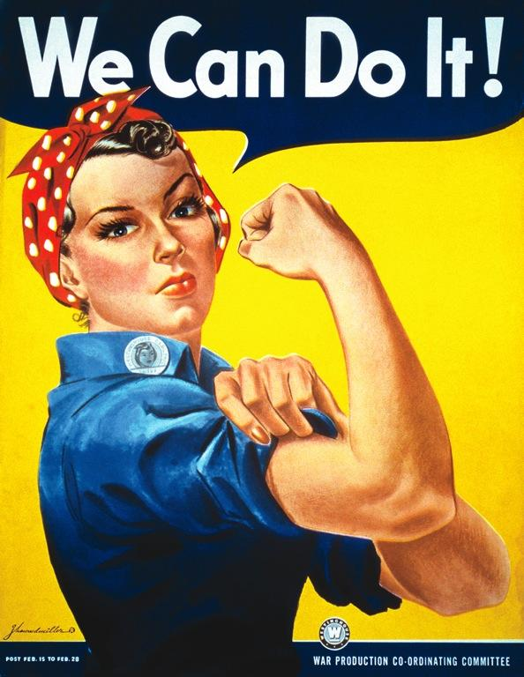
The Road to Women's Right
Created by: Navneet Maan and Daniela Martinez

Slide 2
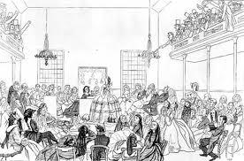
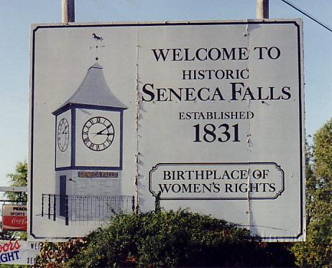
First Milestone- Seneca Falls Convention
The Seneca Falls Convention of 1848, was the first women's rights convention to be organized by women. With this convention, they drafted the Declaration of Sentiments, modeled after the Constitution, to declare that women had as much right to be treated equally as men were. With this, it exemplified that they had the right to cast a ballot. Other topics that they discussed about was, political, economical, and social. Women were stepping up to the plate and weren't afraid to show what they were able to accomplish. Luckily, in the early 1900's, there moment to shine had came upon.

Slide 3
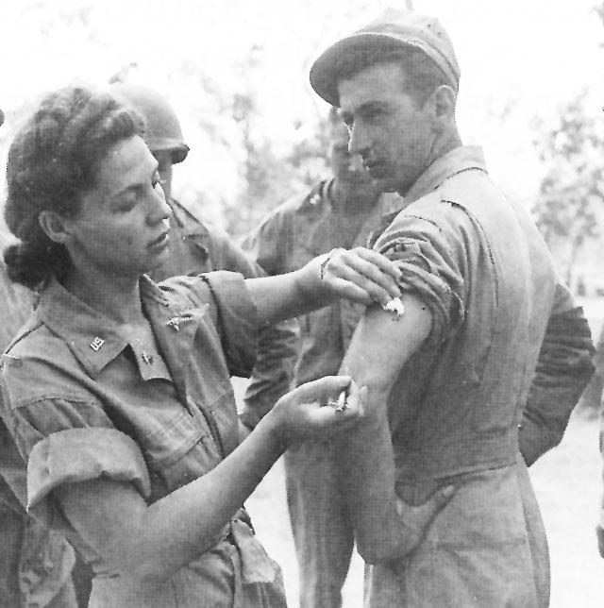
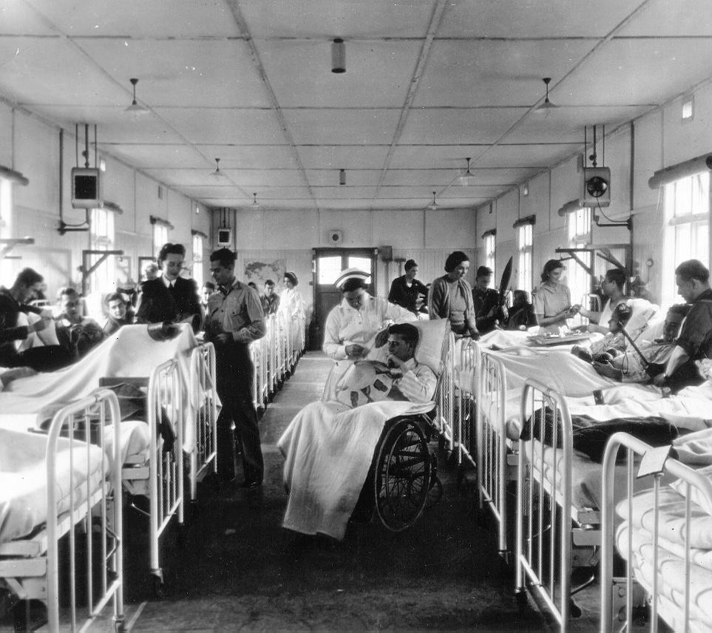
Women in War -Nursing
After the Seneca Falls Convention, women rose rapidly. Yet there moment to shine was an unfortunate one. World War One need everyone's support in the homefront. Women began to volunteer in the Red Cross, Army Nurse Corps. By 1918, 21,480 were serving on land and another 10,000 overseas. Only trained by basic medical care, not only did they accept the task of taking care of the soldiers, but they were often the last person the soldier would talk to. While a lot of people still saw this as a shock, the demand of women in the nursing field, made society accept it faster.

Slide 4
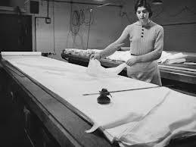
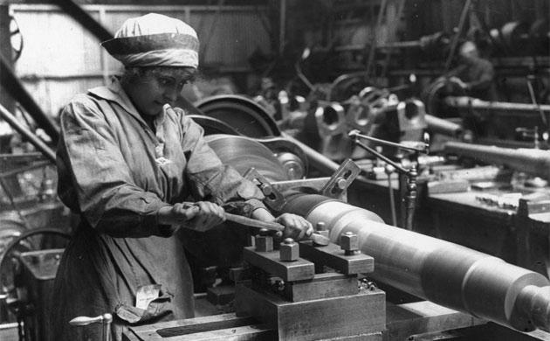
Women in War- Factory
To maintain the men supplied in war, women had to take factory jobs as well. Women has to work in ammunition factories, clothing factories and food factories. Without these essentials, then the war would not have been the same. As well allow more food to go to the soldiers, women used propaganda to make women around the United States to begin gardening vegetables and fruits to help out the war situation. America slowly opened to the idea that without the work of women, they could not continue the First World War.

Slide 5
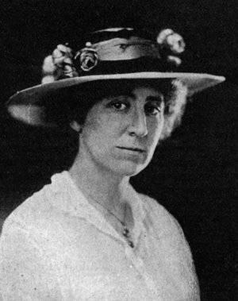
Women in War- Politics
Not only were women becoming socially and economically active, they as well were becoming active politically. Jeannette Rankin from Montana became the first women to be part of Congress. Jeanette Rankin was able to win a house seat from Montana on April 12, 1917. She voted against going to WW1 and WW2. With a feminist view, she brought compassion to the table and the view of a mother.

Slide 6
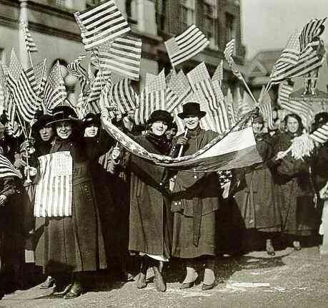
Winning the President
Women were devoted to the war efforts. They demonstrated this by boosting funds, selling war bonds, working in factories, and serving as nurses. Finally, in 1918, under the pressure of the NWP’s public efforts and the NAWSA’s lobbying, President Wilson agreed to support women suffrage and act upon it.. He supported the 19th Amendment to grant women suffrage. With recognizing the major impact that women suffrage had upon the war, he addressed it to the Senate. On August 26, 1920, women had won the war.

Slide 7
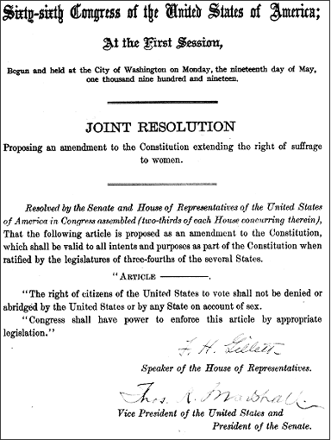
19th Amendment
"The right of citizens of the United States to vote shall not be denied or abridged by the United States or by any State on account of Sex."

Slide 8
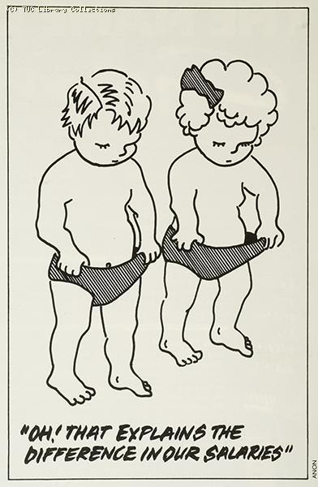
Equals Pay Act of 1963
The Equal Pay Act requires that men and women must the same pay for same work in their workplace. The job doesn't have to be identical, but they must be pretty equal. It is the job content, and not the job titles, that determine the line of equality.

Slide 9
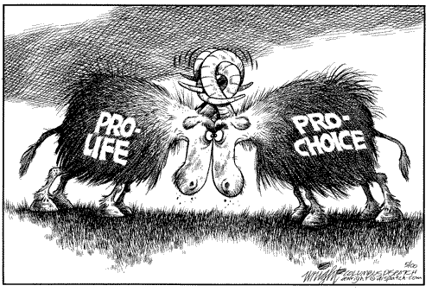
Roe V Wade
1970
Jane Roe was a unmarried and pregnant women from Texas.
During that time in Texas, it was illegal to abort an unborn child unless there was danger to the life of health of the mother.Roe fought the supreme court case and in the end the decision was made in her favor.
The supreme court ruled that women have the right of privacy and that such abortions were a "patient- doctor" basis

Slide 10
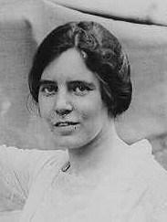
Equal Rights Amendments
The ERA was an amendment designed to guarantee equal rights to women. It was written originally by Alice Paul. It was essentially "freedom from legal sex discrimination" (the idea that men were superior to women)
The ERA passed both houses of congress and went to state legislatures and then failed to meet the required amount of ratifications and therefore was not adopted.
Alice Paul

Slide 11
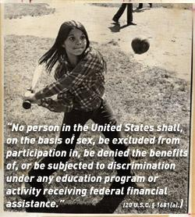
Title IX
Gender Equality in Education
Title IX, a groundbreaking statute intended to end sex discrimination in education, became the law of the land on June 23, 1972. It helped women in educational institutions find a spot where they belonged without a male telling her she couldn't do it.
While most famous for its requirement that schools provide girls with equal athletic opportunities, the law applies to all educational programs that receive federal funding, and to all aspects of a school's educational system.

Slide 12

Title VII of The Civil Rights Act
In 1964, Discrimination of all types was outlawed by the congress. Race, Ethnicities and sexes of all types were given equal rights it the workplace, and school. in the beginning of the outlawing of discrimination, it was weak act but soon grew to be a strong standing law. this helped tremendously in the women rights act because women were now given the same respect as men wherever they were.

