Slide 1
Miranda v. Arizona
Navjot Kaur, MC Nguyen, Cassandra Williams, Arveen Bahia, Jackie Yee

Slide 2
The Miranda Rights
"You have the right to remain silent. Anything you say, can and will be used against you in a court of law. You have the right to an attorney. If you can't afford one, one will be provided for you. Do you understand the rights I have just read to you? With these rights in mind, do you wish to speak to me?"

Slide 3
What is Miranda v. Arizona?
The 1966 supreme court case that ruled that detained criminal suspects must be informed of their constitutional right to an attorney and against self discrimination.
This became known as the Miranda Rights or Miranda warning.

Slide 4
What Happened
On March 2, 1963, an 18-year-old woman from Phoenix, Arizona claims she was abducted and raped in the desert.
Ernesto Miranda was one of the suspects, but wasn't picked out of the lineup and was still brought in for interrogation. The police left the interrogation room with a full confession and he was sent to prison. Miranda later recanted his statement because he was unaware that he didn't have to say anything at all. The Supreme Court overturned his conviction. But he was retried and convicted in October 1966. As a result, every person must now be informed of their rights when arrested.

Slide 5
Hearing Both Sides
Miranda:
The police violated the 5th amendment, the right to remain silent, and the 6th amendment, the right to counsel. Arizona ignored the Escobedo rule (evidence obtained illegally is not admissible in court) and the Gideon rule (the right to an attorney) in prosecuting Miranda.
Arizona:
Miranda signed the confession willingly, making the prosecution proper. The conviction was based on Arizona law and his imprisonment was just.

Slide 6
Court Hearing
In a 5-4 decision written by Chief Justice Earl Warren, the Supreme Court ruled that the prosecution's evidence could not introduced. Because the police had failed to first inform Miranda of his right to an attorney and to not self-incriminate himself, Miranda's confession could not be used. It is the police officer's duty to give these warnings compelled by the Constitution's Fifth Amendment, which gives a criminal suspect the right to refuse "to be a witness against himself," and Sixth Amendment, which guarantees criminal defendants the right to an attorney. As a result of the Supreme Court case the Miranda Rights were created in 1966.

Slide 7
Purpose of The Miranda Rights
The Miranda warning is intended to protect the suspect’s Fifth Amendment right to refuse to answer self-incriminating questions. It is a warning given by police in the United States to criminal suspects in police custody before they are interrogated to preserve the admissibility of their statements against them in criminal proceedings.

Slide 8
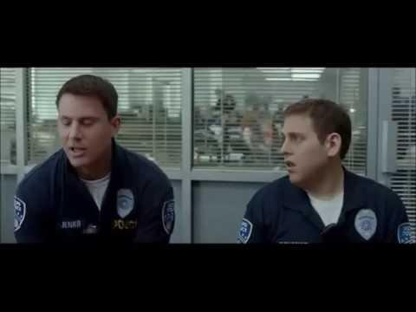
The Wrong Way To Do It...

Slide 9
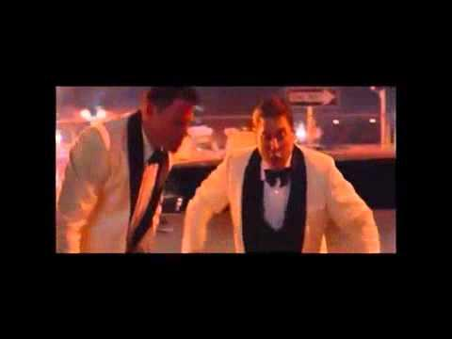
The Right Way to Do It...

Slide 10
Mini Quiz!
1. What Supreme court case established the Miranda Rights?
A. Miranda v. Ohio
B. Miranda v. Connecticut
C. Miranda v. Arizona
D. Miranda v. Forrest

Slide 11
Quiz (continued...)
2. What year were the Miranda rights established?
A. 1982
B. 1976
C. 1924
D. 1966

Slide 12
Quiz (continued...)
3. The Miranda rights are intended to protect the suspect's _______ amendment.
A. 1
B. 3
C. 5
D. 6
E. 5 and 6

Slide 13
Quiz (continued...)
4. Is it legal for a police officer to stop and ask questions without having told me my Miranda rights?
A. Yes
B. No
C. Idk
D. None of the above

Slide 14
Quiz (continued...)
5.True or false?
If an officer fails to read me my rights, will my charges automatically be dismissed?
A. True
B. False

Slide 15
Quiz Answers!
1. C
2. D
3. E
4. A
5. B

