Slide 1
Anthony Realin
APS Project
May 29, 2013
Forrest

Slide 2
Political Socialization
Political Socialization - The process by which people acquires political beliefs and attitudes.
Public Opinion - The aggregate of individual attitudes or beliefs shared by some portion of the adult population.

Slide 3
Education
Education as a Source of Political Socialization. From early days of the republic, schools were perceived to be important transmitters of political information and attitudes. Children in the primary grades learn about their country mostly in patriotic ways. They learn about the Pilgrims, the flag, and some of the nation’s presidents. They also learn to celebrate national holidays. Later, middle grades, children learn more historical facts and come to understand the structure of government and the functions of the president, judges and Congress. By high school, students have a more complex understanding of the political party, and may take positions on issues.
Generally, education is closely linked to party participation. The more education a person receives the more likely it is that the person will be interested in politics, be confident in his or her ability to understand political issues and be an active participant in the political process.

Slide 4
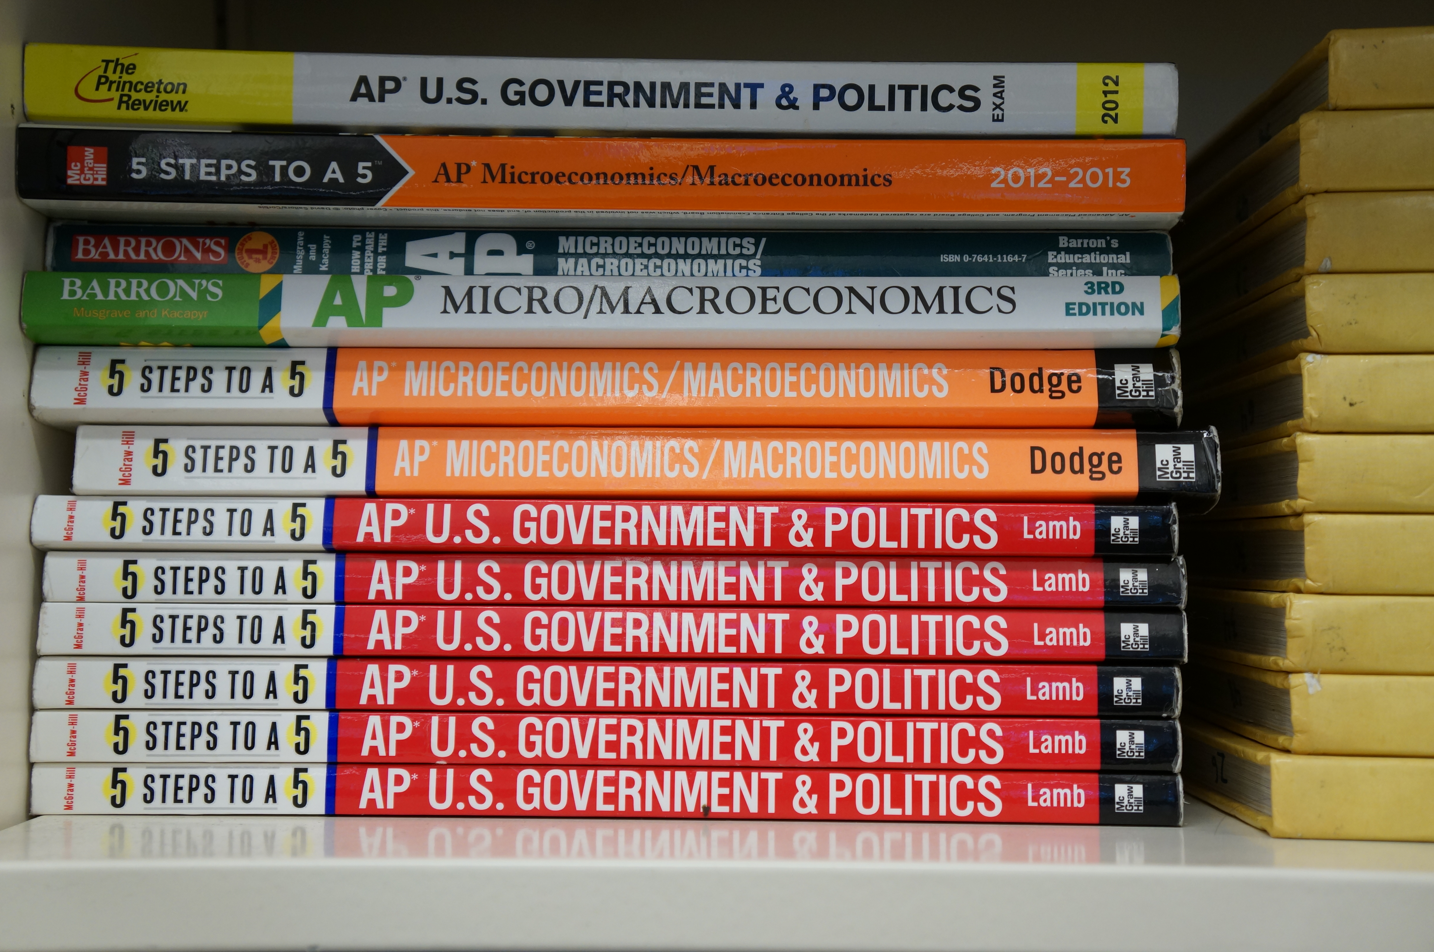
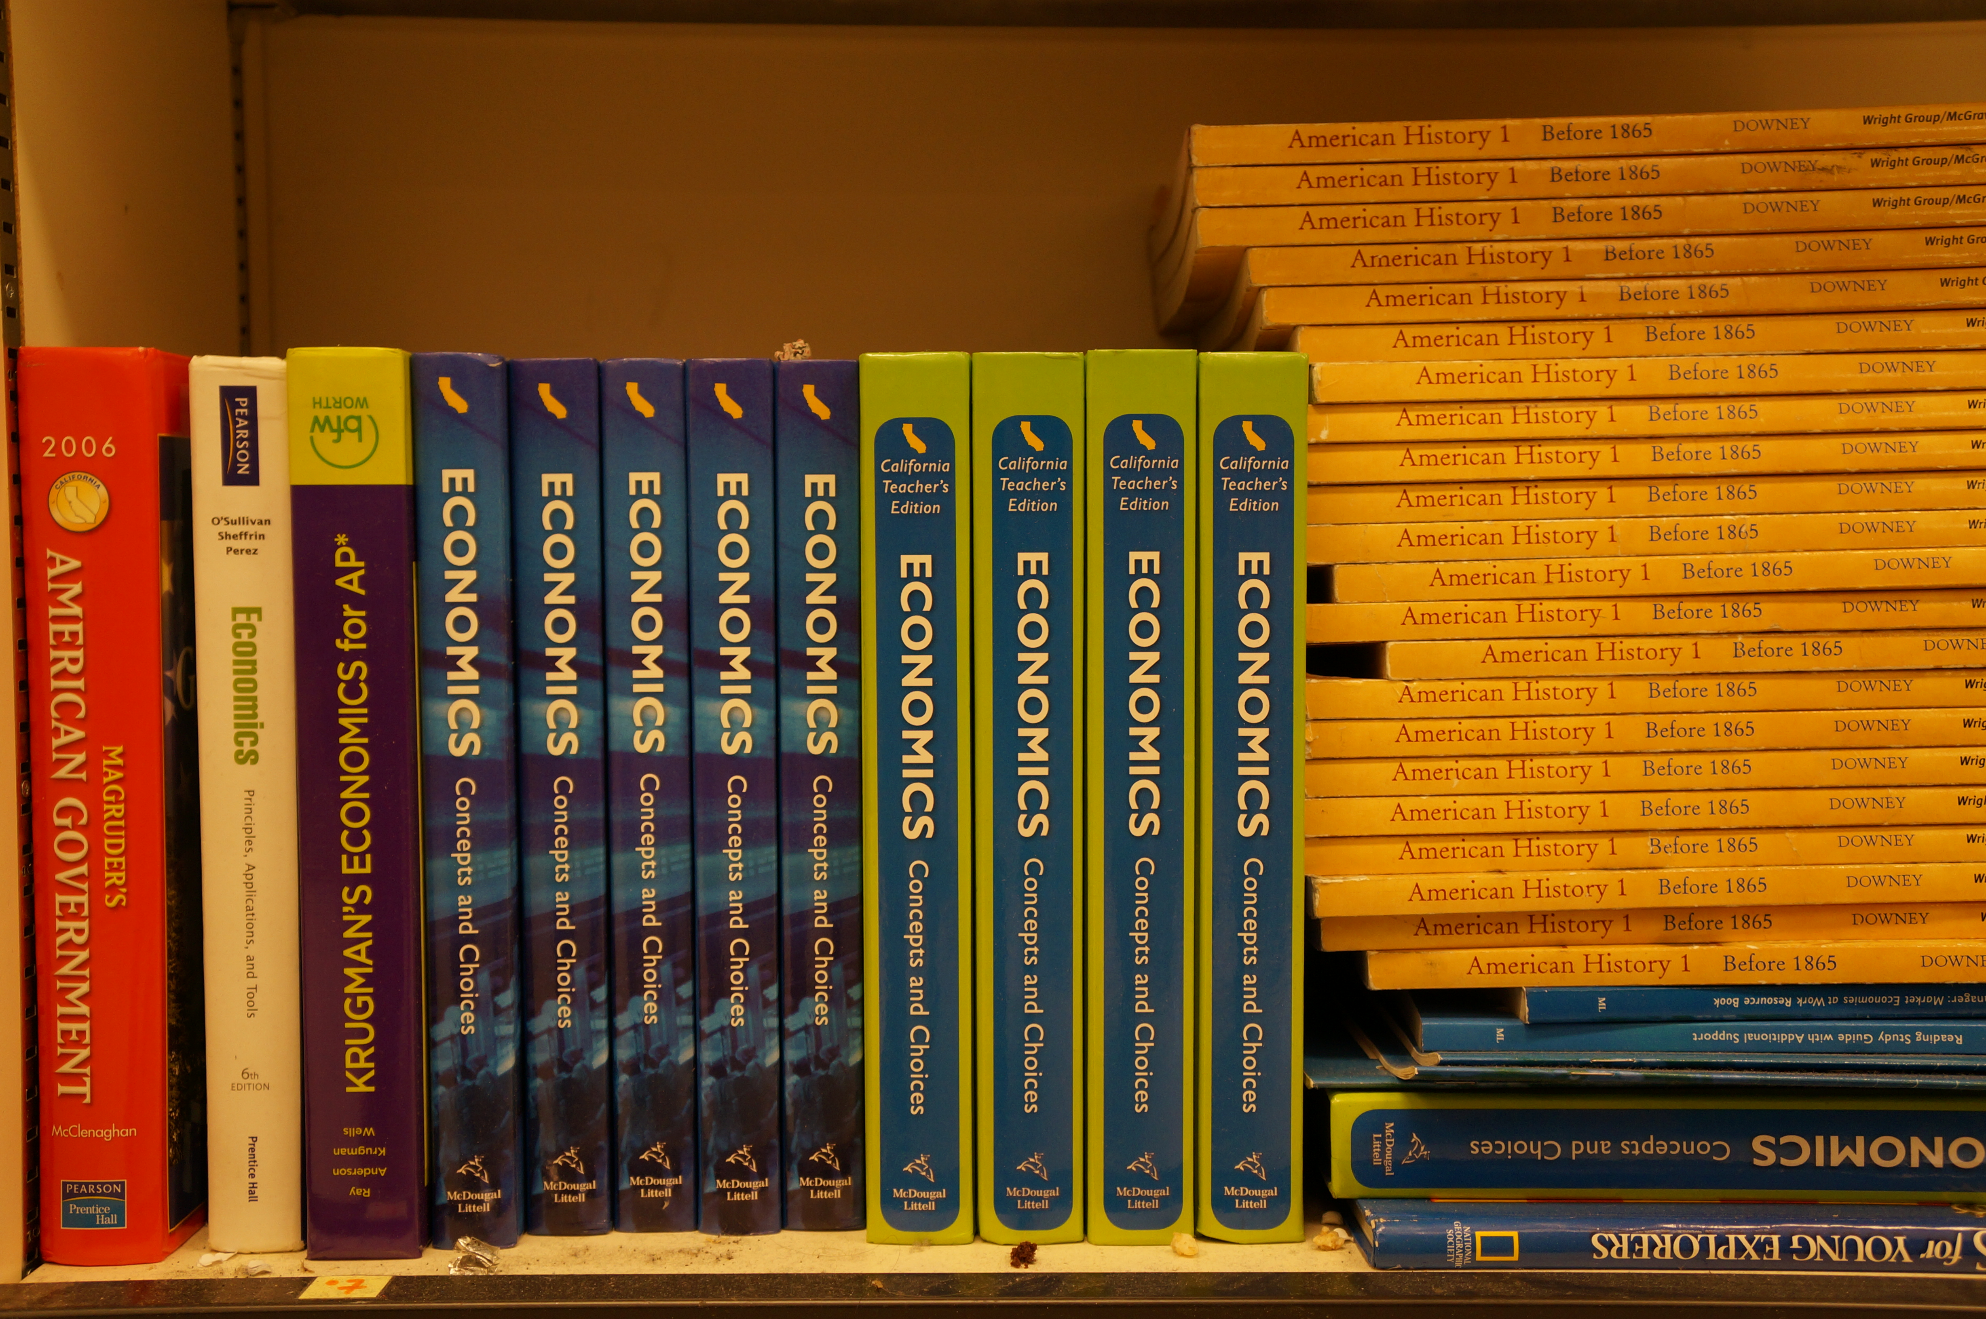
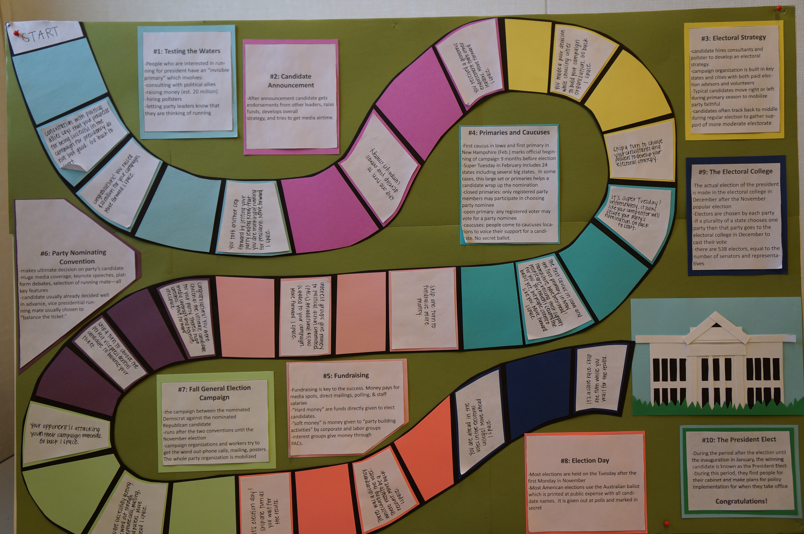

Slide 5
Peers and Peer Group Influence
Peers and Peers Group Influence. Once a child enters school, the child’s friends become an important influence on behavior and attitudes. For children and for adults, friendships and associations in peer groups affect political attitudes. We must, however, separate the effects of peer group pressure on opinions and attitudes in general from the effects of peer group pressure on political opinions. For the most part, associations among peers are nonpolitical. Political attitudes are more likely to be shaped by peer groups when the peer groups are involved directly in political activities.

Slide 7
Media
Media plays a vital role in the political socialization process. Youth are exposed to multiple sources of media such as television, radio, music, newspapers, and magazines on a daily basis. This is because the media informs the public about issues and events of our times and thus an agenda-setting effect.

Slide 8
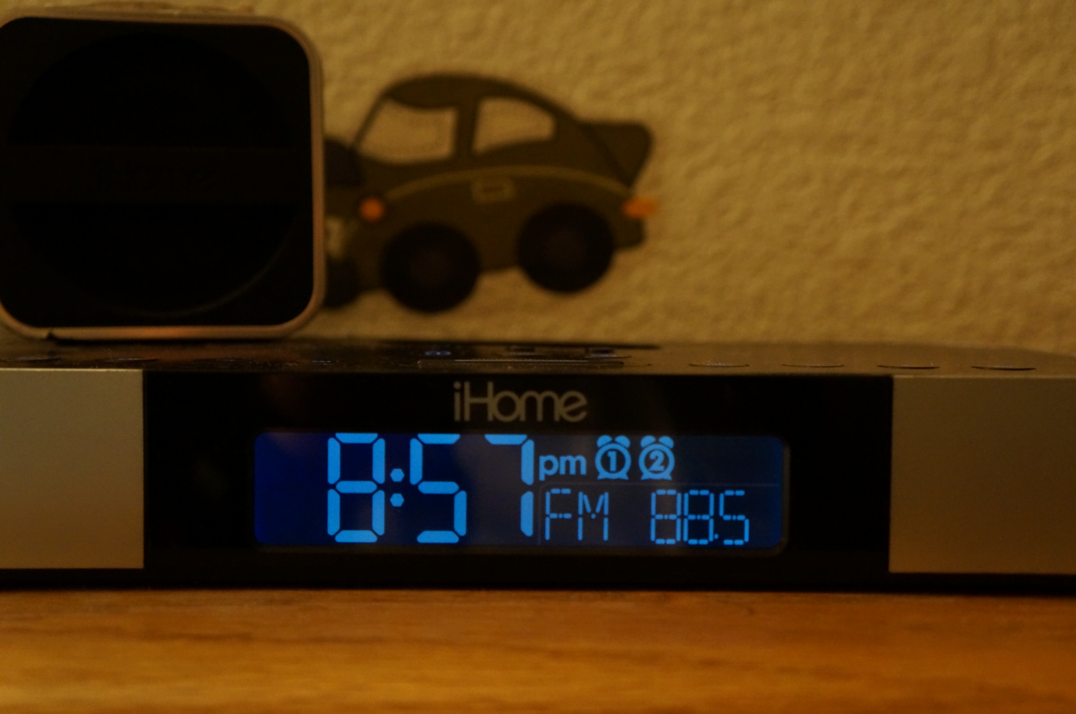
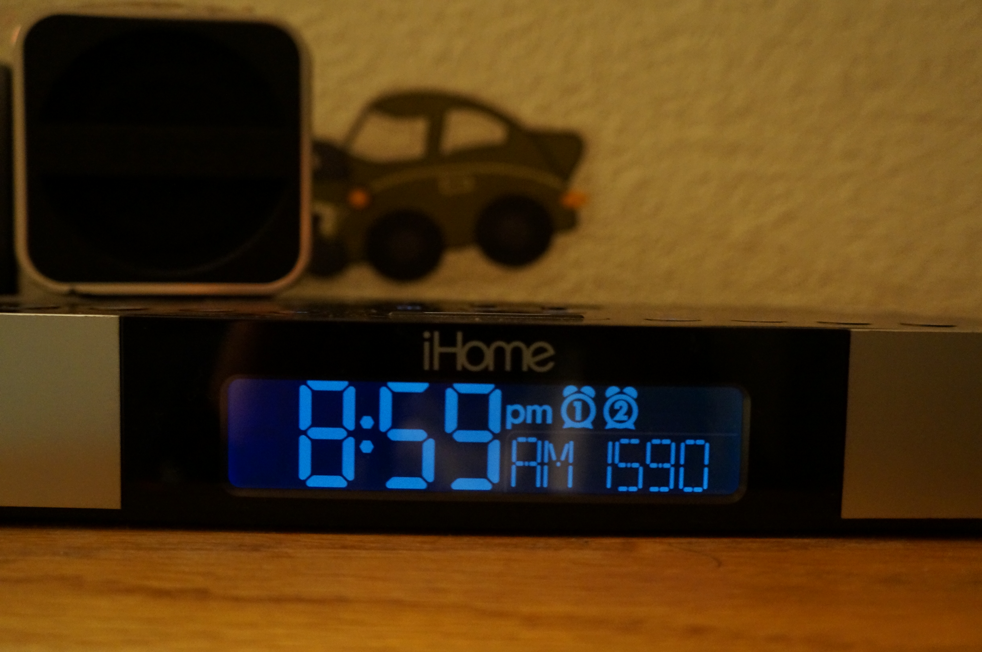

Slide 9
Opinion Leader’s Influence
Opinion Leaders’ Influence. Those with whom we are closely associated or whom we hold high regard- friends at school, family members and other relatives, and teachers influence us all. In a sense, these people are opinion leaders, but on an informal level; that is, their influence on our political views is not necessarily intentional or deliberate. Formal opinion leaders, such as the presidents, lobbyists, congresspersons, news commentators, and religious leaders who have as part of their jobs the task of swaying people’s views also influence us. Their interest lies in defining the political agenda in such a way that discussions about policy options will take place on their terms.

Slide 10
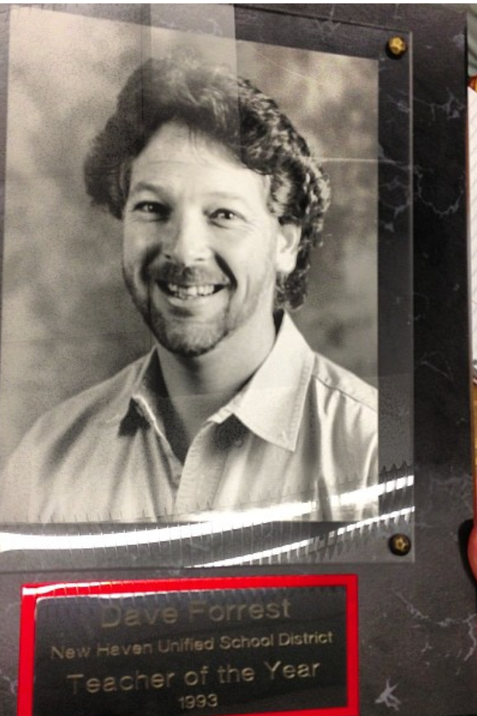

Slide 11
All come together to make Political Socialization

