Slide 1
AP Macroeconomics
Graphs in order to survive Mr. Forrest’s class
By: Martin Malimban
Class of 2013

Slide 2
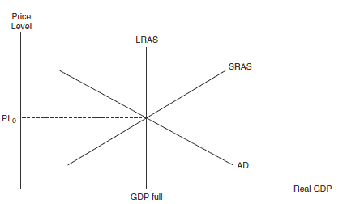
Basics
Modern Economics Graph
Gross Domestic Product (GDP): the total amount of goods and services produced in an economy over one year.
Nominal GDP: the current GDP in today’s prices
Real GDP (RGDP): Nominal GDP – Price Level Change from year to year = RGDP
Aggregate Demand (AD): Consumption (C) + Business Investment (I) +Government Spending (G) +Net Exports (NX) = Aggregate Demand
Aggregate Supply (AS): the total supply of goods and services that firms in a national economy plan on selling during a specific time period
Long Run Aggregate Supply Curve (LRAS): represents the economy running at “full employment” or the maximum level of income
- Equilibrium Price: The point at which the supply curve and the demand curve intersect indicates the equilibrium price and the quantity in a market

Slide 3
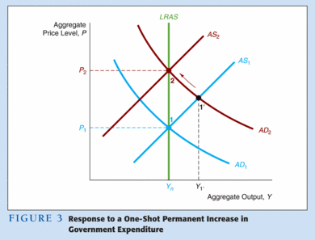
Increase/Decrease in Aggregate Demand
Increase in AD lead to an increase in price levels, however with the LRAS there is no change in RGDP
These increases are called, demand pull inflation
This type of inflation is common during period of economic expansions
Decrease in AD lead to lower price levels, however RGDP does not change
Decreases in AD commonly occurs during a contraction or recession

Slide 4
Increases/Decreases in Short Run Aggregate Supply Curve (SRAS)
The SRAS can shift when there are temporary efficiencies in capital, labor, and land
EX) Workers worker overtime (thus increasing the productivity of labor), Plants can run at more than 100% capacity, when they run at night
Increase in the SRAS
Decreases in the SRAS:
The SRAS curve shifts rightward when there is:
Labor working overtime
Introduction of more efficient technologies
The costs of land, labor, or capital declines.
The SRAS can also decline if:
Natural disasters disrupt the flow of resources
Any increase in the price of the inputs of production: land, labor, and capital
Any fall in the productivity or efficiency of: land, labor, or capital

Slide 5
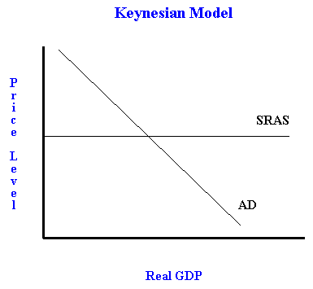
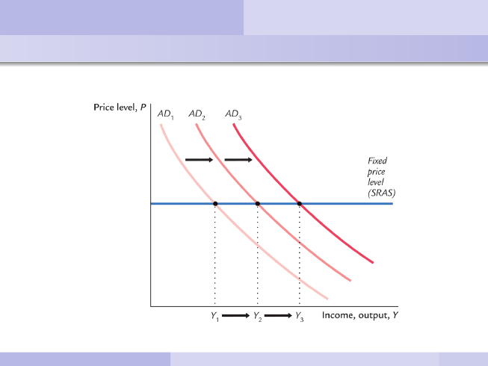
Keynesian Model (“Sticky Price” Model)
John Maynard Keynes argued that wages weren’t as flexible as the classical model suggested, due to labor union and contracts.
Changes in AD doesn’t necessarily change price
The horizontal portion of the supply curve where there is high unemployment and unused capacity
A leftward shift reduces RGDP creating unemployment
Any change in AD will change RGDP, thus it is demand determined
Price Level does not change

Slide 6
Inflationary Gap Graph
PL22
AD2
Y2
When Aggregate Supply is stable and Aggregate Demand increases, Price Level increases then, RGDP increases
The difference or gap between equilibrium is the inflationary gap

Slide 7
Recessionary Gap Graph
PL2
AD2
Y2
When Aggregate Supply is stable and Aggregate Demand decreases, price level and RGDP decline
The difference or gap between equilibrium RGDP at SRAS and equilibrium at full employment is called the recessionary gap

Slide 8
Cost Push Inflation Graph
SRAS 2
PL2
Y2
When inflation occurs because of supply
A decrease in SRAS causes Price Levels to increase

Slide 9
Demand Pull Inflation Graph
PL2
AD2
Y2
When inflation occurs because of demand
An increase in demand causes an increase in Price Levels

Slide 10
Keynesian Consumption function
Savings
Autonomous consumption
Consumption is above income
Dissavings
Autonomous Consumption: the part of consumption that is independent of the level of disposable income
45-degree Reference Line: the line along which planned real expenditures equal RGDP per year
Dissaving: (negative saving) a situation in which spending exceeds income

Slide 11
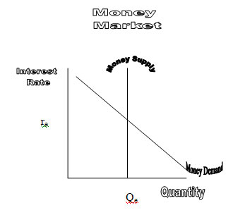
Money Supply Graph
Money Supply 2
r₂
Q₂
If Money Supply increases, then Interest Rate decreases and Quantity of Money borrowed increases

Slide 12
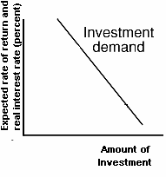
Contractionary Monetary Policy
i₂
i₁
(Interest Rate)
Investment
I₂
I₁
(Amount of Investment)
If interest rate goes up, then Investment goes down

Slide 13
Expansionary Monetary Policy
i₁
(Interest Rate)
i₂
Investment
I₁
I₂
(Amount of Investment)
If interest rate goes down, then Investment goes up

Slide 14
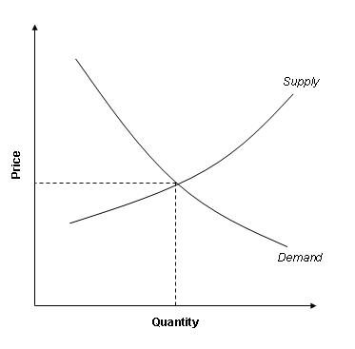
Graphing a tarrif (Domestic Cars)
PL₂
Q₂
If demand for domestic cars increase, then price levels and quantity of cars increase

Slide 15
Graphing a tarrif (Imported Cars)
PL₂
Q₂
If supply for imported cars decreases, then price level increases and quantity of cars decreases

