Slide 1
Die Soziale Marktwirtschaft
Antonio Castillo & Albert Tran

Slide 2
What is this?
Soziale Marktwirtschaft, or “Social Market Economy”, is a German form of market capitalism that rejects both laissez-faire economics and socialism.
Instead, the Social Market Economy is a “third way” between Democratic Socialism and Classical Economics.
It is also known as the Rhine Model or Social Capitalism

Slide 3
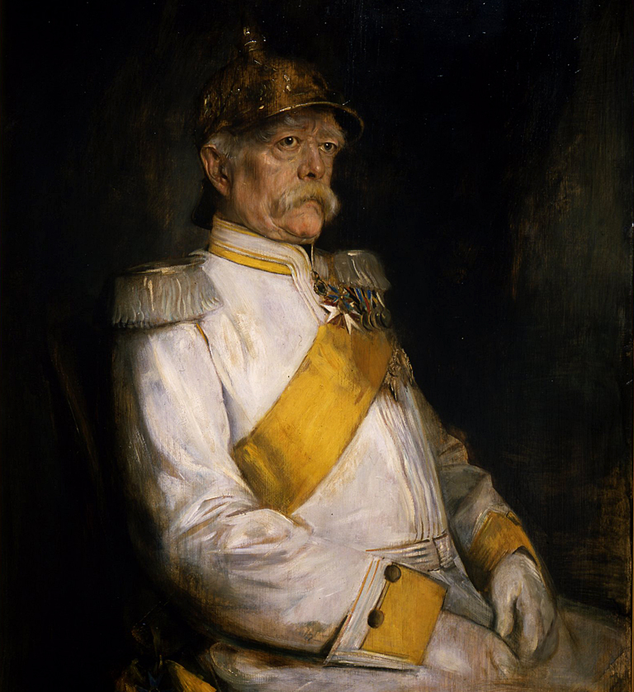
Origins: Otto Von Bismarck
Otto von Bismarck was a German chancellor from 1871 to 1890
Considered by many the father of modern Germany, his policies had a huge impact on German history and economics

Slide 4
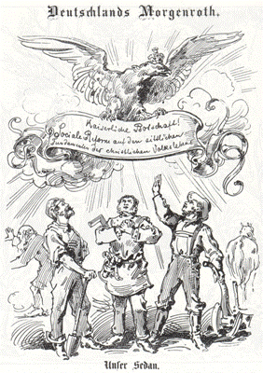
Bismarck’s Reforms
Rapid industrialization, coincided with the establishment of free trade and the liberalization of the German market.
The establishment of the first Welfare State, with healthcare insurance and a pension fund for German workers.
Suppression of “subversive” movements, like Socialism and Political Catholicism.

Slide 5
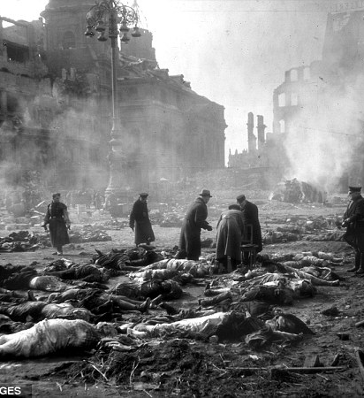
Fast Forward to 1945
Germany suffered a humiliating defeat after World War 2; millions of its people were dead and its cities lay in ruins.
The powerful Nazi institutions that laid its framework were now abolished and one-third of the country was now communist.

Slide 6
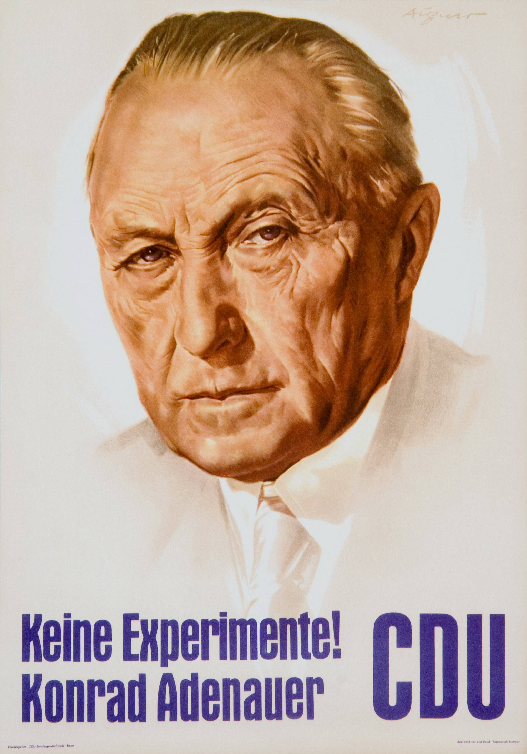
Christian Democratic Union
The CDU is a centre- right, Christian Democratic party that assumed the Soziale Marktwirtschaft as its economic platform.
Konrad Adenauer was the shrewd leader of the CDU and chancellor during their time in government.

Slide 7
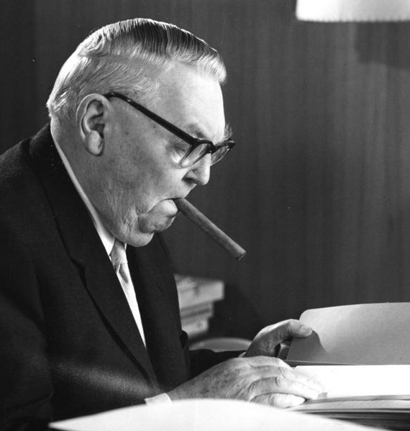
The mastermind
Ludwig Erhard was the Minister for Economics from 1949 to 1963; he later served as Chancellor from 1963 to 1966.
He was the brains behind the Social Market Economy

Slide 8
Two pronged
“Soziale”
“Marktwirtschaft”
A driving force behind the adoption of these policies in Germany was maintaining social stability.
Dedication to the free market, with pragmatic regulation.
Providing enough for each German.

Slide 9
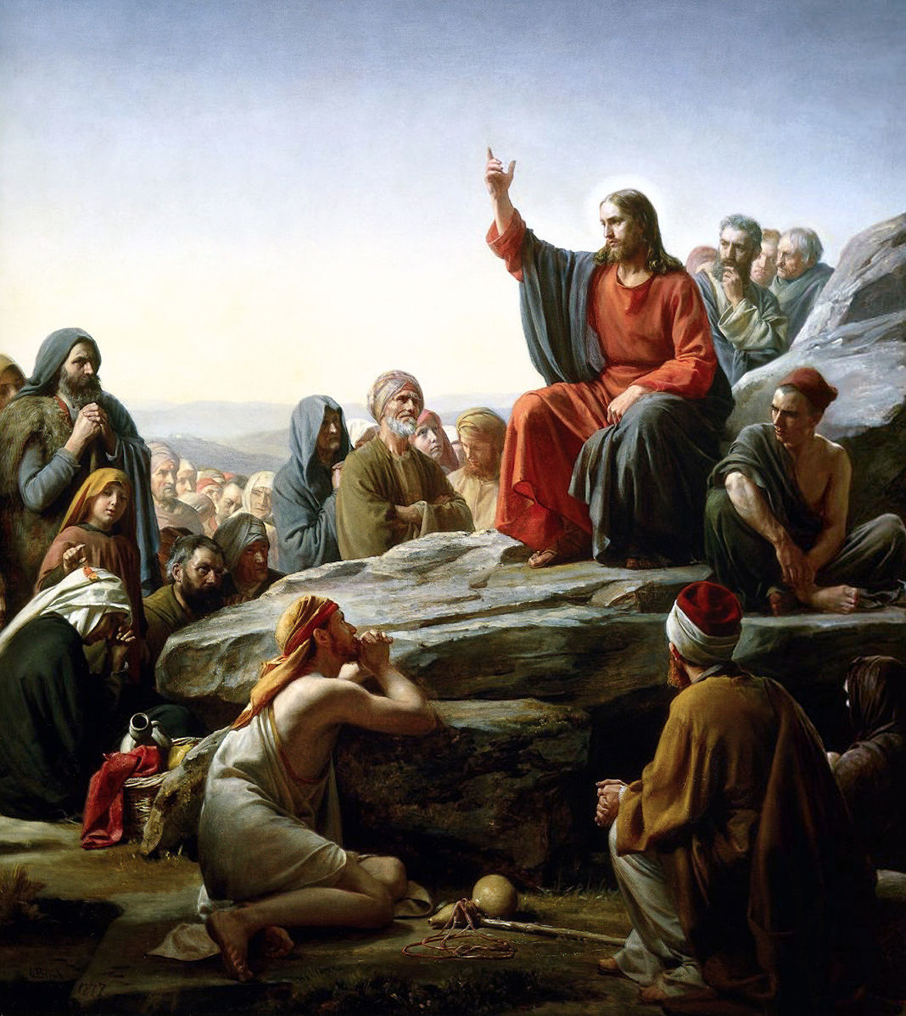
Underlying Ideology:
Christian Ethics
Defines concepts of right (virtuous ) and wrong (sinful) behavior.
More specifically, the Social Market was influenced by Catholic Social Teachings.

Slide 10

Wirtschaftswunder
During the 1950s, Germany was one of the fastest growing economy in the World.
Unemployment:
1950 – 11%
1960 – 3%

Slide 11
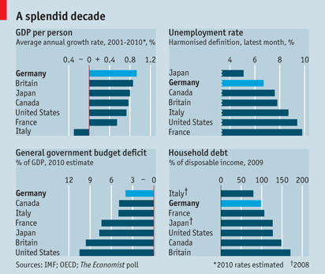
Continued Success and Influence
Germany has the best economy in Europe.
The Lisbon Treaty cites the Soziale Marktwirtschaft as a model for all of Europe.

Slide 12
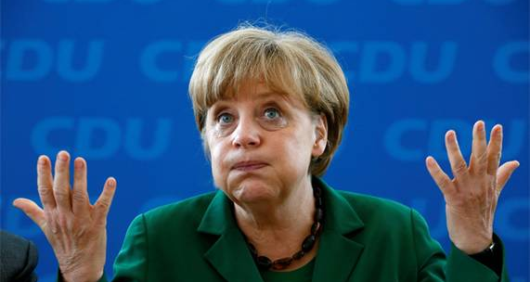
Why should You care?

